Slide 1

Society OnLine (Security)
: Design & Developed By :
Ram Prakash
Echo Software Consultancy Services
Mobile : +91 9821885190
Email : echonetin@yahoo.in
https://www.echonet.in/HousingsocietyOnLine.aspx

Slide 2
: Society OnLine :
Security Pages :
Member List
Visitor
Parking Information

Slide 3
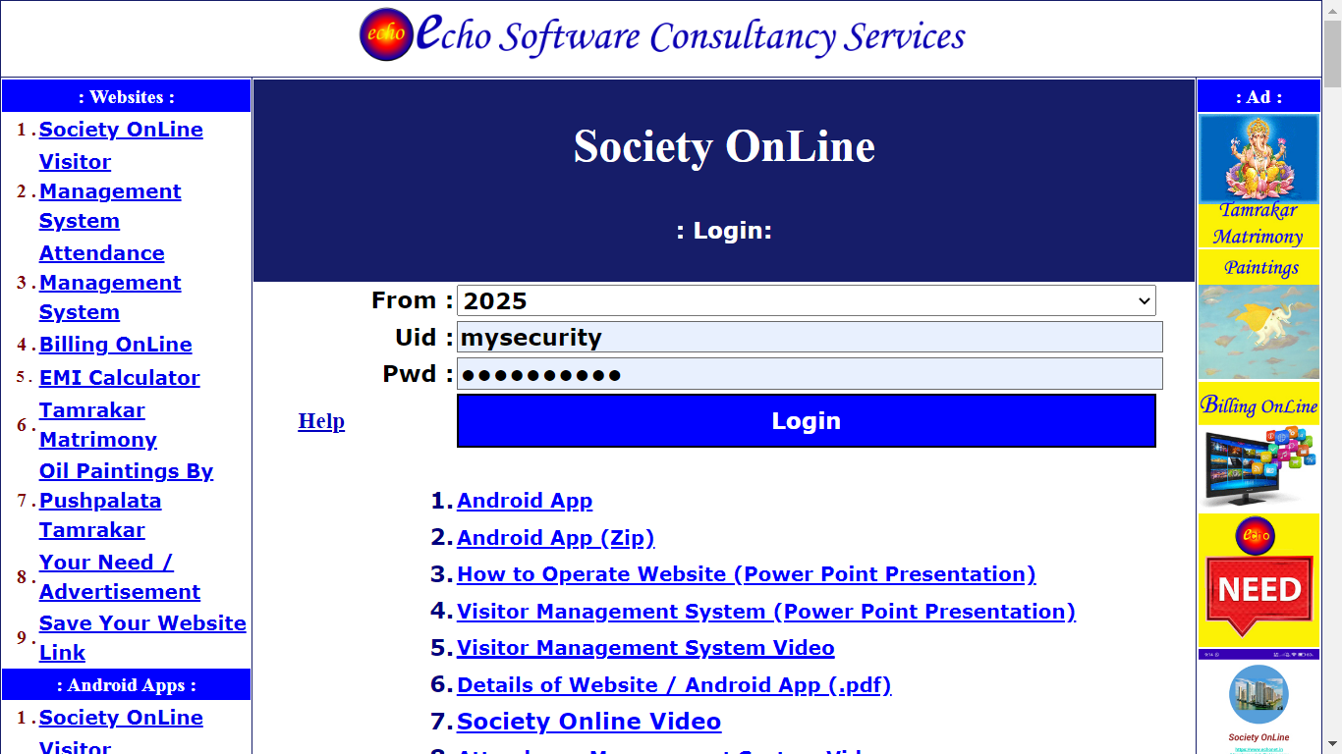
: Society OnLine :
Security Logon:

Slide 4
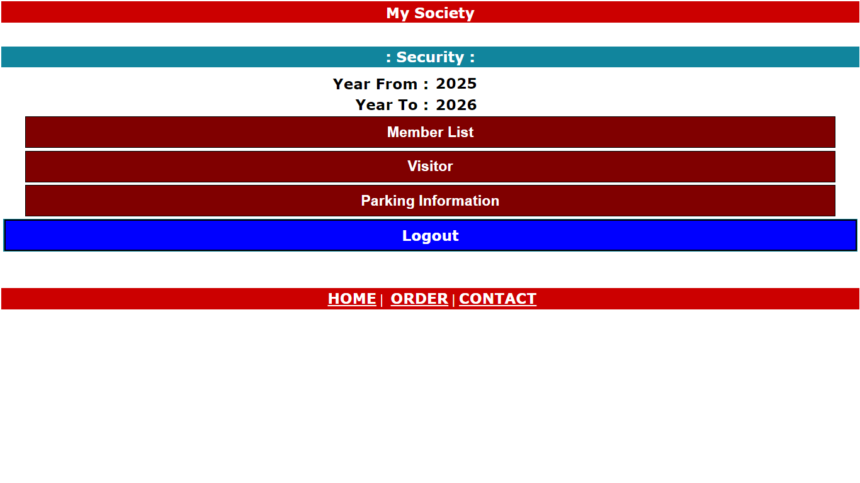
: Society OnLine :
Security :

Slide 5
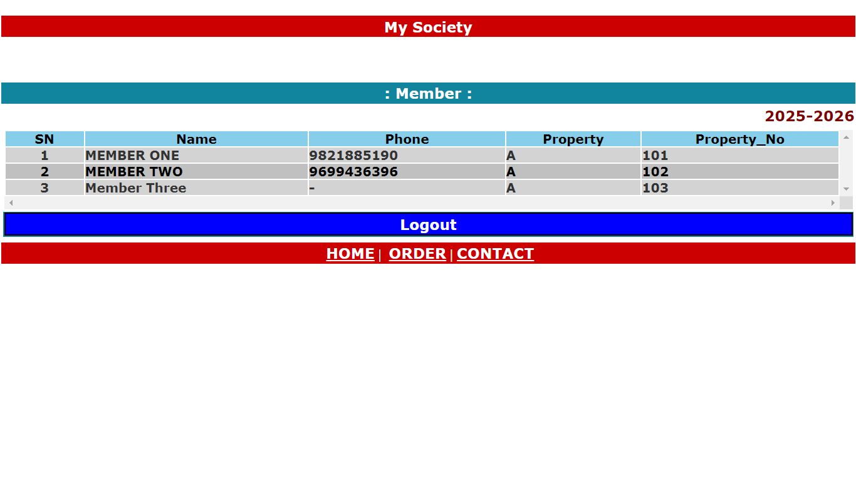
: Society OnLine :
Member List :

Slide 6
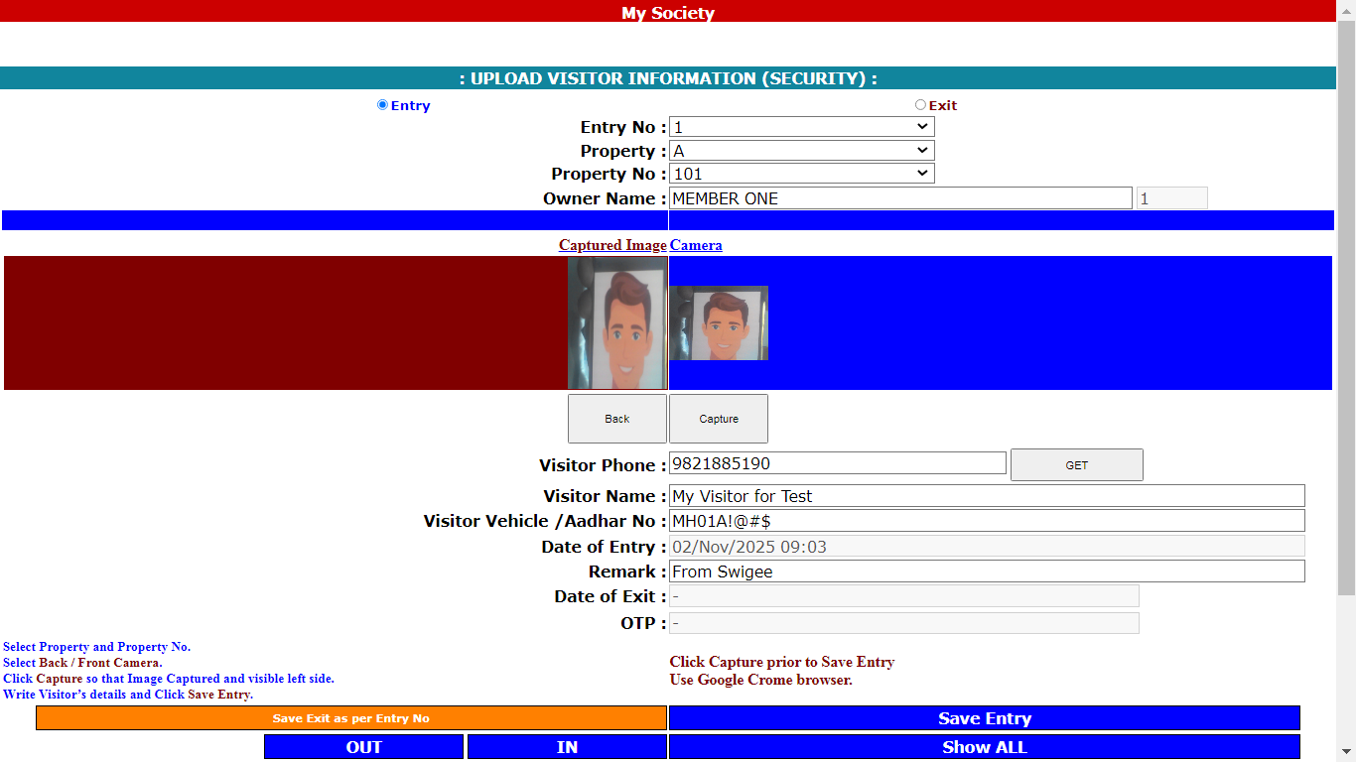
: Society OnLine :
U
Visitor Entry (Page using Computer) :
1. Click Entry
2. Select Property
3. Click Capture so that left side Image appear
5. Save Entry
4. Enter Visitor Details
Use this page with Mobile , as mobile has Front and Back camera.

Slide 7
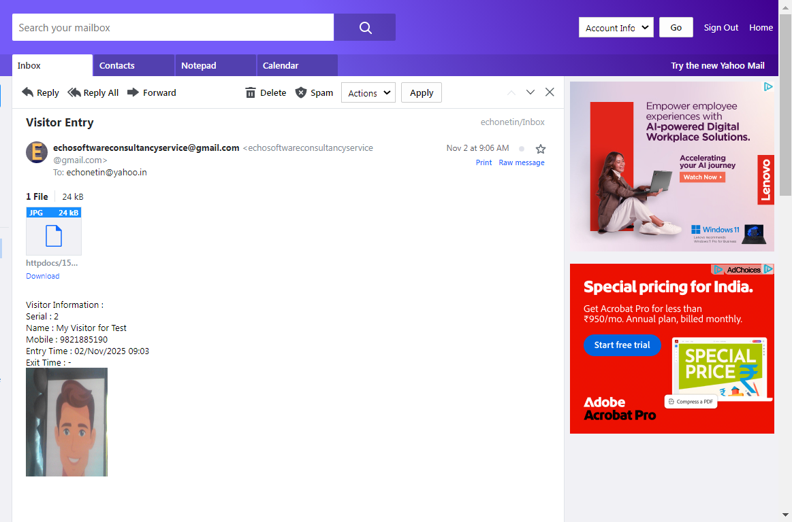
: Society OnLine :
U
Visitor Entry (Owner will get Email after saved by Security) :

Slide 8
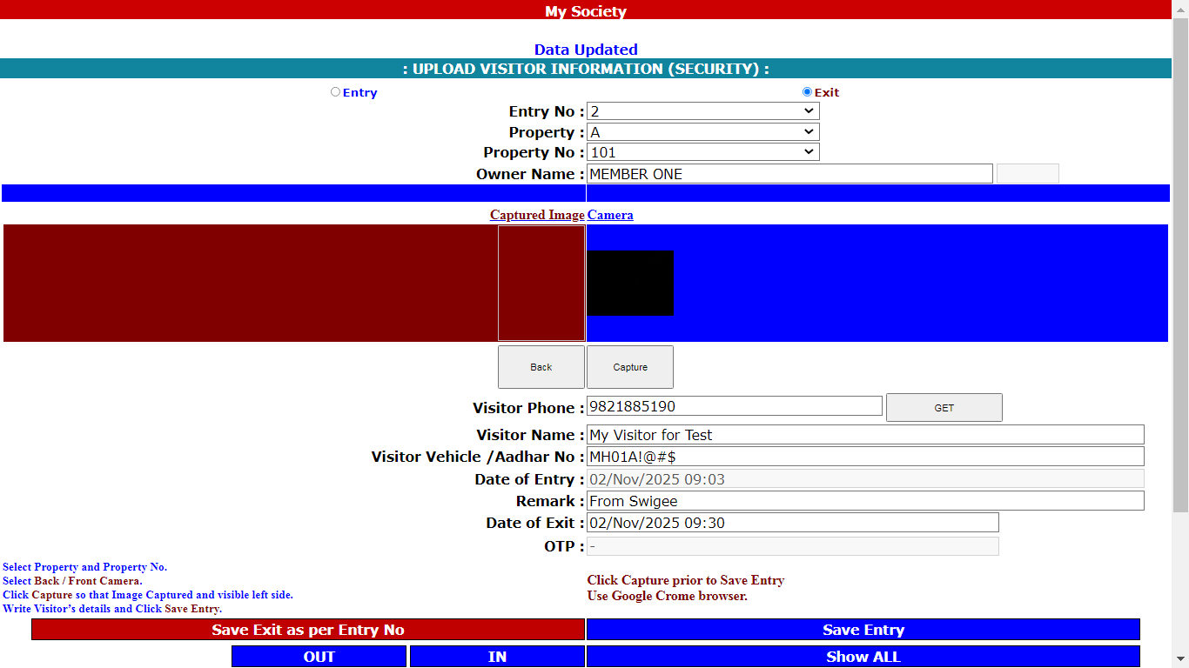
: Society OnLine :
Security (Save Exit) :
1. Select Entry No
2. Select Exit
3. Click Save Exit as per Entry No

Slide 9
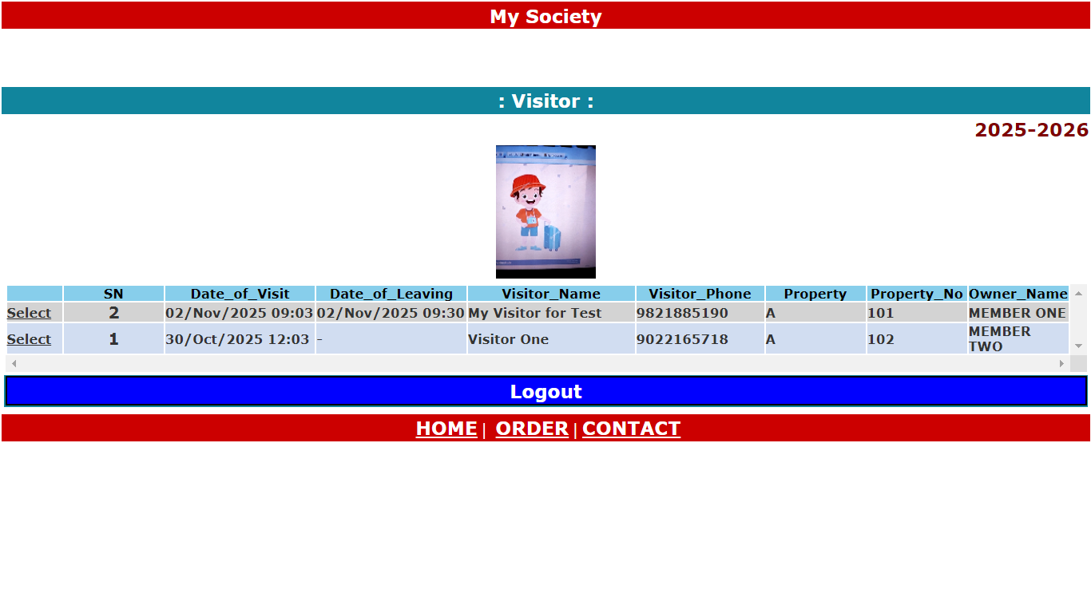
: Society OnLine :
Security (Show All) :

Slide 10
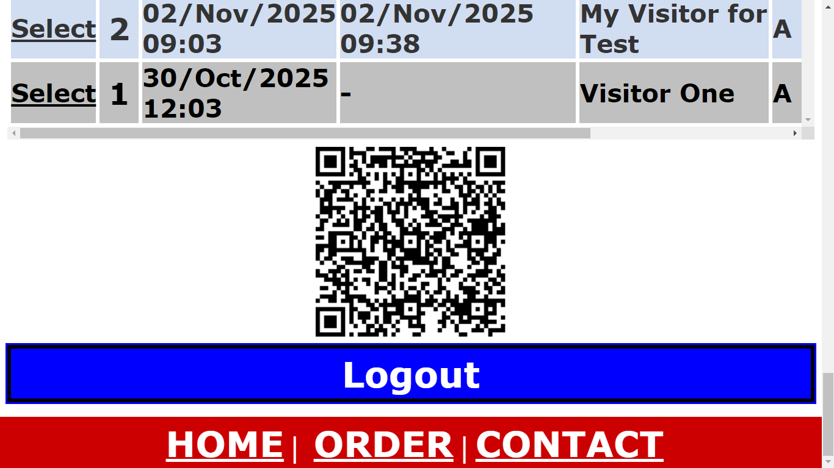
: Society OnLine :
Security (QR Code) :
Security page available with
QR code, Visitor can scan and
Enter own details ,
using own mobile.
It can printed and kept near
Security personnel.

Slide 11
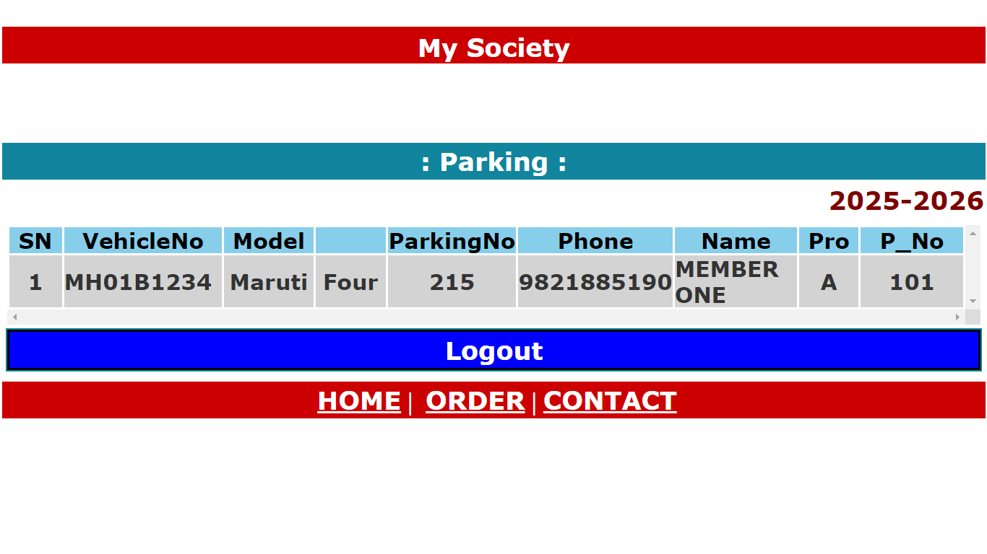
: Society OnLine :
Security (Parking Information) :

Slide 12
Echo Software Consultancy Services Contact : echonetin@yahoo.in

