Slide 1

Society OnLine (Security)
: Design & Developed By :
Ram Prakash
Echo Software Consultancy Services
Mobile : +91 9821885190
Email : echonetin@yahoo.in
https://www.echonet.in/HousingsocietyOnLine.aspx

Slide 2
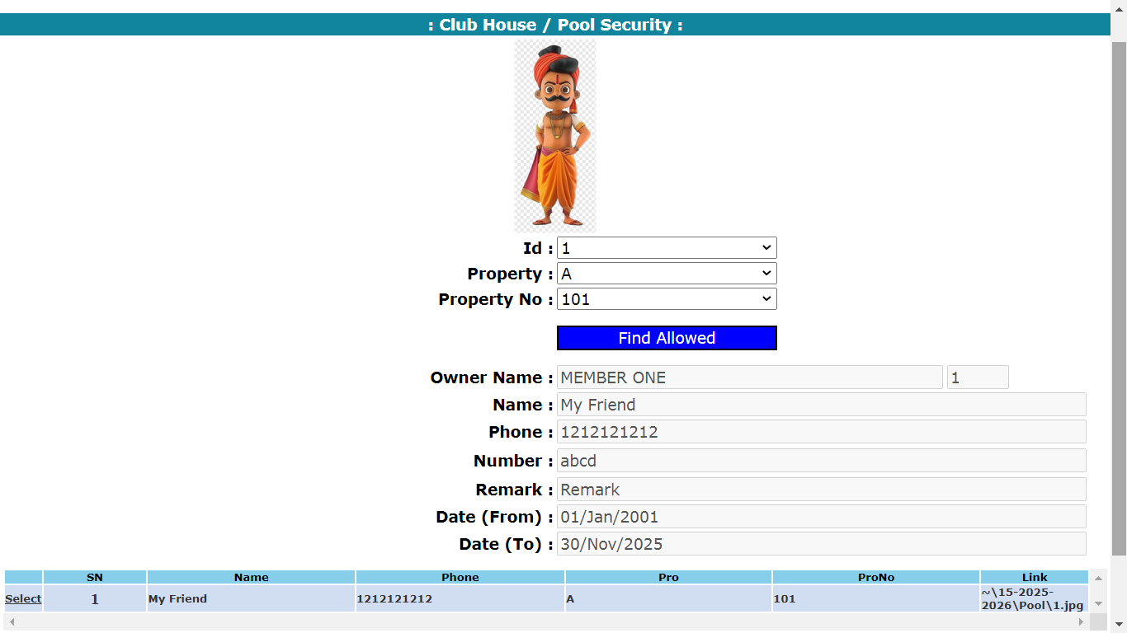
: Society OnLine :
Select Property
Select Property No
Click Find Allowed
Click Select to get details of allowed persons.

Slide 3
Echo Software Consultancy Services Contact : echonetin@yahoo.in

