Slide 1

Society OnLine (Member)
: Design & Developed By :
Ram Prakash
Echo Software Consultancy Services
Mobile : +91 9821885190
Email : echonetin@yahoo.in
https://www.echonet.in/HousingsocietyOnLine.aspx

Slide 2
: Society OnLine :
Member Pages :
Member List
Vehicle
Visitor
Bill
Receipt
Information (Can check information posted by Manager)
Important Phone
Download Document (Download document , uploaded by Manager)
Complaint
Complaint Status
Entry Important Phone (Enter important phone shared with all members)
Allow Visitor ( Enter remark for visitor in Advance)
Insert OTP Visitor (Enter OTP received during entry of visitor by security)

Slide 3
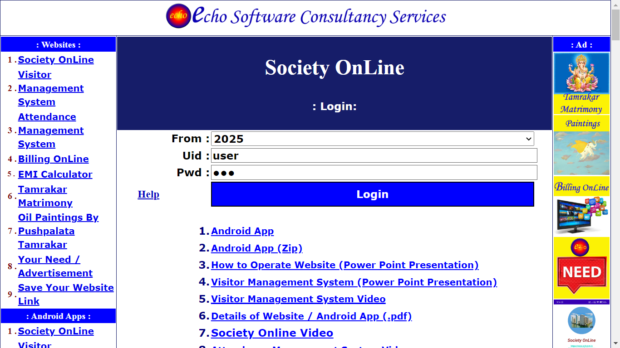
: Society OnLine :
Member Logon:

Slide 4
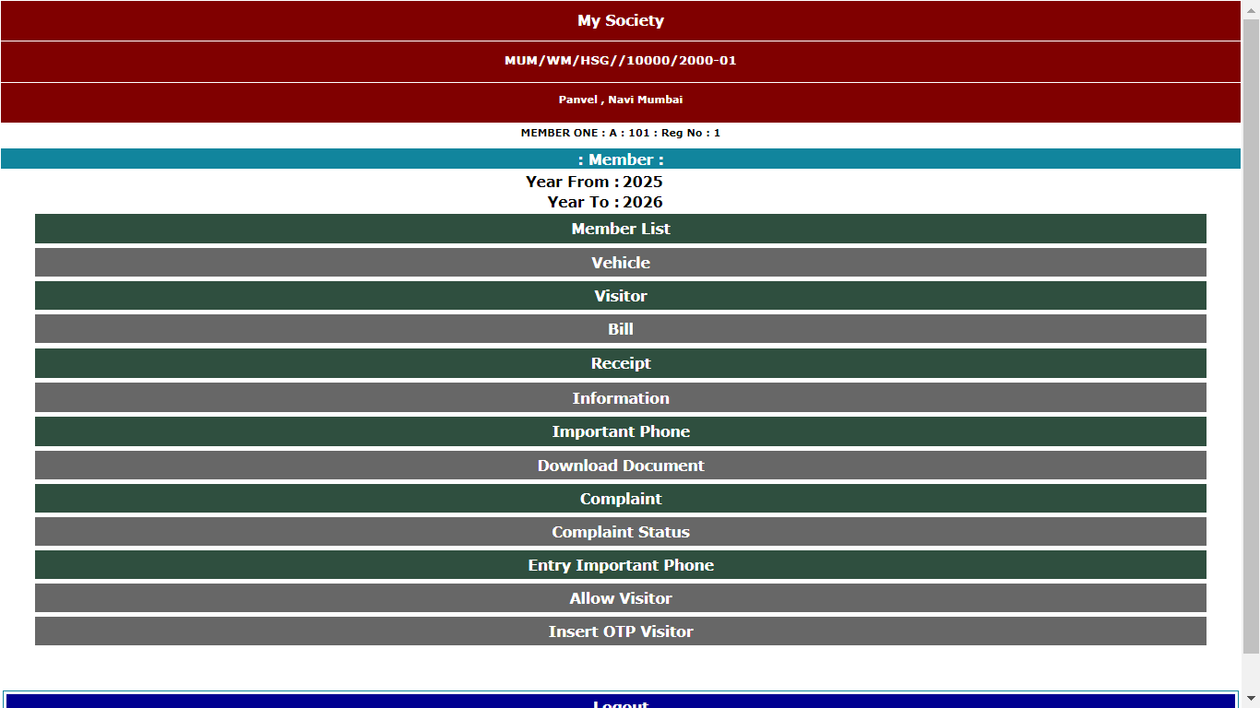
: Society OnLine :
Member Menu :

Slide 5
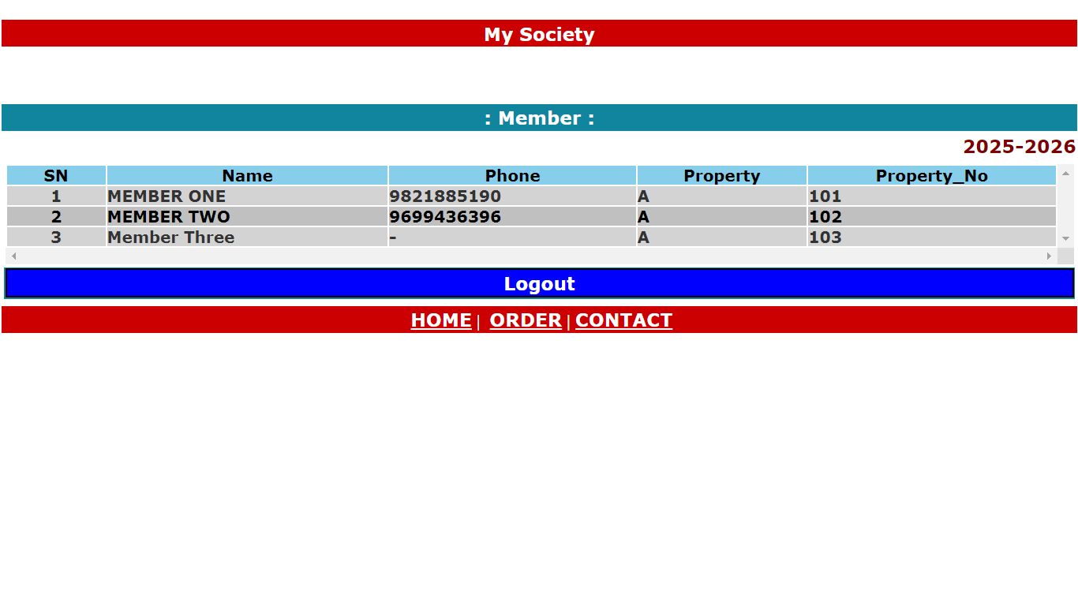
: Society OnLine :
Member List :

Slide 6
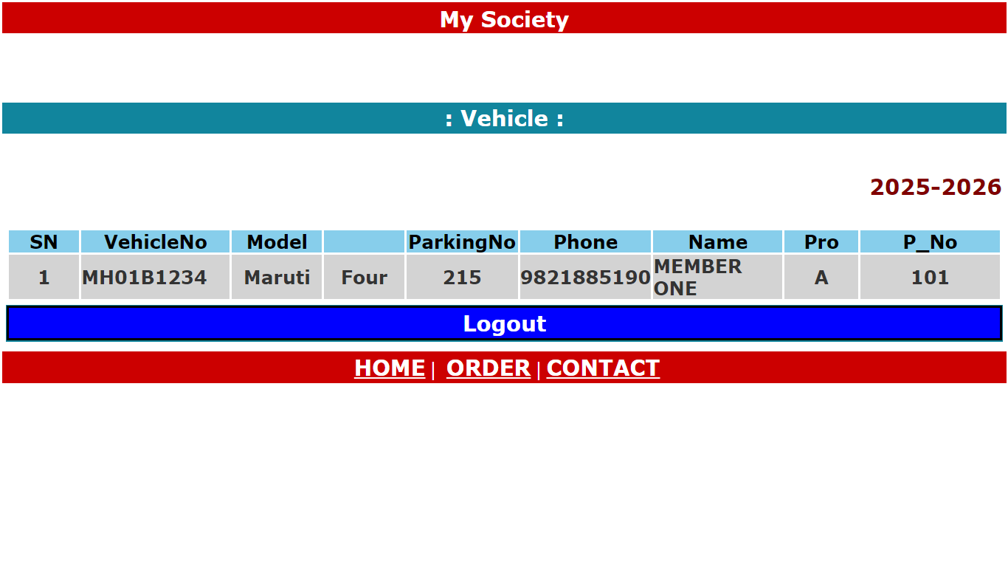
: Society OnLine :
U
Vehicle:
3. Click Capture so that left side Image appear

Slide 7
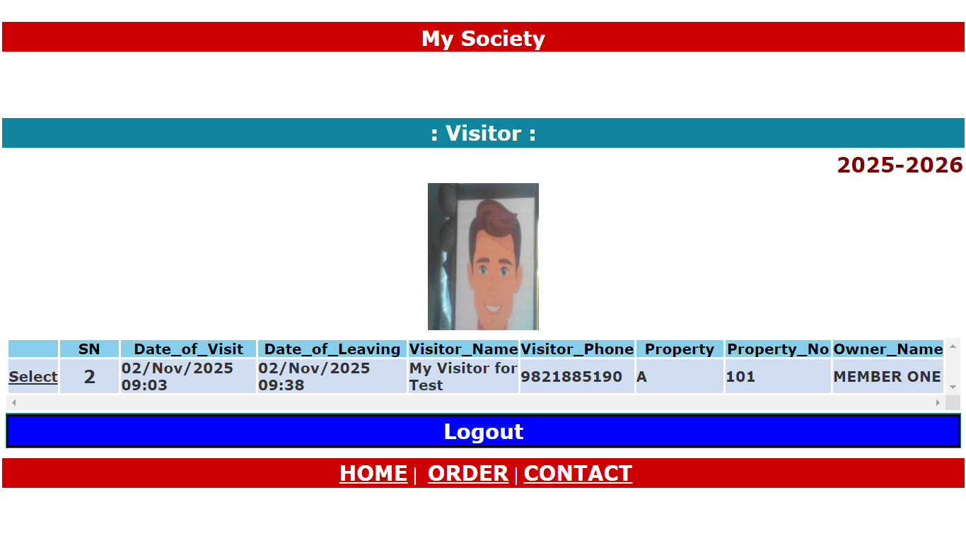
: Society OnLine :
U
Visitor :

Slide 8
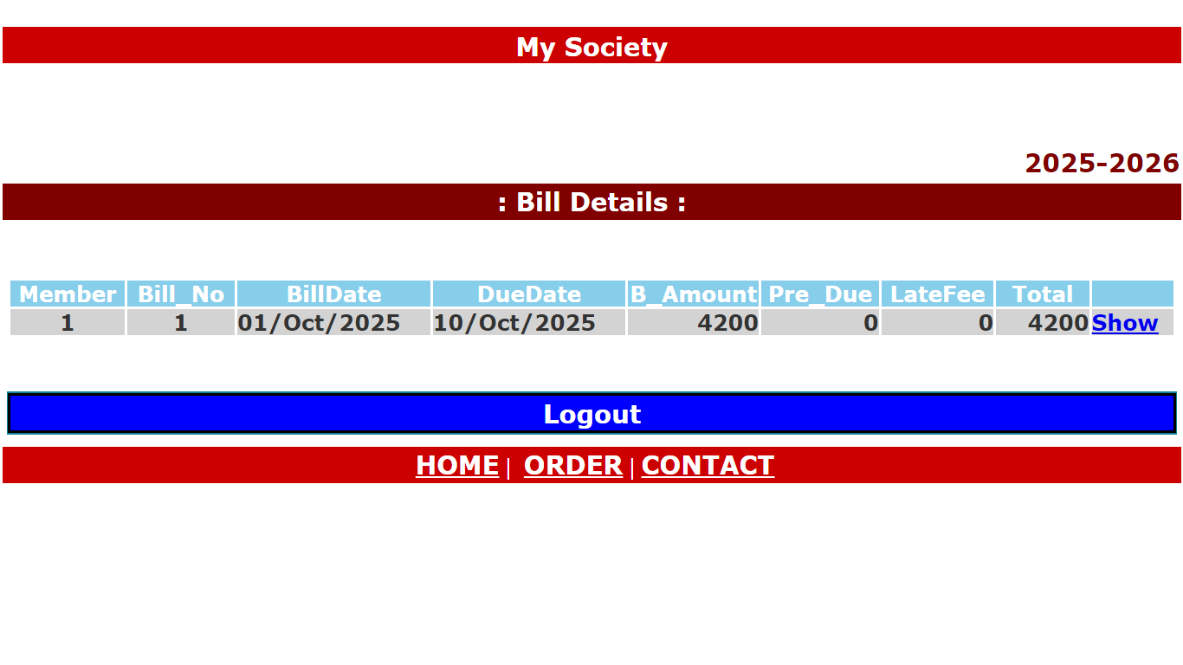
: Society OnLine :
Bill :

Slide 9
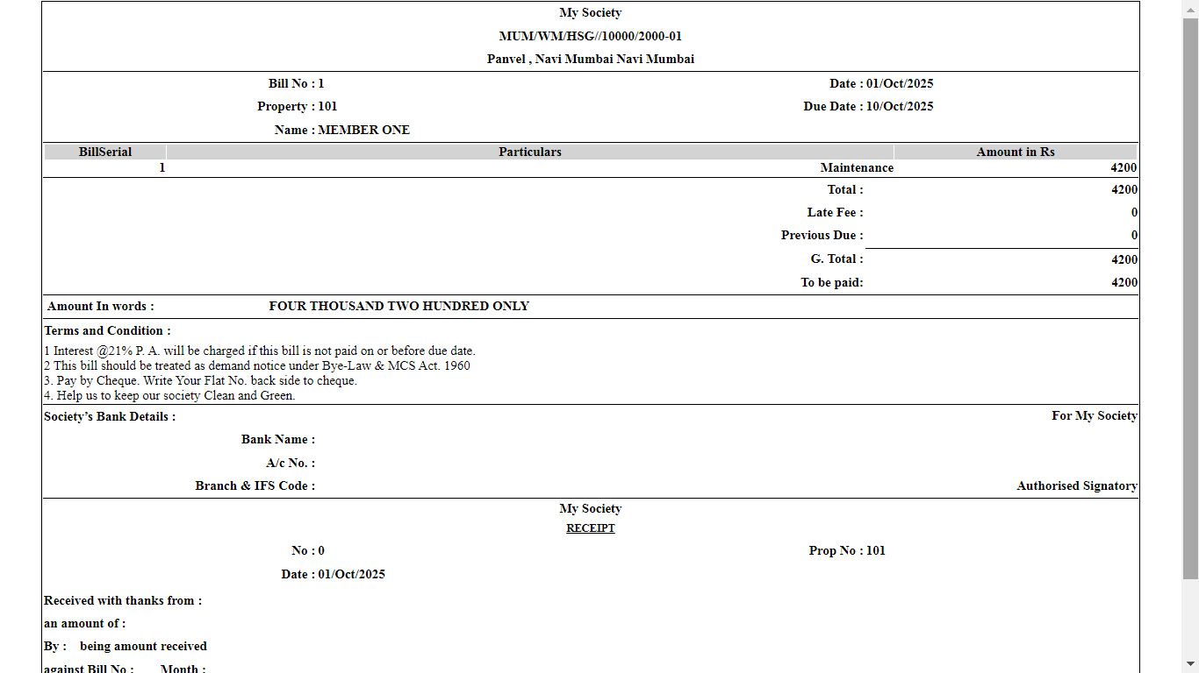
: Society OnLine :
Bill :

Slide 10
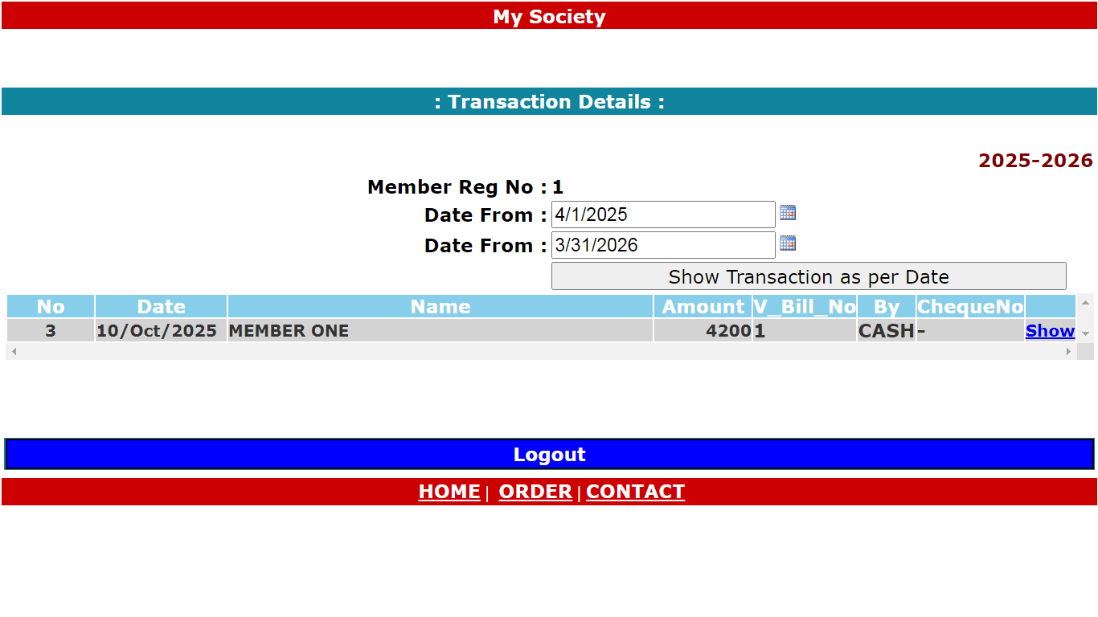
: Society OnLine :
Receipt :

Slide 11
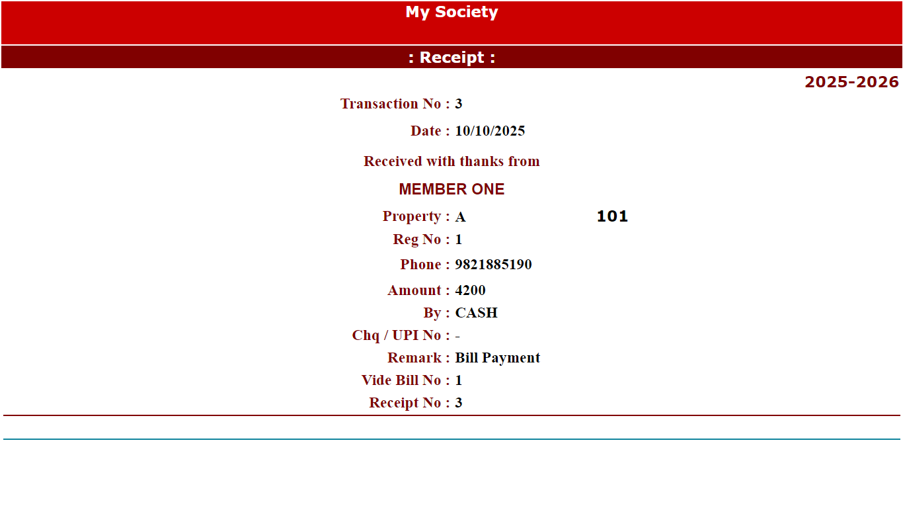
: Society OnLine :
Receipt :

Slide 12
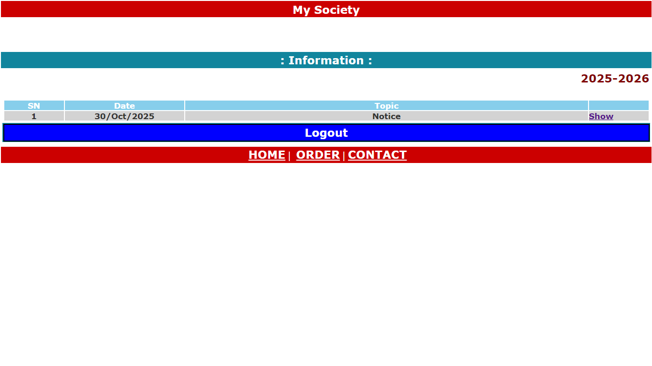
: Society OnLine :
Information :

Slide 13
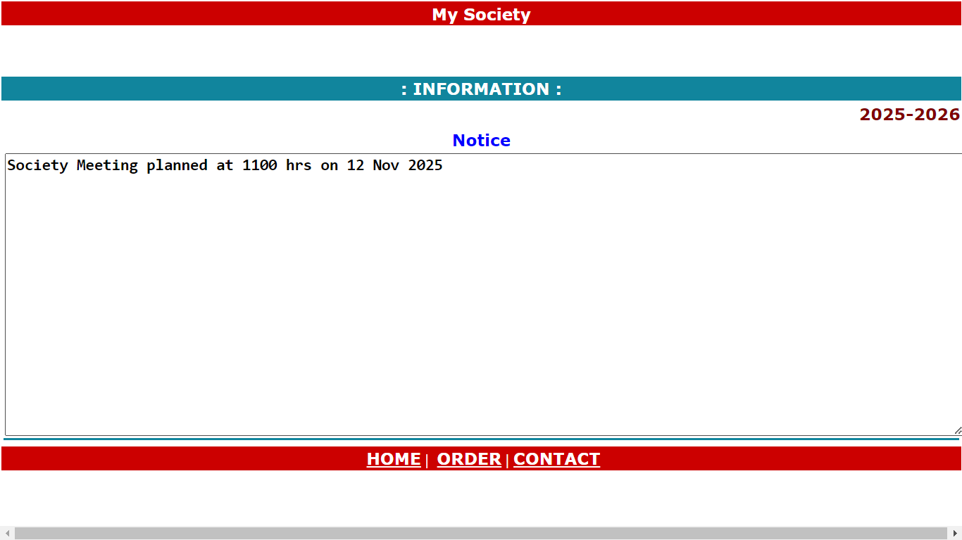
: Society OnLine :
Information :

Slide 14
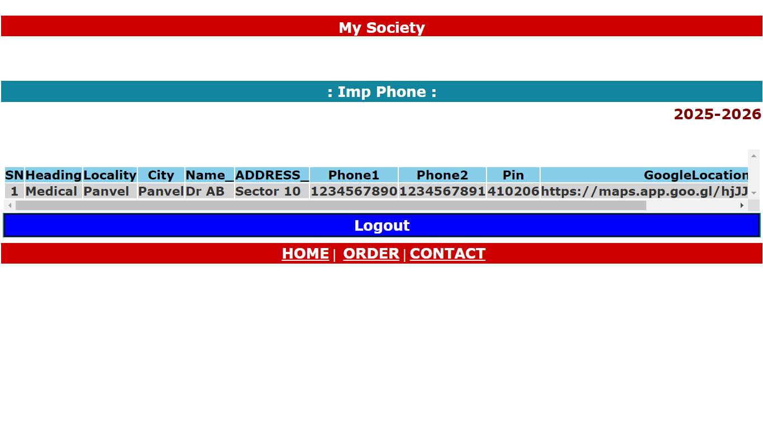
: Society OnLine :
Important Phone :

Slide 15
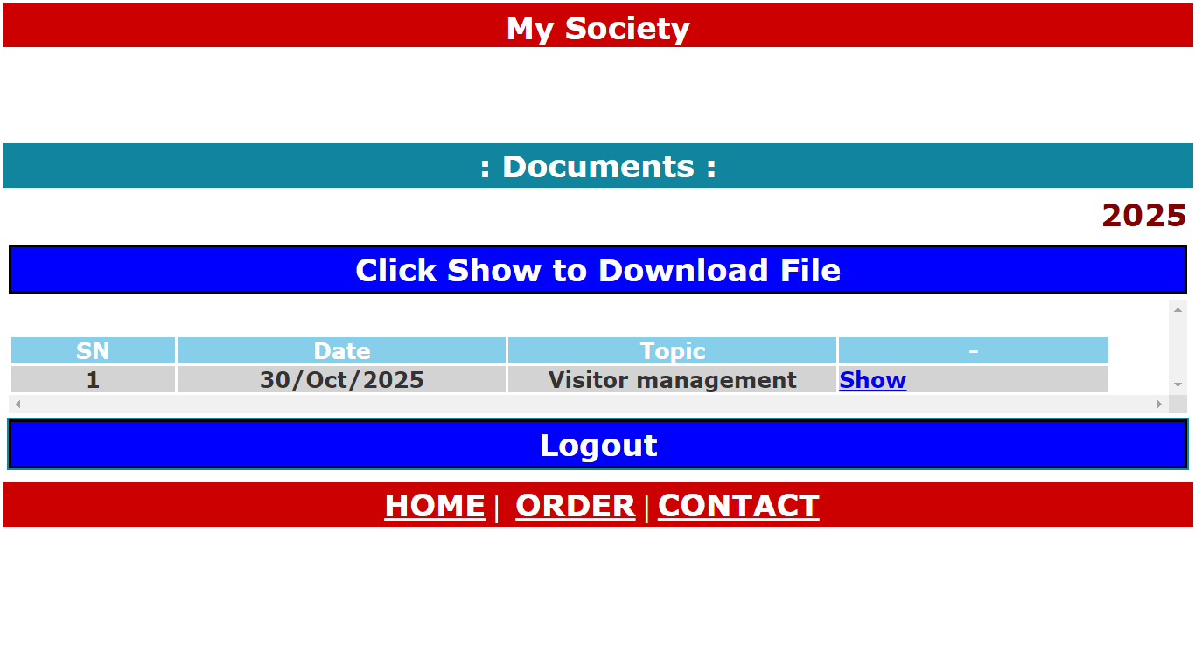
: Society OnLine :
Download Document :

Slide 16
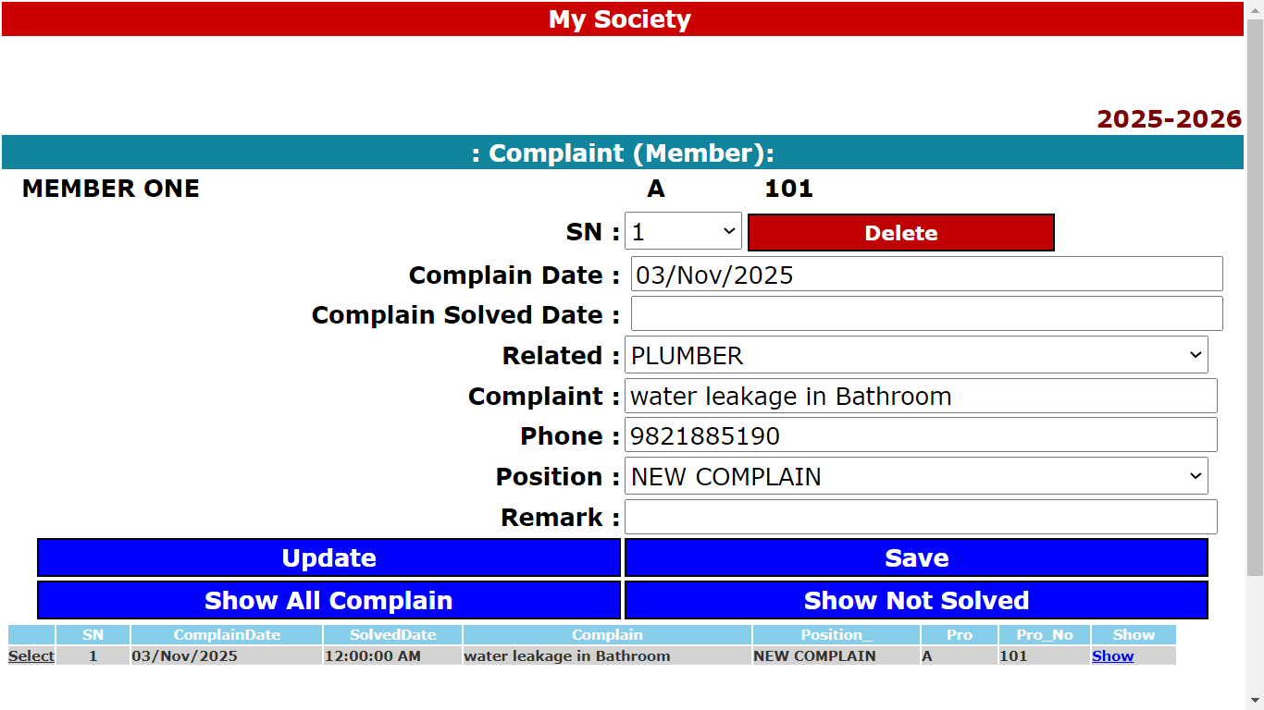
: Society OnLine :
Complaint :

Slide 17
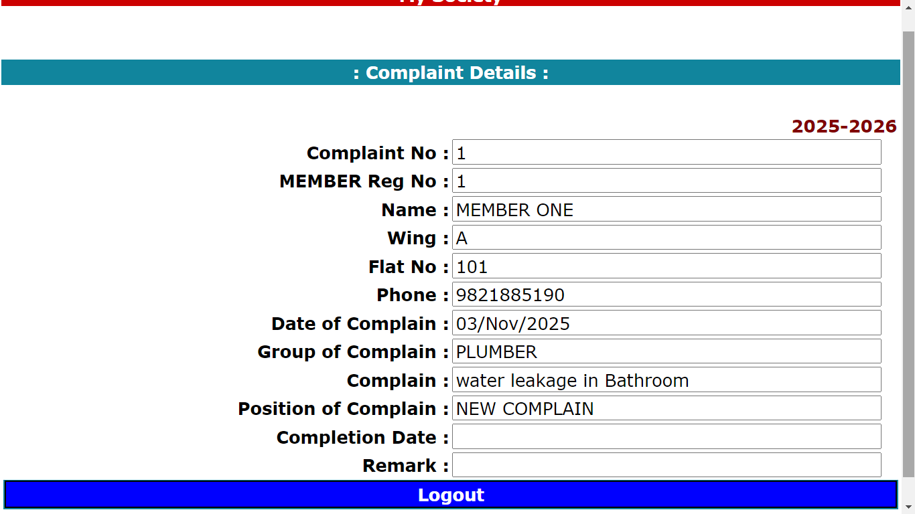
: Society OnLine :
Complaint :

Slide 18
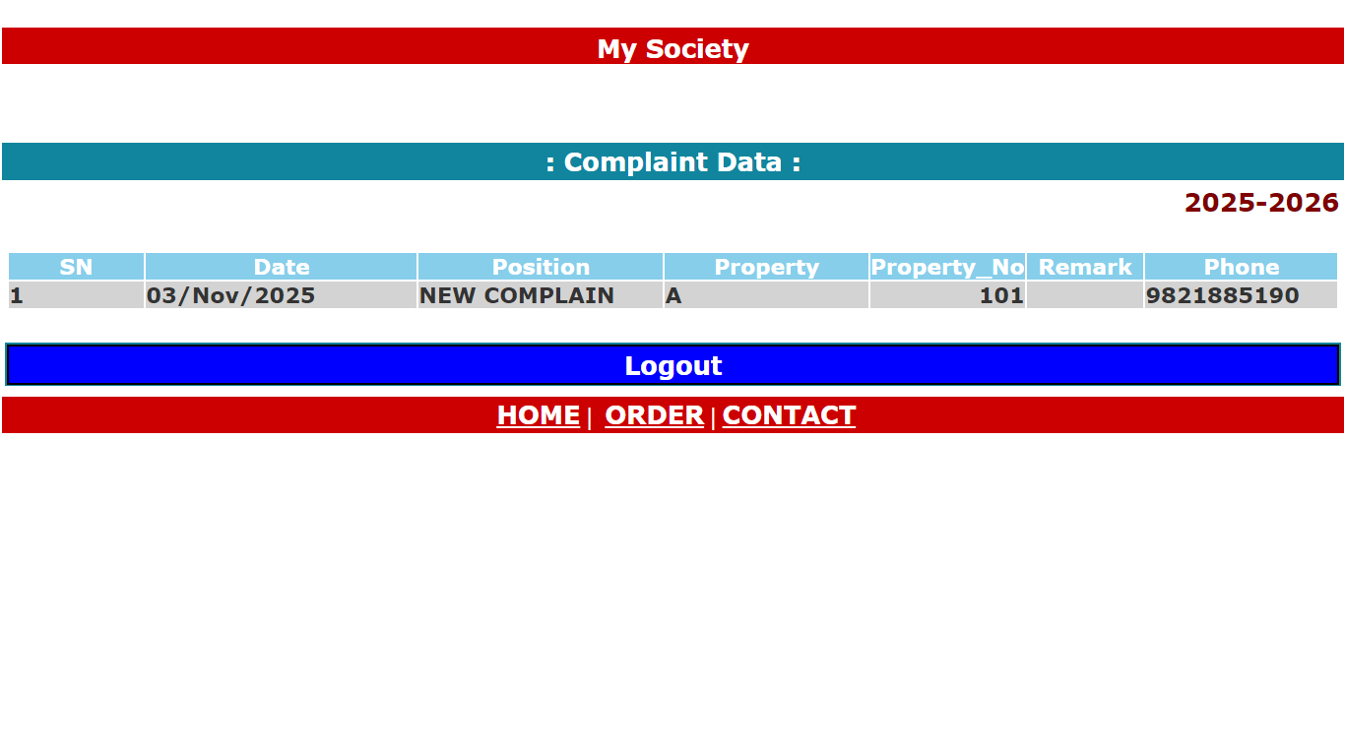
: Society OnLine :
Complaint Status :

Slide 19
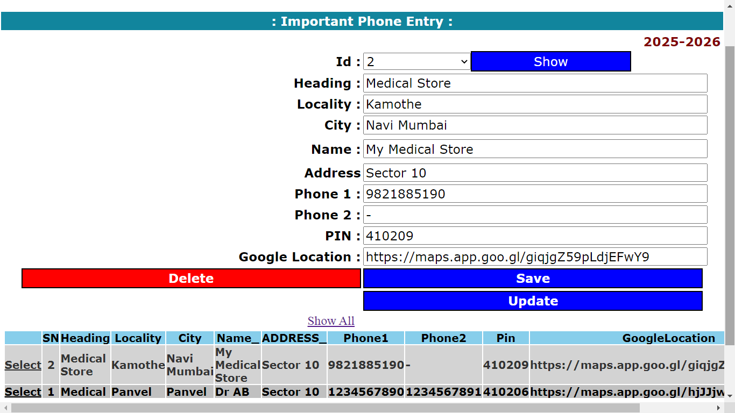
: Society OnLine :
Entry Important Phone :

Slide 20
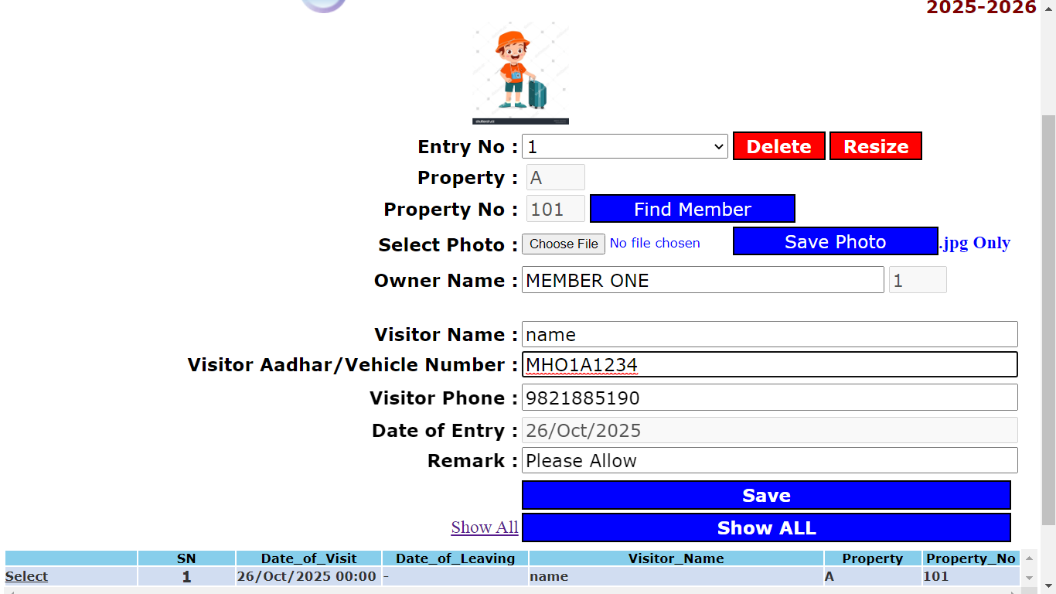
: Society OnLine :
Allow Visitor :

Slide 21
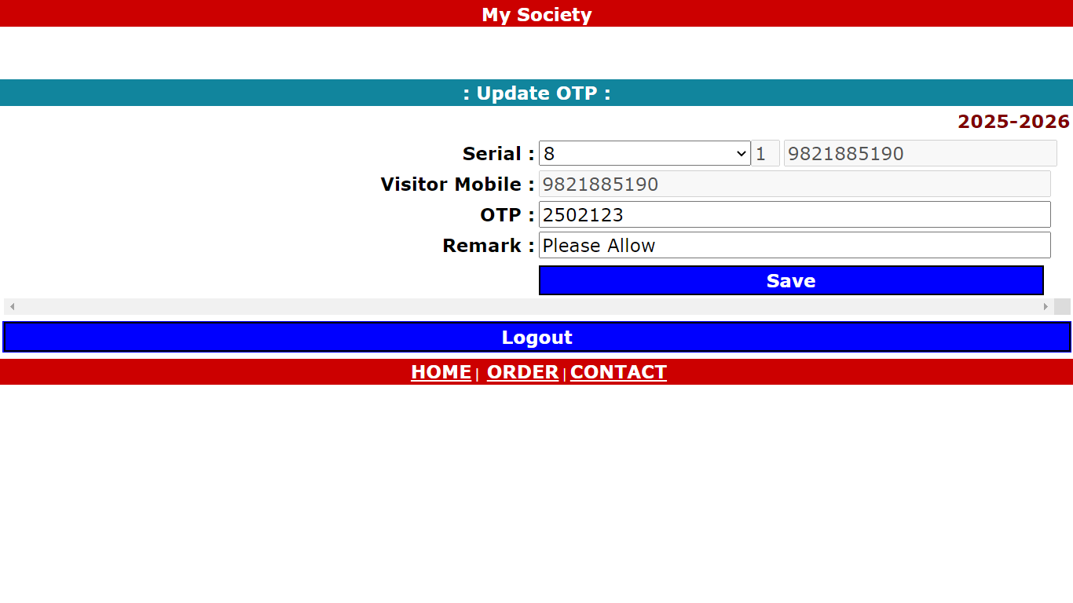
: Society OnLine :
Insert OTP Visitor :

Slide 22
Echo Software Consultancy Services
Contact : echonetin@yahoo.in

