Slide 1

Society OnLine
: Design & Developed By :
Ram Prakash
Echo Software Consultancy Services
Mobile : +91 9821885190
Email : echonetin@yahoo.in
https://www.echonet.in/HousingsocietyOnLine.aspx

Slide 2
: Society OnLine :
Data entered using website :
Generate Charges types
Expenditure Head
Property details
Members details
Assign charges
Assign Late charges
Non Member group
Non member details
Employee
Employee Job details
Tenant
Vehicle
Visitor
Society Items
Important Phone numbers
Authorization of Pool / Club
Bill Creation, Transaction Record.
Other facilities :
Upload Information for Members
Upload Documents for Member’s View
Send Mail to Members
Send Bills / Receipt by Email
Generate QR codes for Visitors
Complaint Register
Generate different queries in .pdf format.

Slide 3
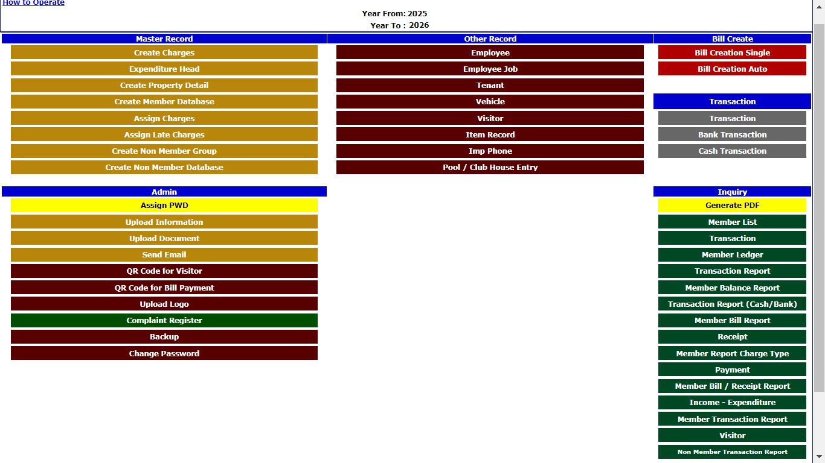
: Society OnLine :
Menu :

Slide 4
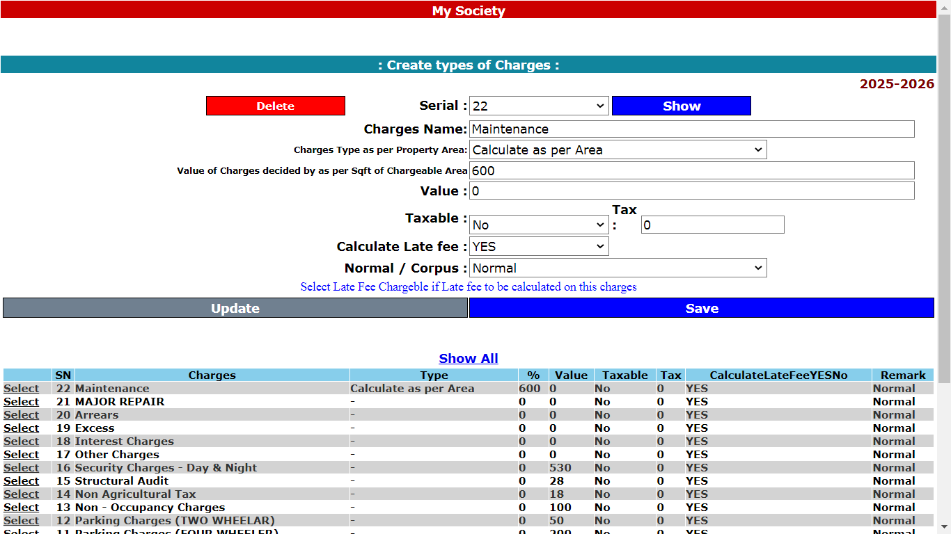
: Society OnLine :
1. Generate Charges types:

Slide 5
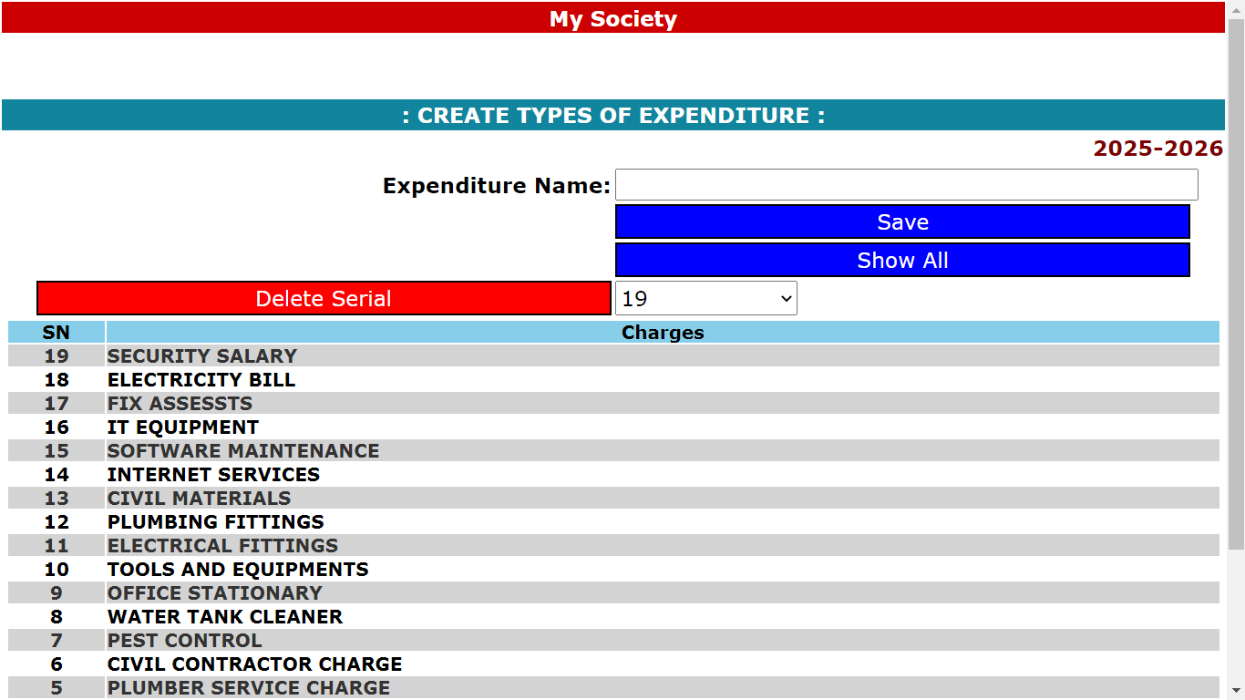
: Society OnLine :
2.Expenditure Head

Slide 6
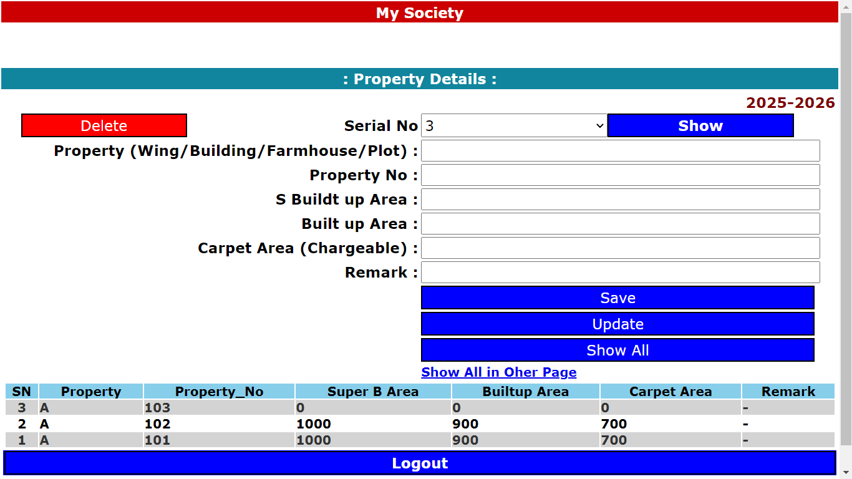
: Society OnLine :
3. Property details

Slide 7
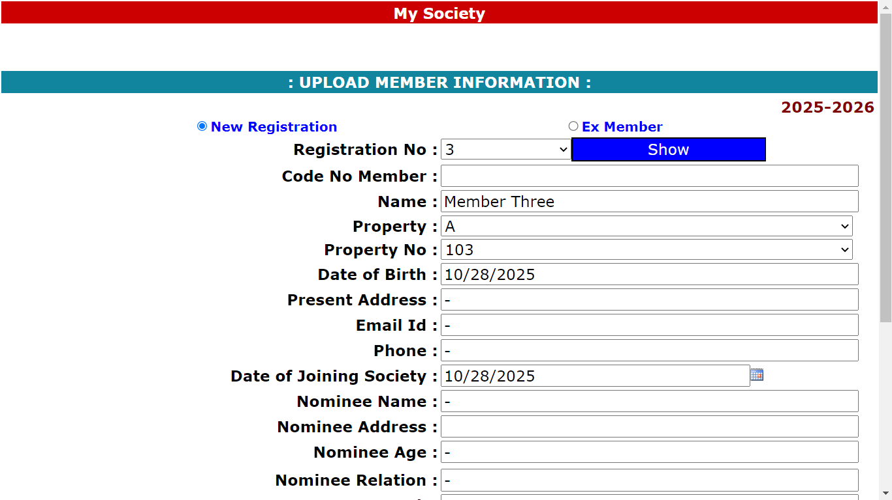
: Society OnLine :
4. Members details

Slide 8
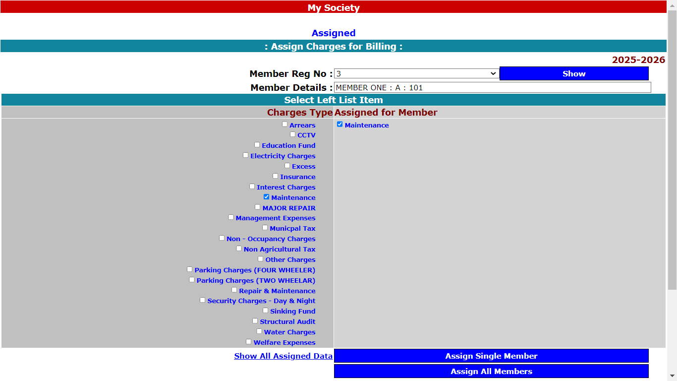
: Society OnLine :
5 (a). Assign charges

Slide 9
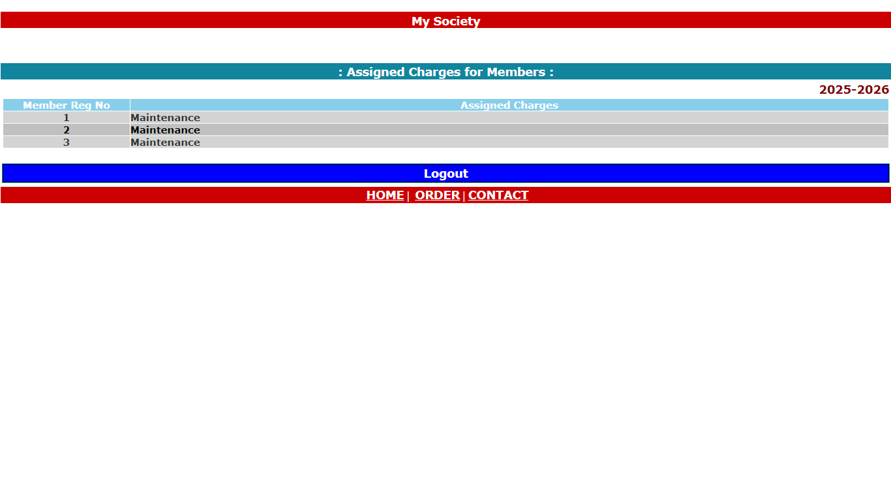
: Society OnLine :
5 (b). Assign charges

Slide 10
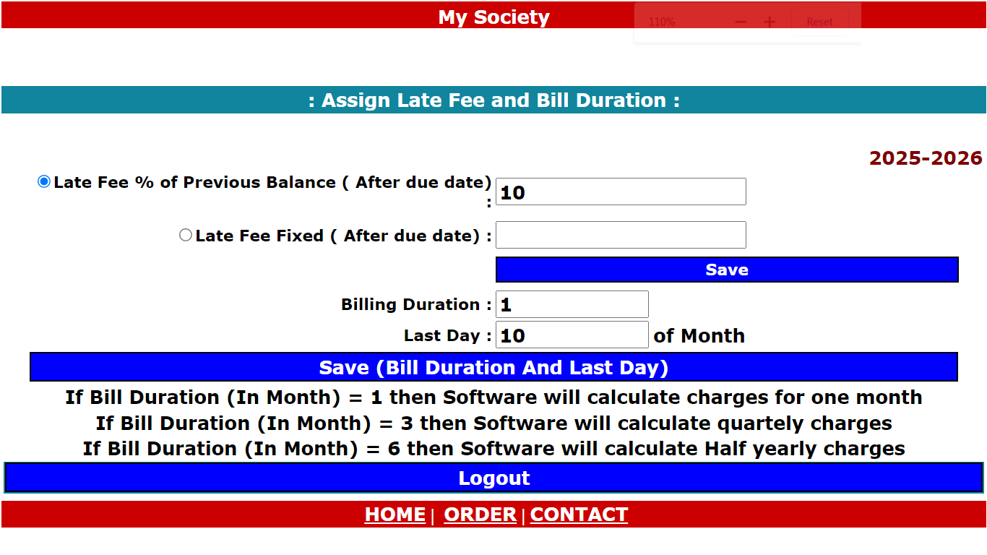
: Society OnLine :
6. Assign Late charges

Slide 11
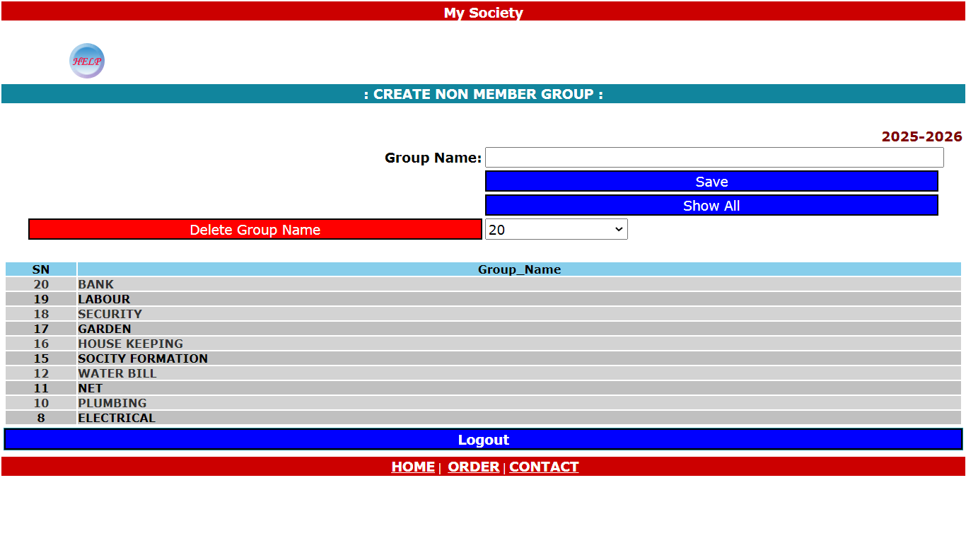
: Society OnLine :
7. Non Member group

Slide 12
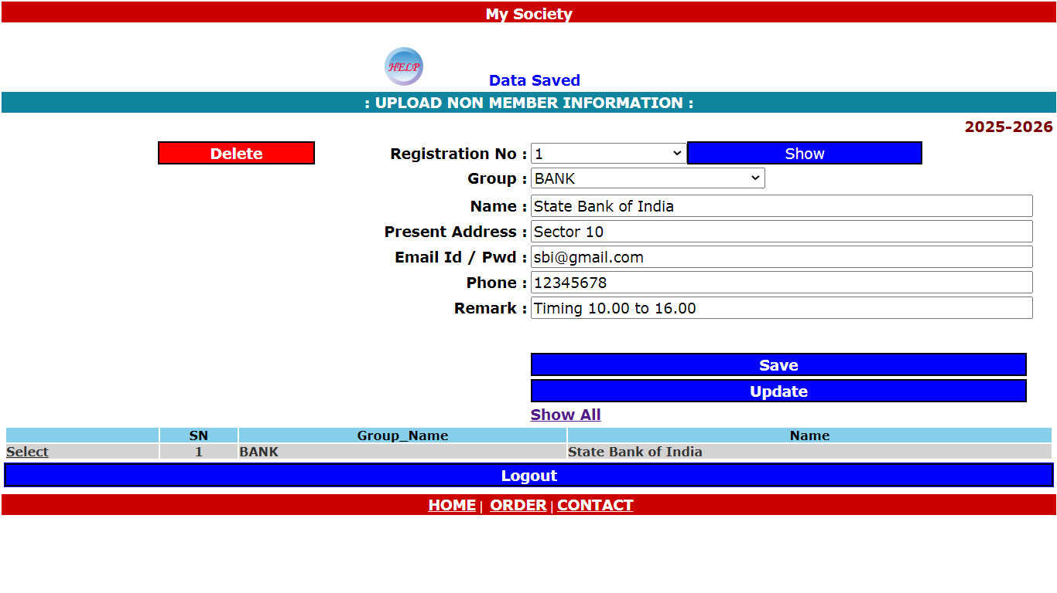
: Society OnLine :
8. Non member details

Slide 13
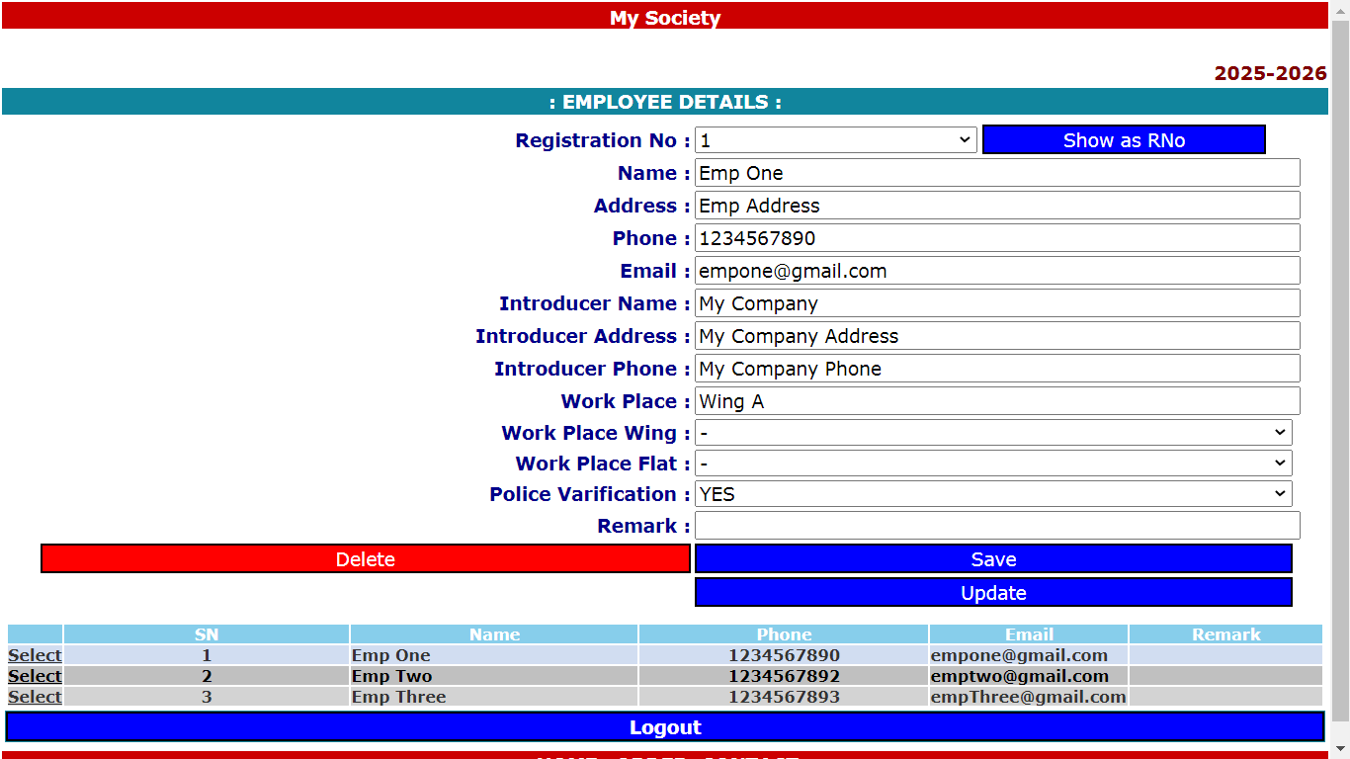
: Society OnLine :
9. Employee

Slide 14
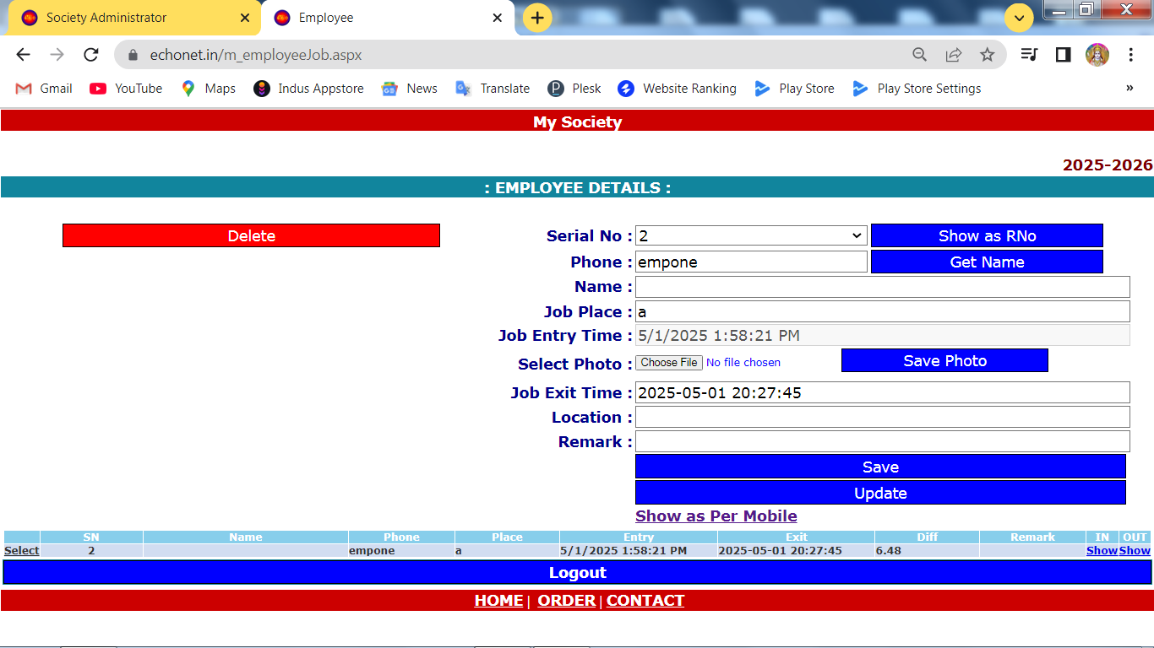
: Society OnLine :
10. Employee Job

Slide 15
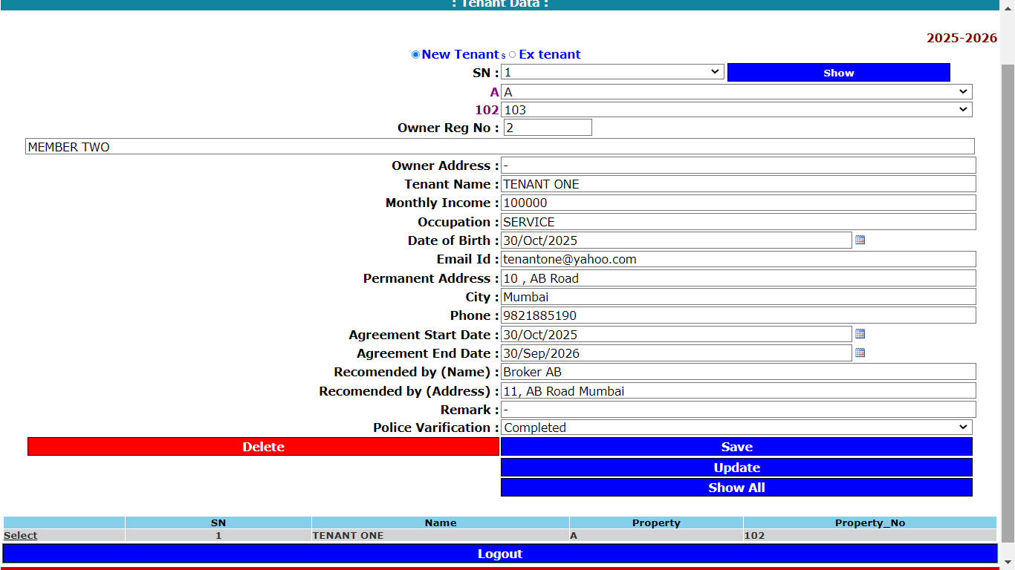
: Society OnLine :
11. Tenant

Slide 16
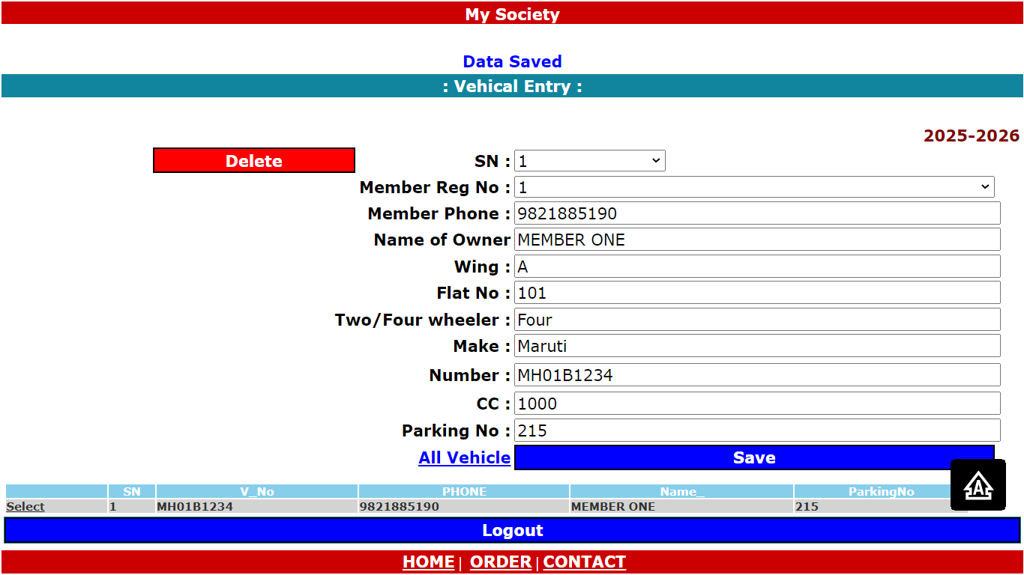
: Society OnLine :
12. Vehicle Details

Slide 17
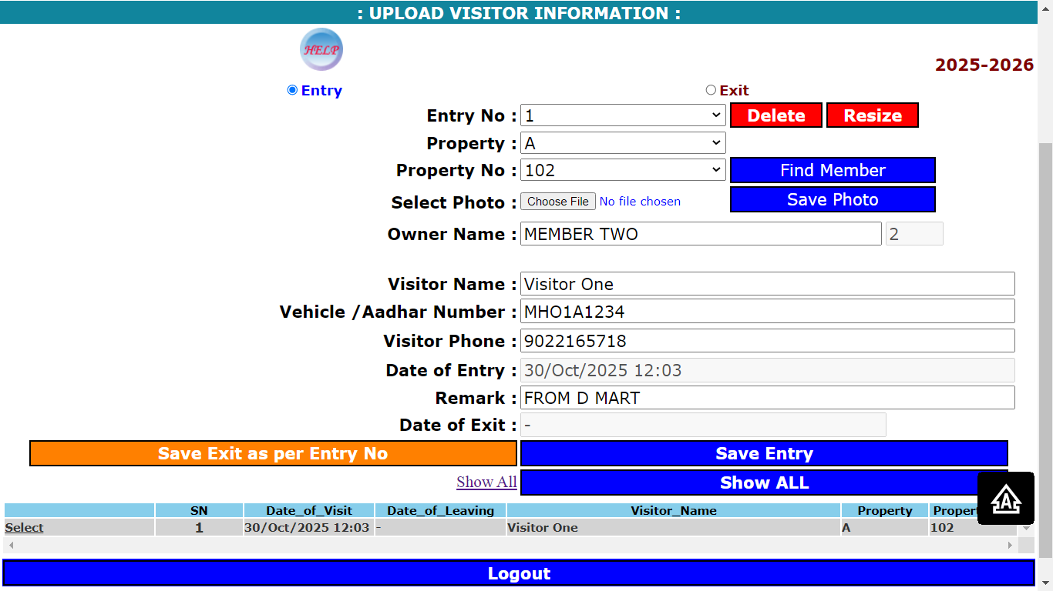
: Society OnLine :
13 (a) . Visitor

Slide 18
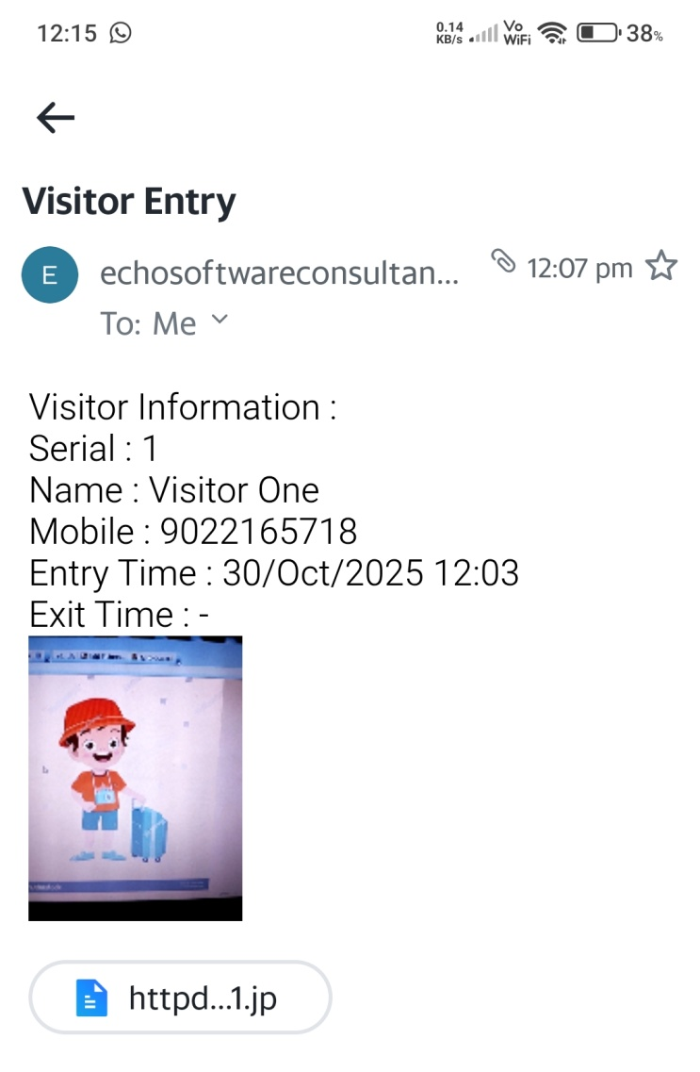
: Society OnLine :
13 (b) . Visitor : Email sent to Owner with visitor Image
after entry of Visitor.

Slide 19
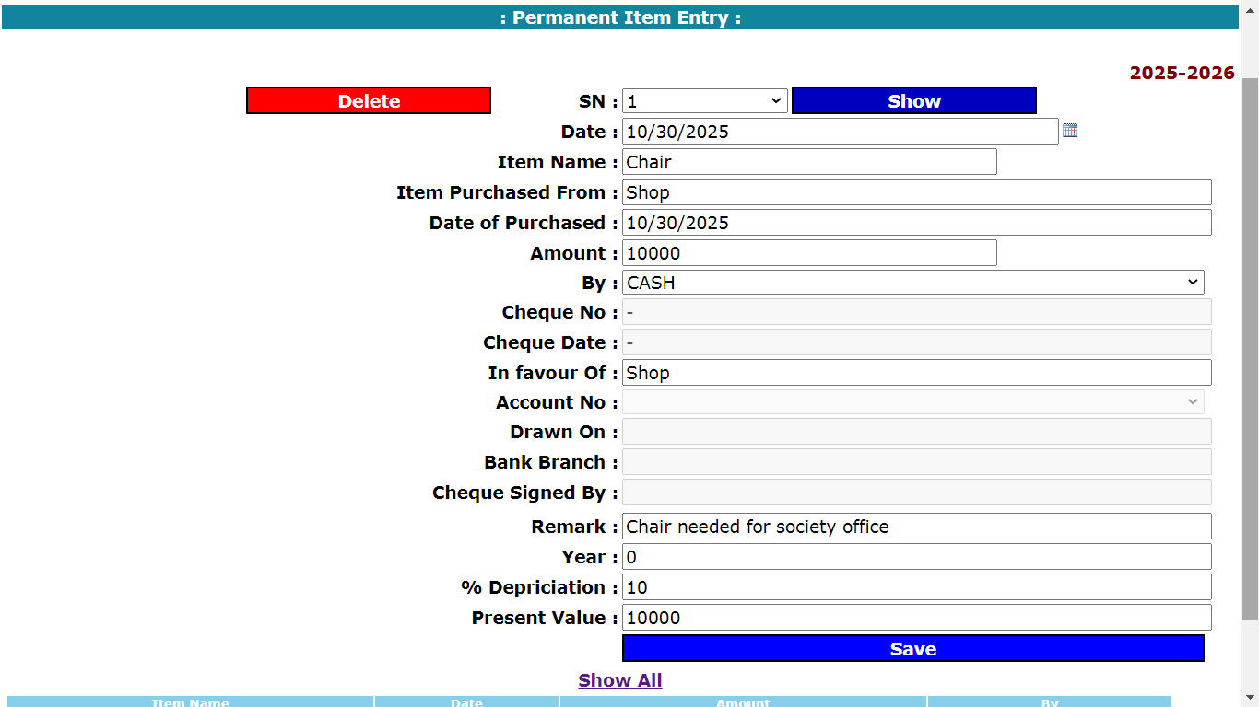
: Society OnLine :
14. Item Record

Slide 20
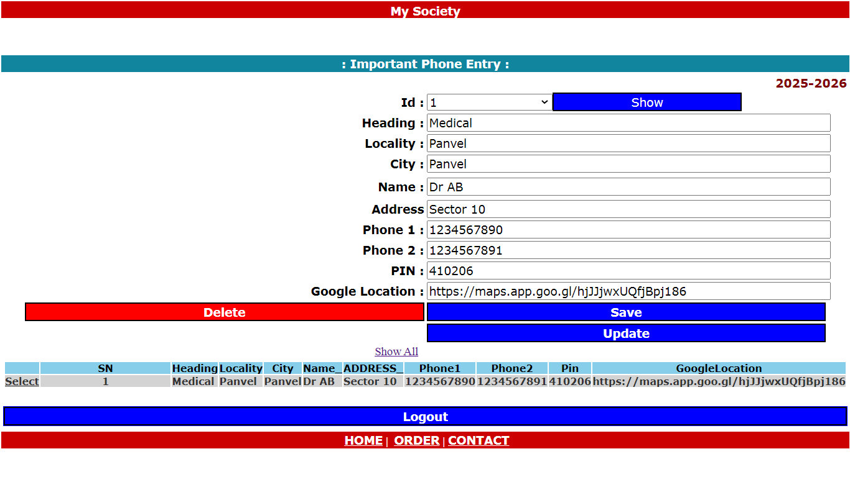
: Society OnLine :
15. Important Phone Numbers

Slide 21
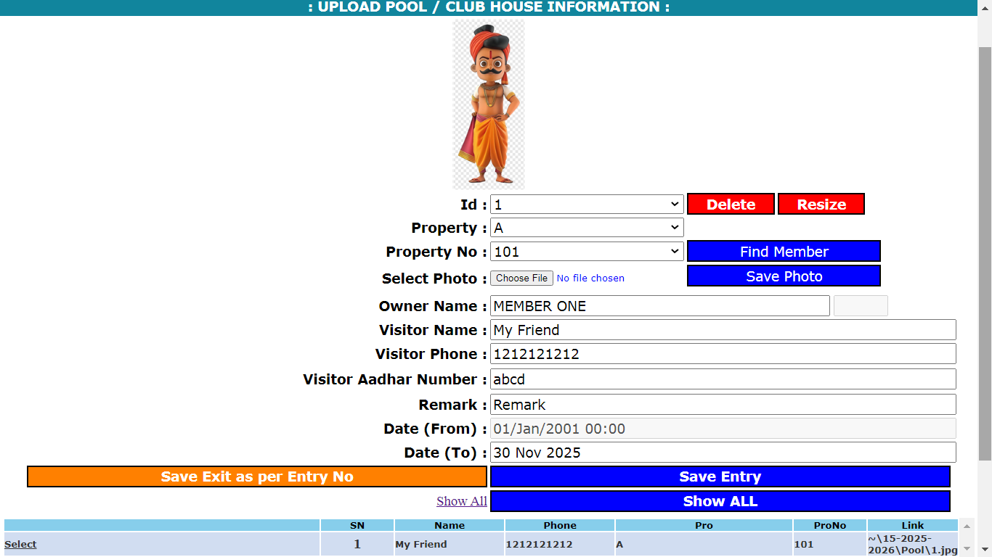
: Society OnLine :
16. Pool Club House Entry

Slide 22
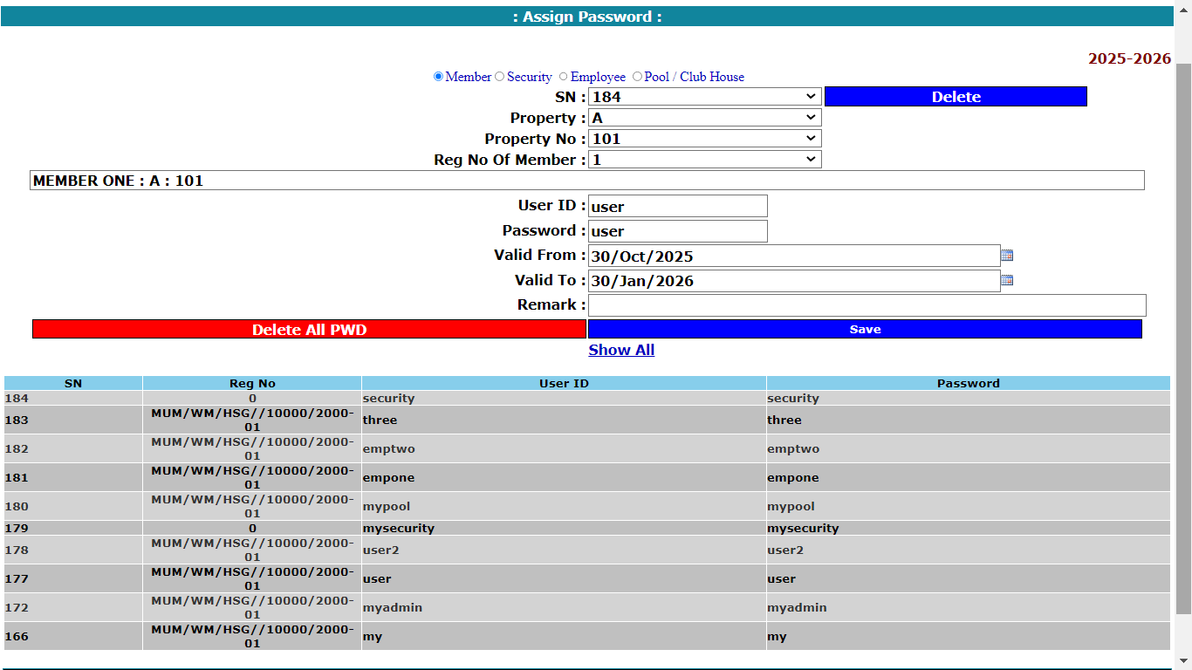
: Society OnLine :
17. Assign Password

Slide 23
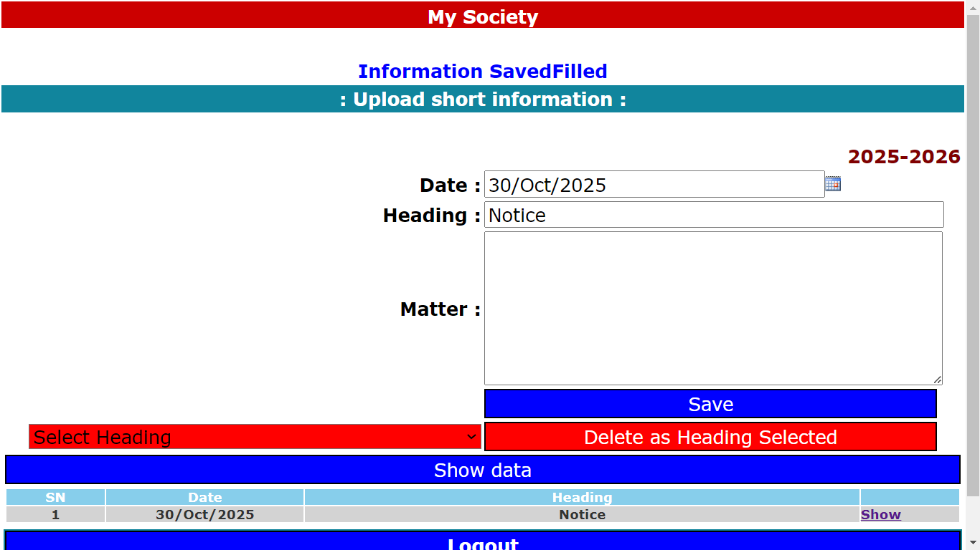
: Society OnLine :
18. Upload Information

Slide 24
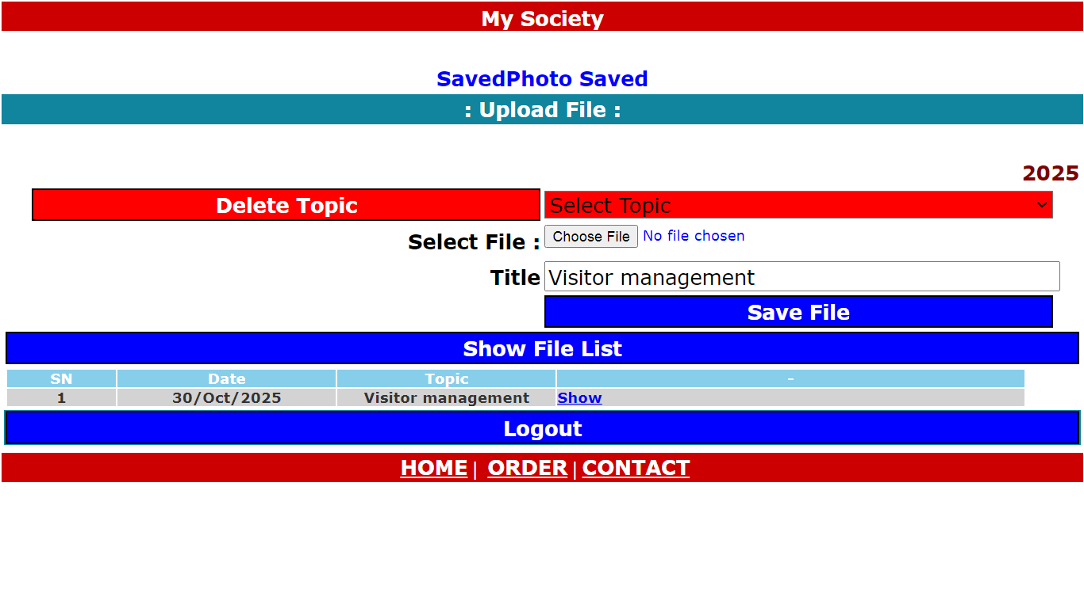
: Society OnLine :
19. Upload Document

Slide 25
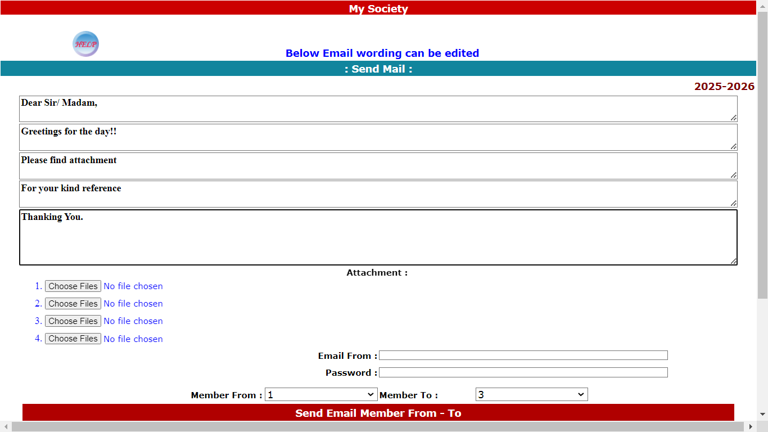
: Society OnLine :
20. Send Mail

Slide 26
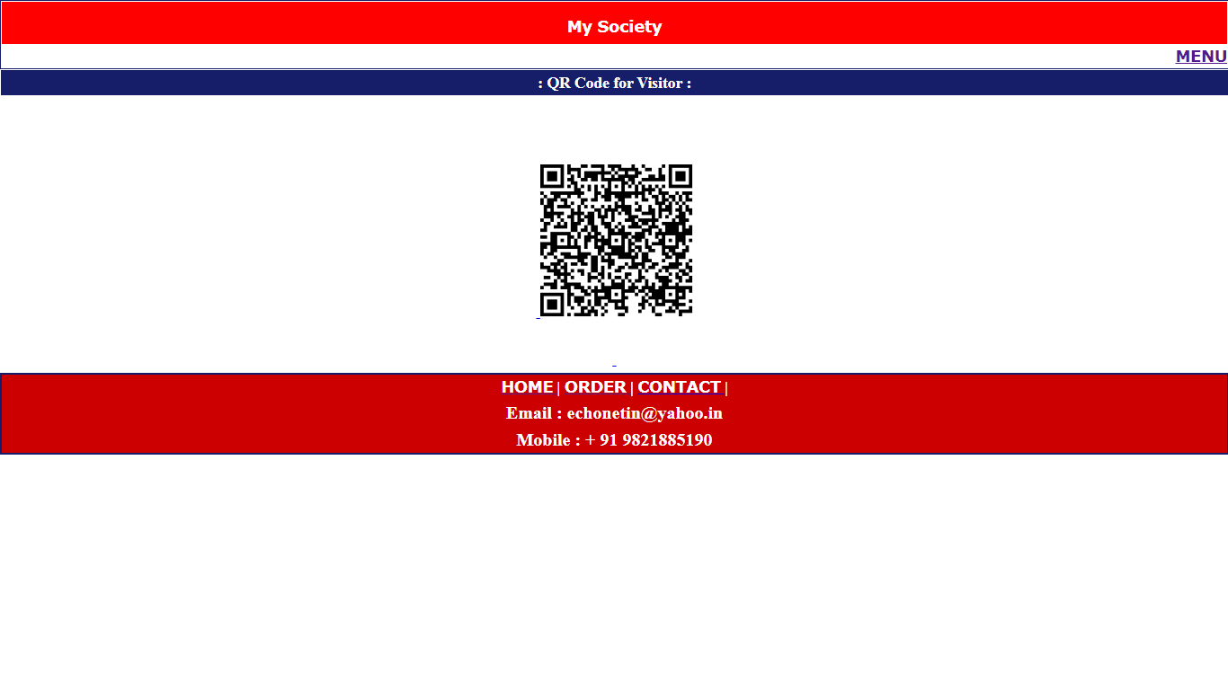
: Society OnLine :
21. QR Code for Visitor

Slide 27
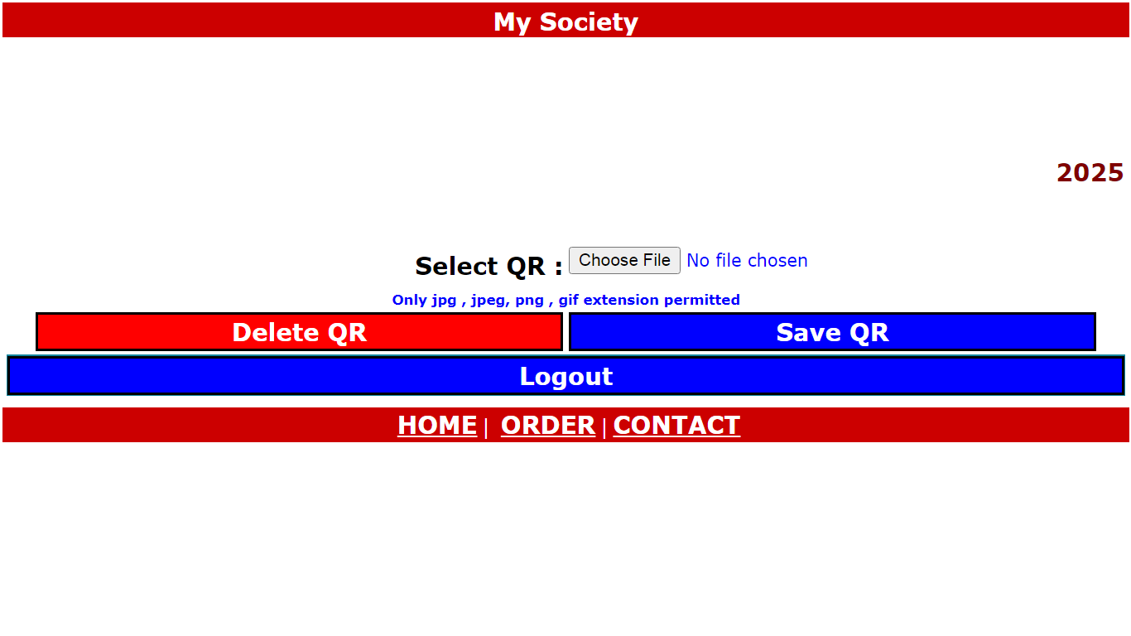
: Society OnLine :
22. QR Code for Bill Payment

Slide 28
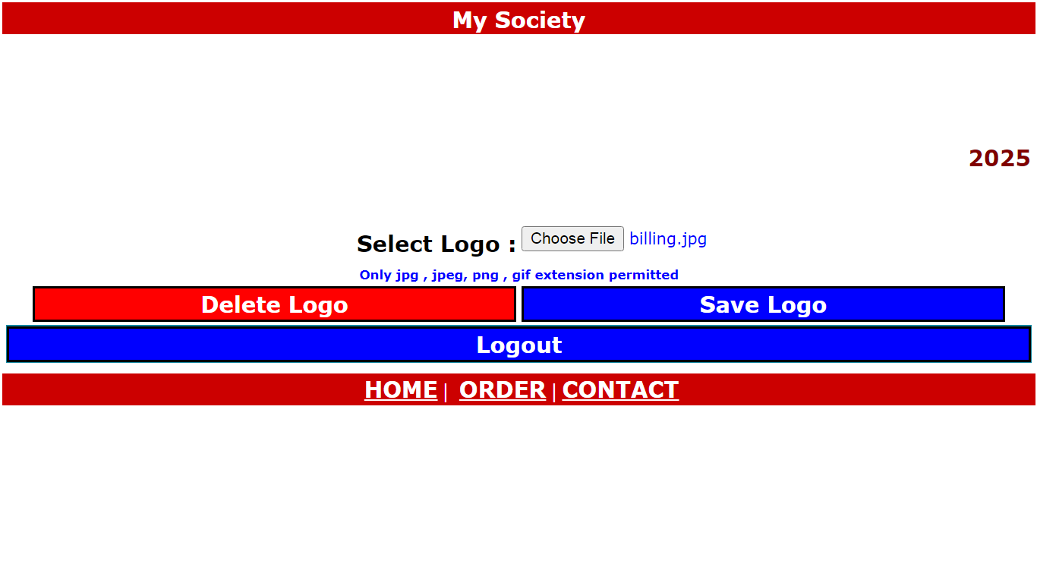
: Society OnLine :
23. Upload Logo

Slide 29
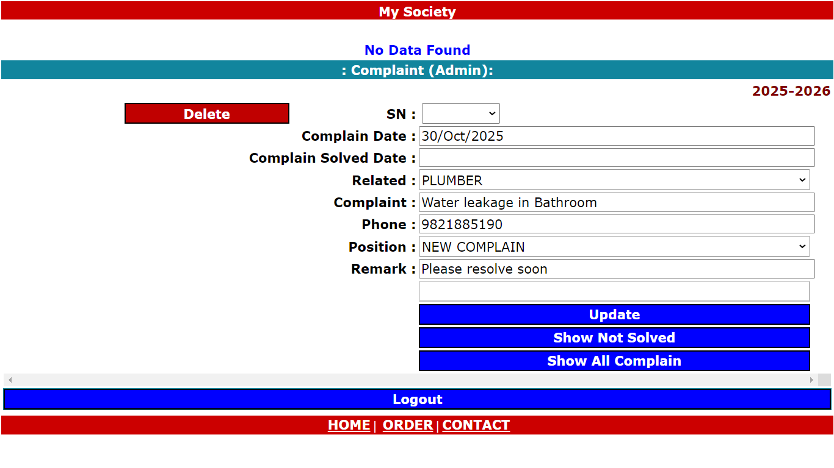
: Society OnLine :
24. Complaint Register

Slide 30
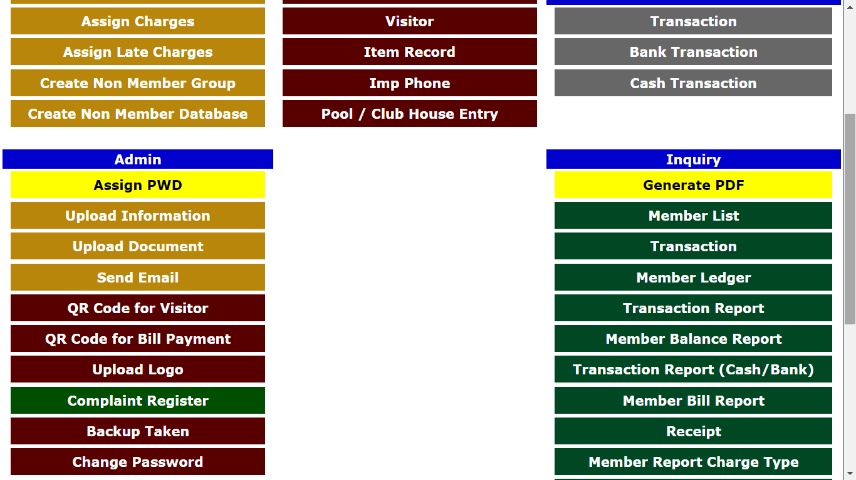
: Society OnLine :
25. Backup of Database

Slide 31
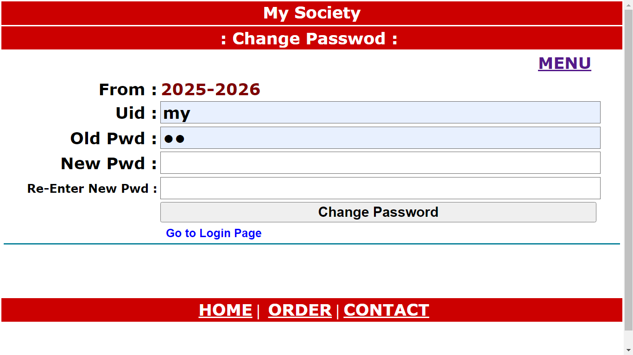
: Society OnLine :
26. Change Password

Slide 32
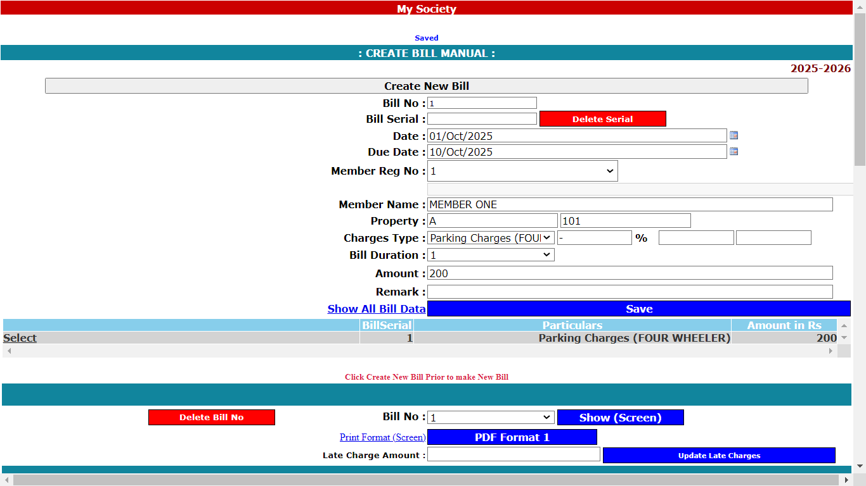
: Society OnLine :
27 (a). Bill Creation Single

Slide 33
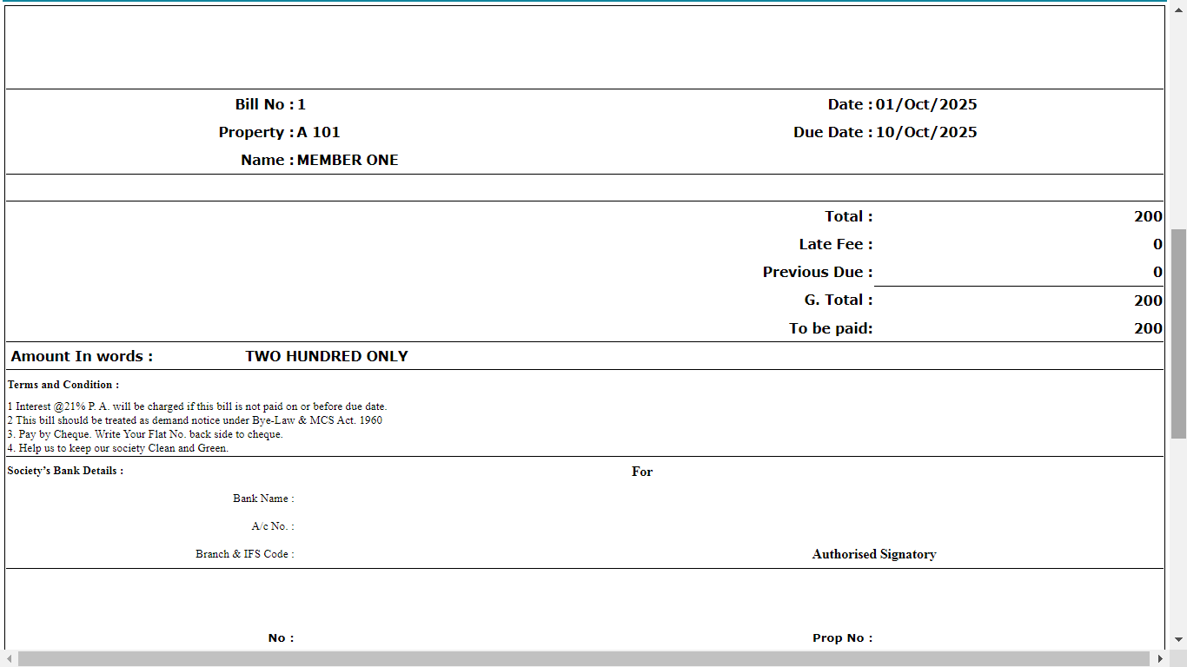
: Society OnLine :
27 (b). Bill Creation Single

Slide 34
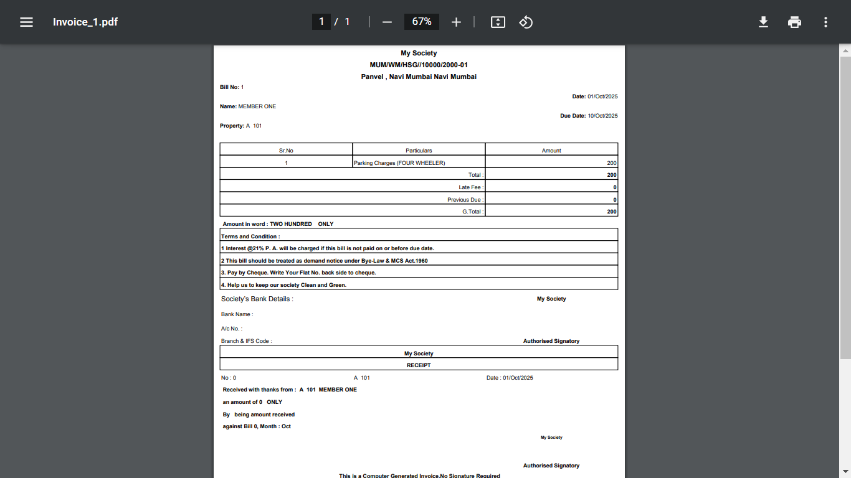
: Society OnLine :
27 (c). Bill Creation Single

Slide 35
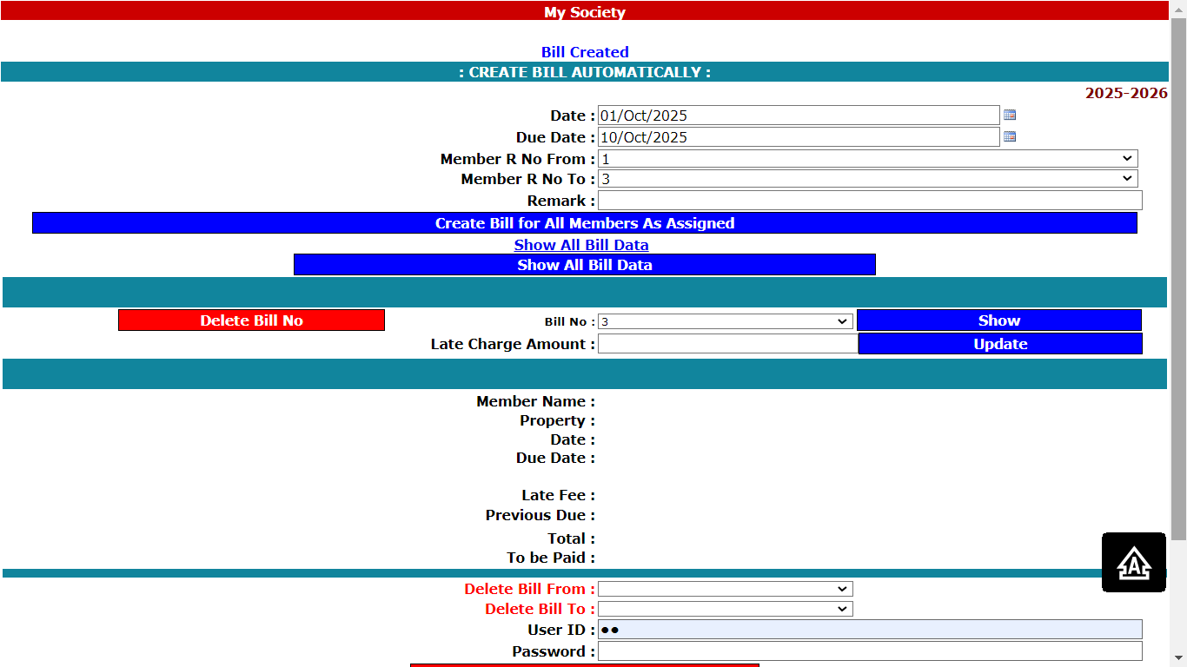
: Society OnLine :
28 (a). Bill Creation Auto
Select Dates , Member Registration Number From – To
Click Create Bill for All Members as Assigned. Bills for all members created as per assigned.

Slide 36
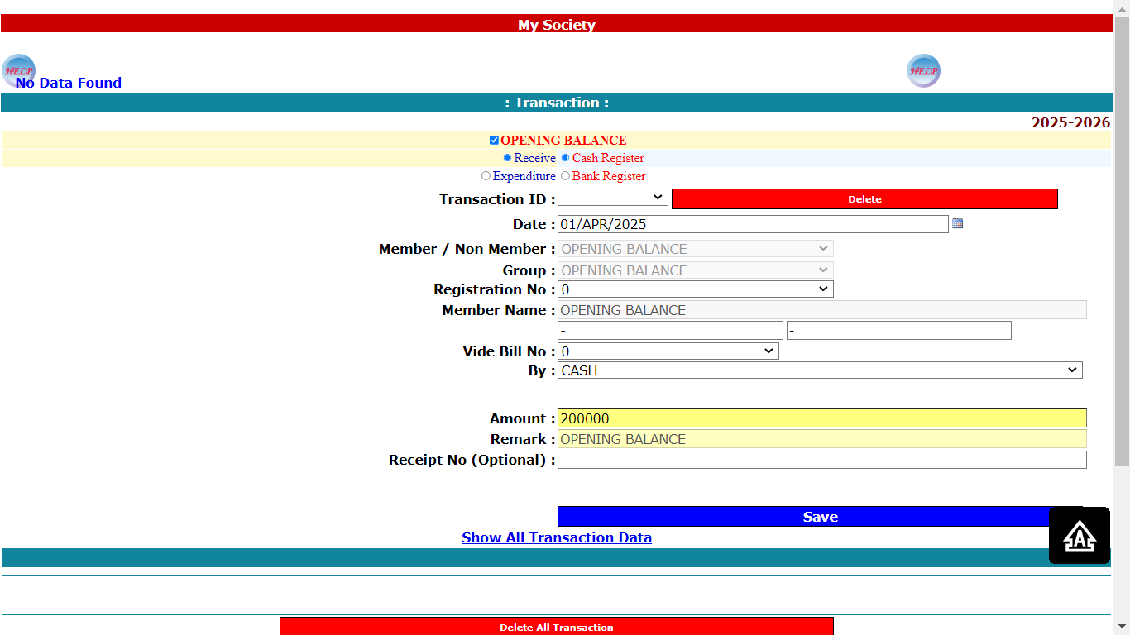
: Society OnLine :
29 (a). Transaction (Opening Balance Cash Entry)
Tick Mark Opening Balance, Receive, Cash Register, Write Date, Write Amount , Click Save.

Slide 37
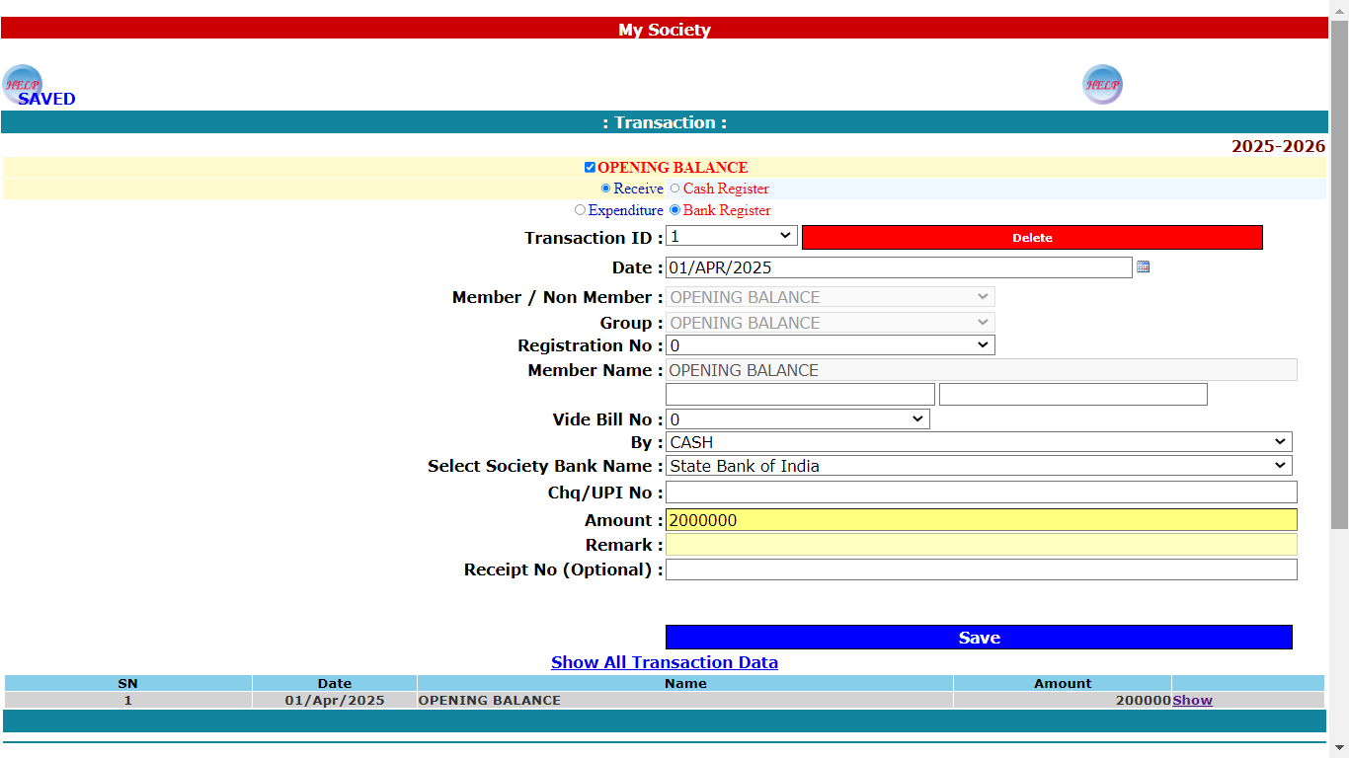
: Society OnLine :
29 (b). Transaction (Opening Balance Bank Entry)
Tick Mark Opening Balance, Receive, Bank Register, Write Date, Write Amount , Click Save.

Slide 38
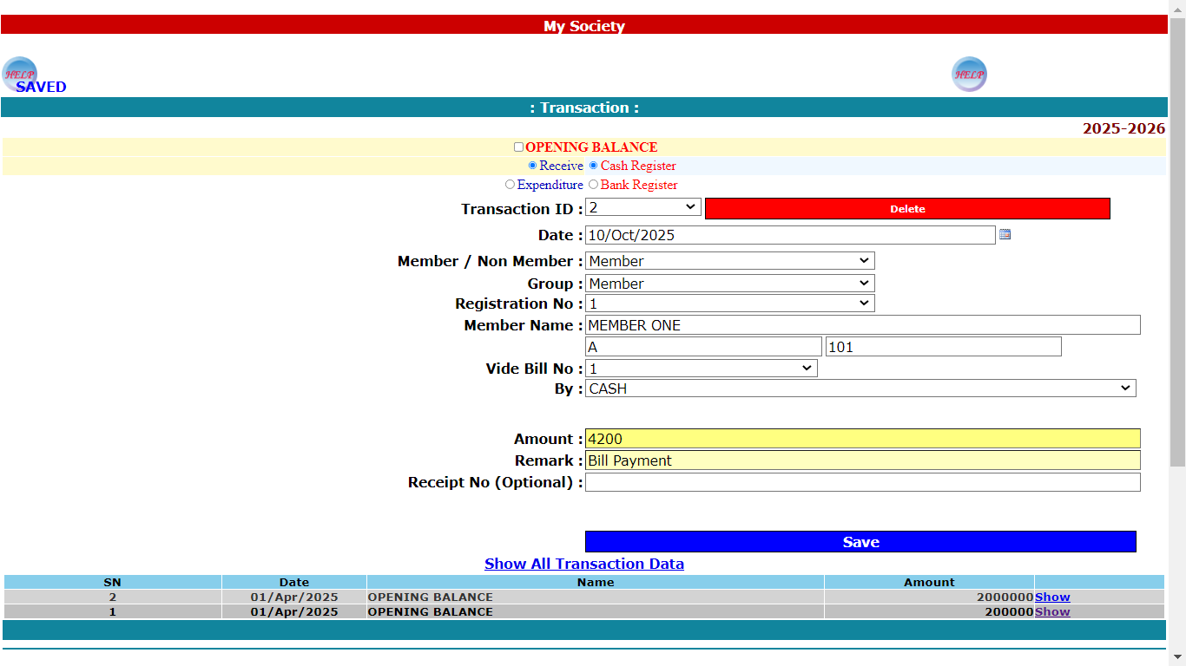
: Society OnLine :
29 (c). Transaction (Bill Deposit Entry in Cash)
Un Tick Opening Balance, Receive, Cash Register, Write Date, Select Member,
Select Member Registration No, Select Vide Bill, Select By, Write Amount , Click Save.

Slide 39
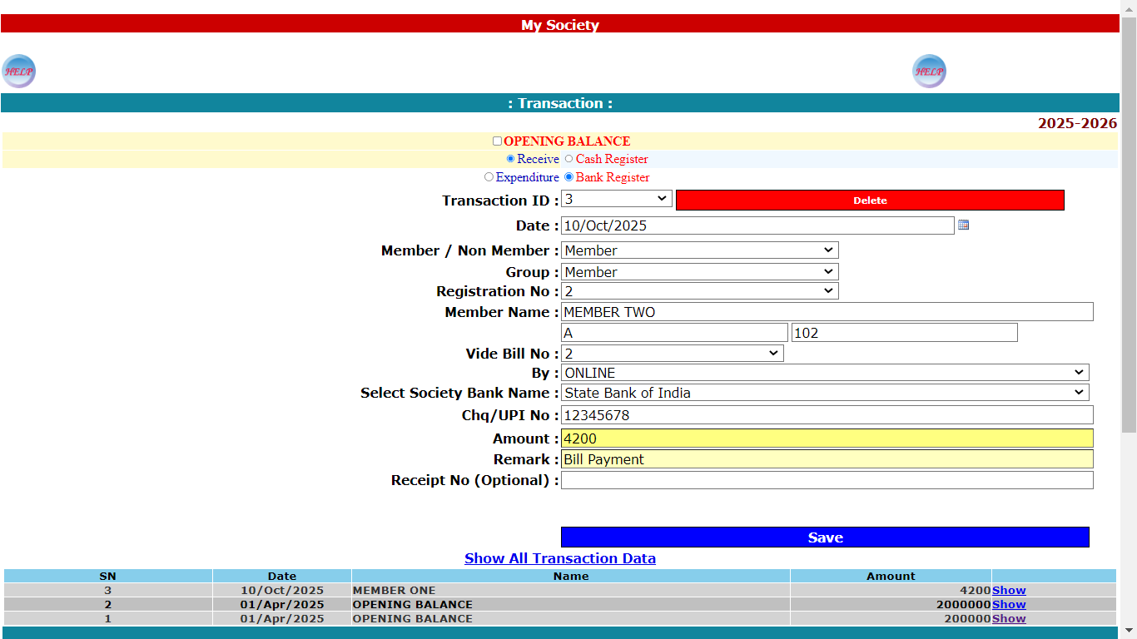
: Society OnLine :
29 (d). Transaction (Bill Deposit Entry in Bank)
Un Tick Opening Balance, Receive, Bank Register, Write Date, Select Member,
Select Member Registration No, Select Vide Bill, Select By, Write Amount ,
Remark Bill Payment ,Click Save.

Slide 40
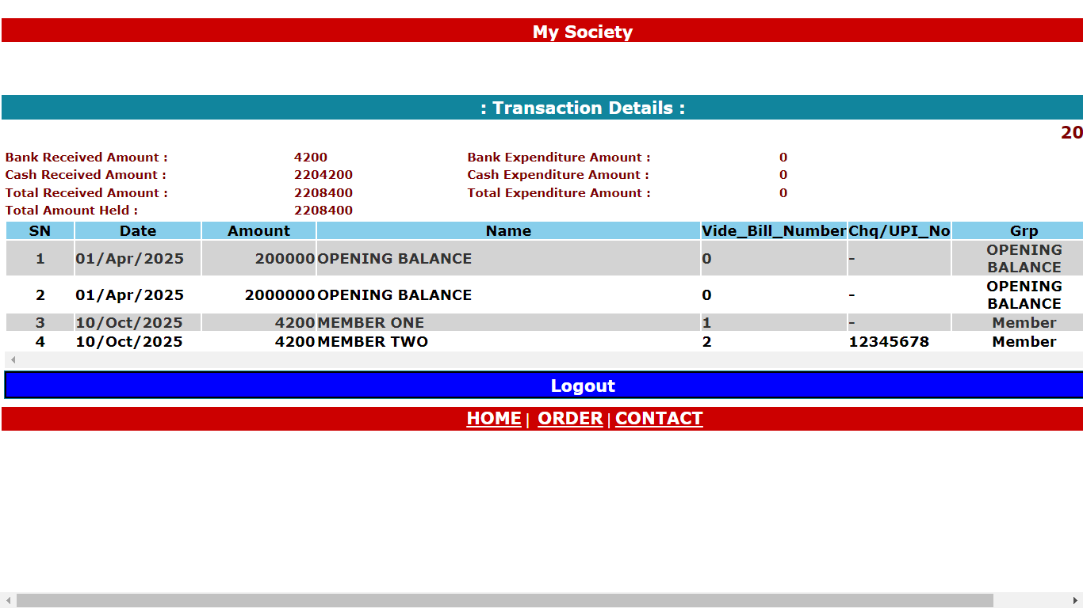
: Society OnLine :
29 (e). Transaction (Show All Transaction Data)

Slide 41
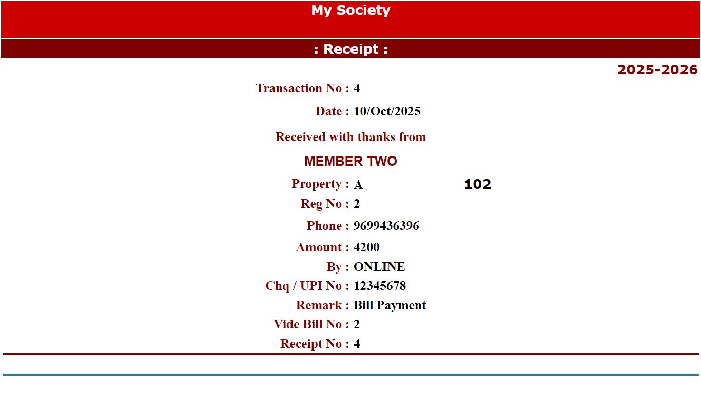
: Society OnLine :
29 (f). Transaction (Receipt)

Slide 42
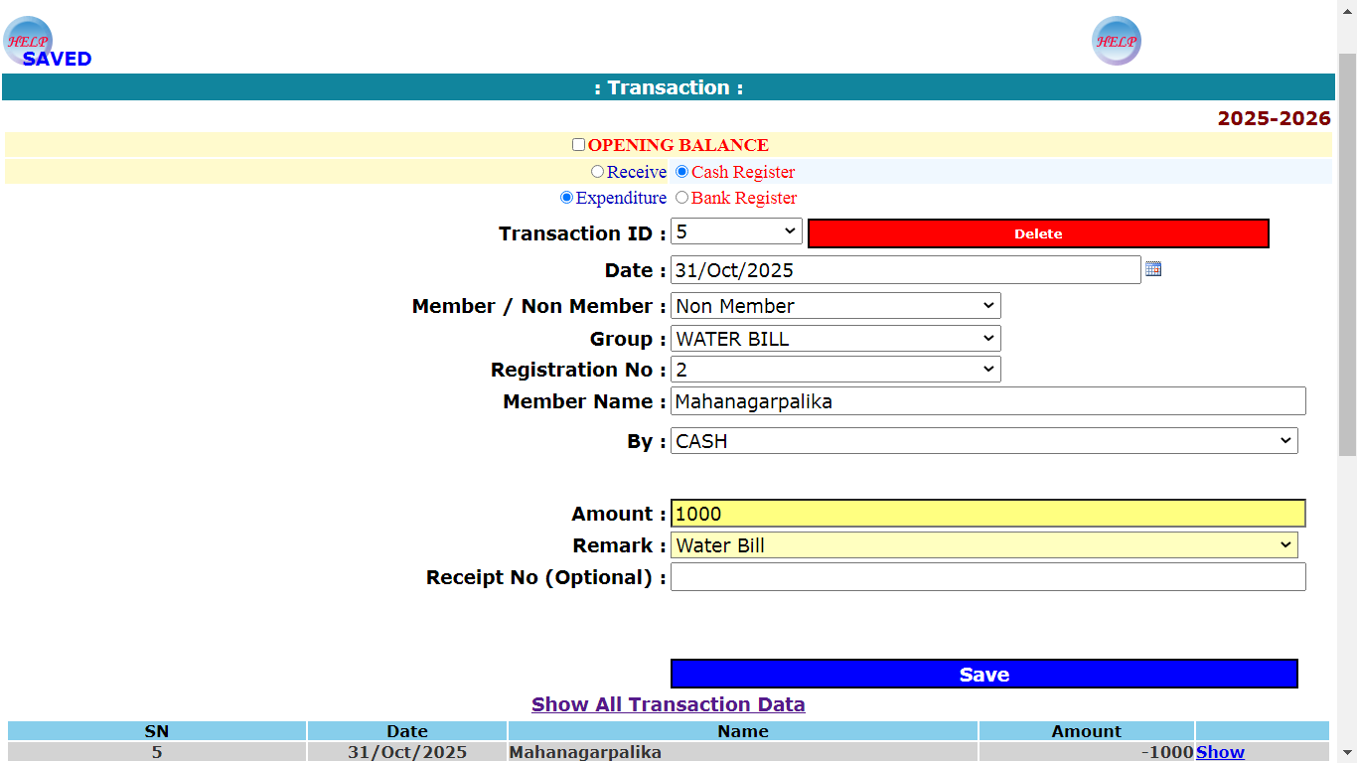
: Society OnLine :
29 (g). Transaction (Expenditure)

Slide 43
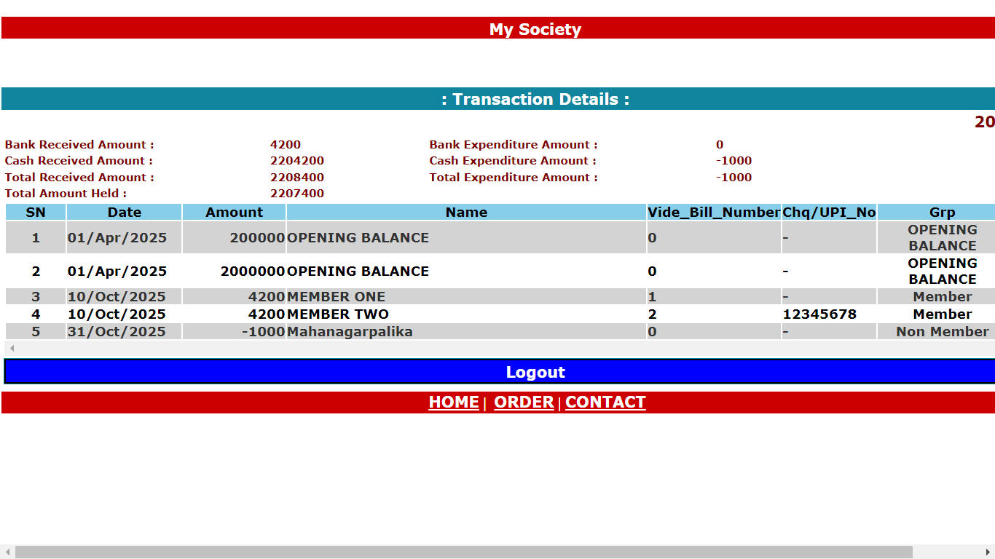
: Society OnLine :
29 (h). Transaction (Show All Transaction Data)

Slide 44
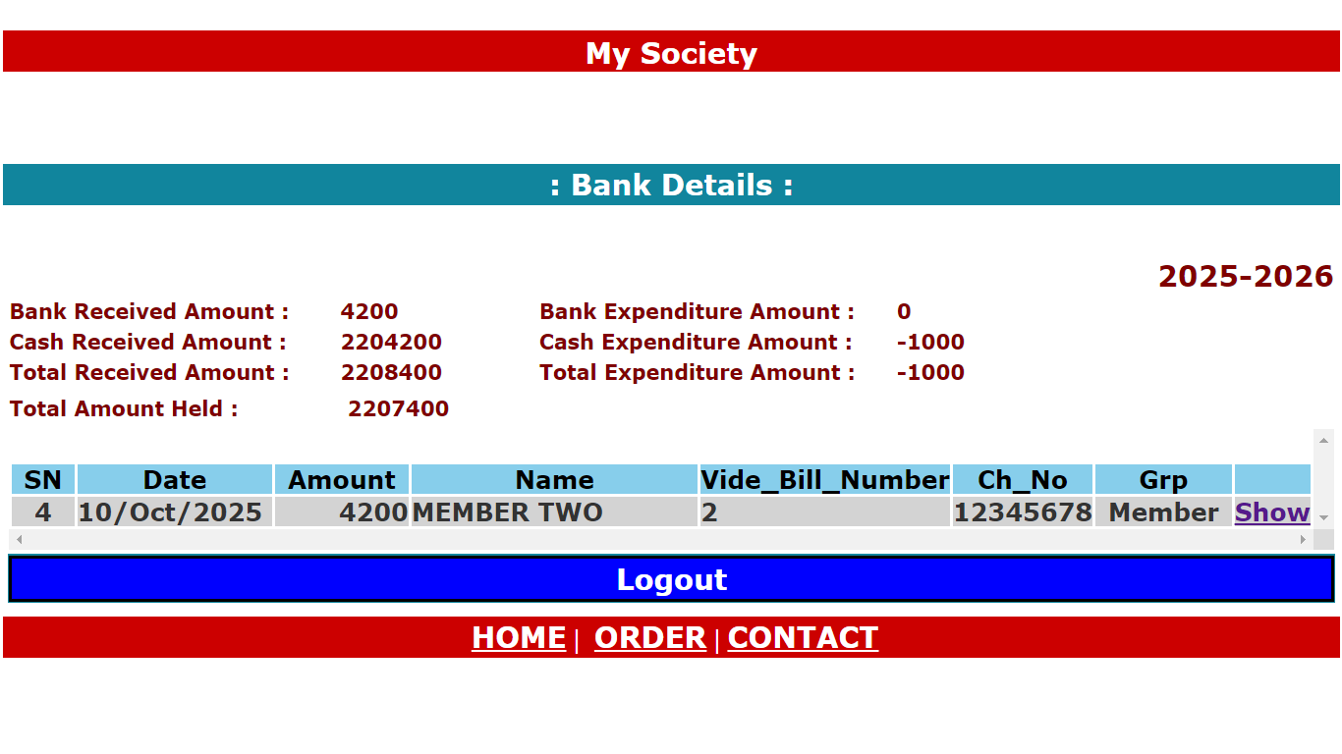
: Society OnLine :
30. Bank Transaction

Slide 45
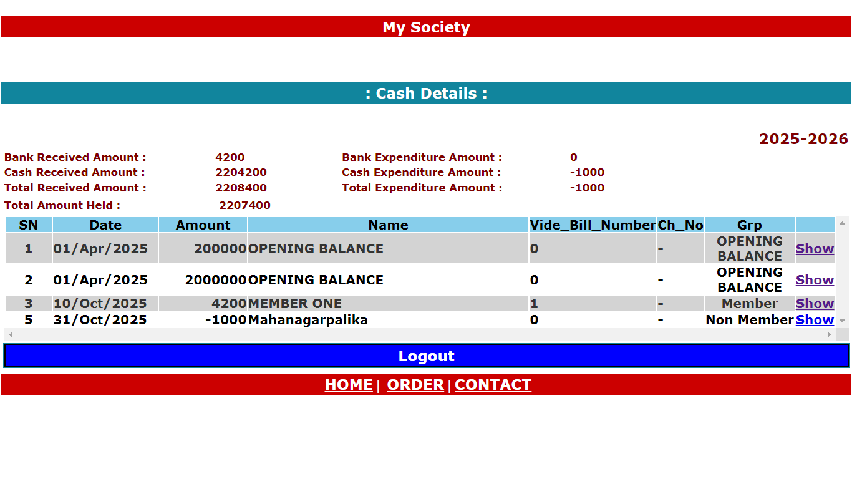
: Society OnLine :
31. Cash Transaction

Slide 46
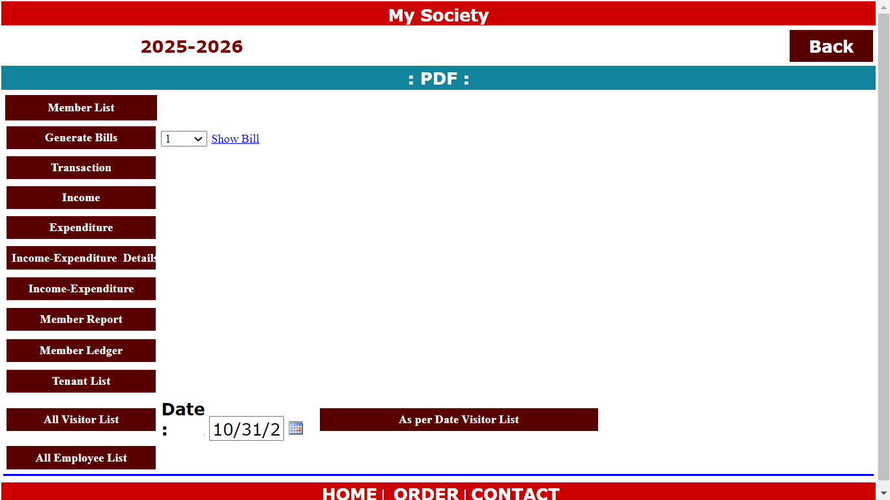
: Society OnLine :
32 . Inquiry -> Generate PDF

Slide 47
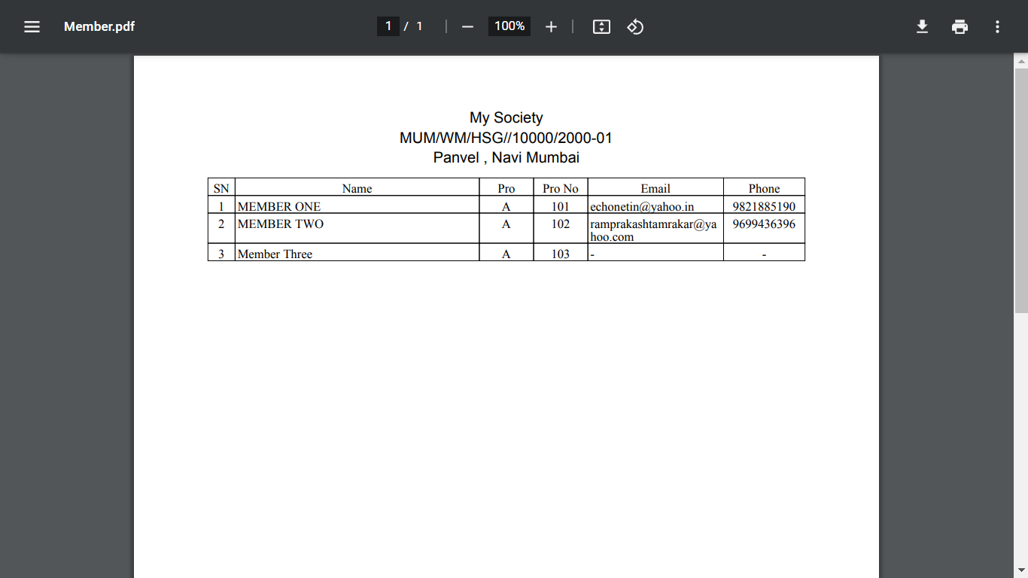
: Society OnLine :
32 (a). Inquiry -> Generate PDF -> Member List

Slide 48
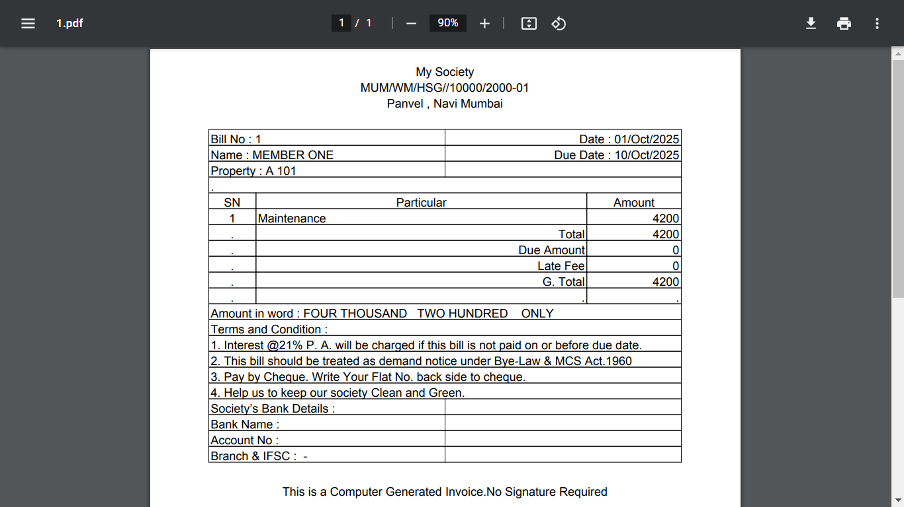
: Society OnLine :
32 (b). Inquiry -> Generate PDF -> Generate Bills

Slide 49
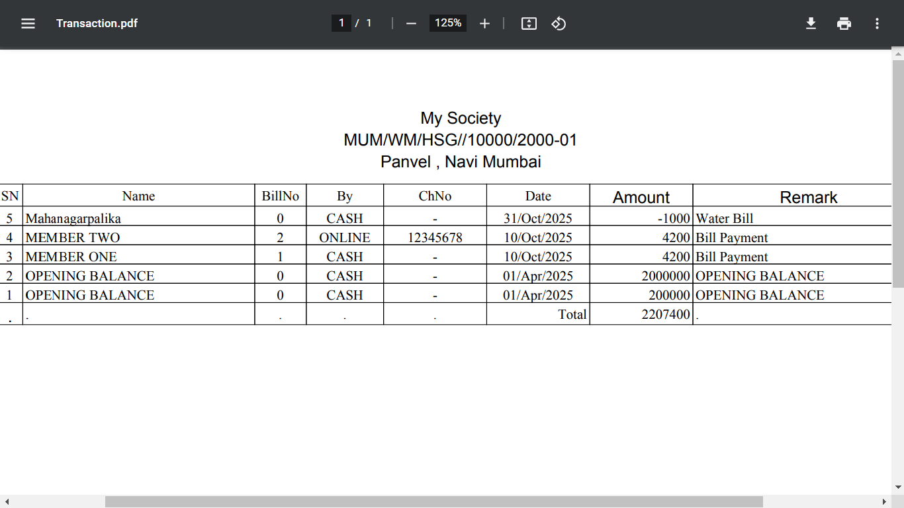
: Society OnLine :
32 (c). Inquiry -> Generate PDF -> Transaction

Slide 50
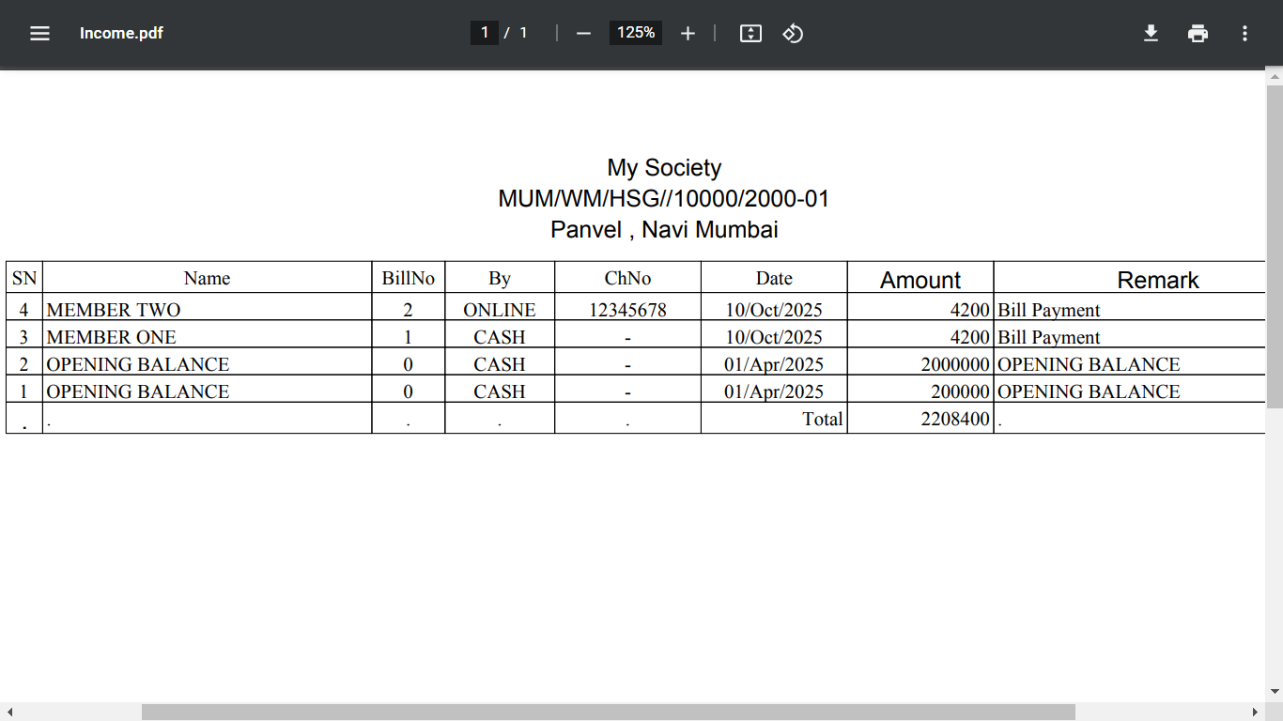
: Society OnLine :
32 (d). Inquiry -> Generate PDF -> Income

Slide 51
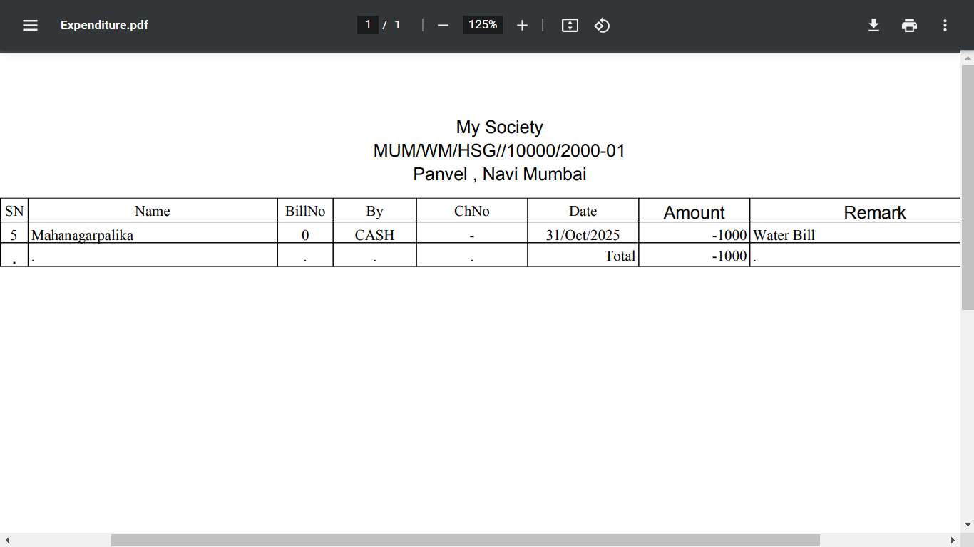
: Society OnLine :
32 (e). Inquiry -> Generate PDF -> Expenditure

Slide 52
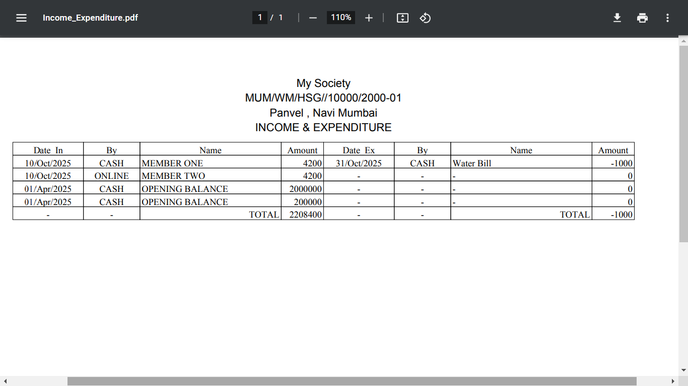
: Society OnLine :
32 (f). Inquiry -> Generate PDF -> Income – Expenditure Details

Slide 53
: Society OnLine :
32 (g). Inquiry -> Generate PDF -> Member Report

Slide 54

: Society OnLine :
32 (h). Inquiry -> Generate PDF -> Member Ledger

Slide 55
: Society OnLine :
32 (i). Inquiry -> Generate PDF -> Tenant List

Slide 56

: Society OnLine :
32 (j). Inquiry -> Generate PDF -> All Visitor List

Slide 57

: Society OnLine :
32 (k). Inquiry -> Generate PDF -> All Employee List

Slide 58

: Society OnLine :
33. Member List

Slide 59

: Society OnLine :
34. Transaction

Slide 60

: Society OnLine :
35. Members Ledger

Slide 61

: Society OnLine :
36. Transaction Report

Slide 62

: Society OnLine :
37. Members Balance Report

Slide 63

: Society OnLine :
38. Transaction Report (Cash / Bank)

Slide 64

: Society OnLine :
39. Members Bill Report

Slide 65

: Society OnLine :
40. Receipt

Slide 66

: Society OnLine :
41. Members Report Charge Type

Slide 67

: Society OnLine :
42. Payment

Slide 68

: Society OnLine :
43. Members Bill / Receipt Report

Slide 69

: Society OnLine :
44. Income / Expenditure

Slide 70

: Society OnLine :
45. Members Transaction Report

Slide 71

: Society OnLine :
46. Non Member Transaction Report

Slide 72
Echo Software Consultancy Services Contact : echonetin@yahoo.in

