Slide 1

Billing (Android Application) https://www.echonet.in/BillingAndroidApp.aspx
By : Echo Software Consultancy Services

Slide 2
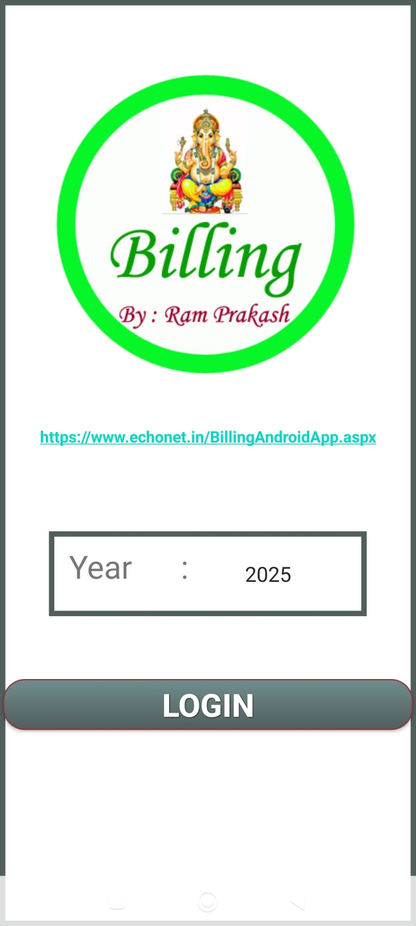

Slide 3
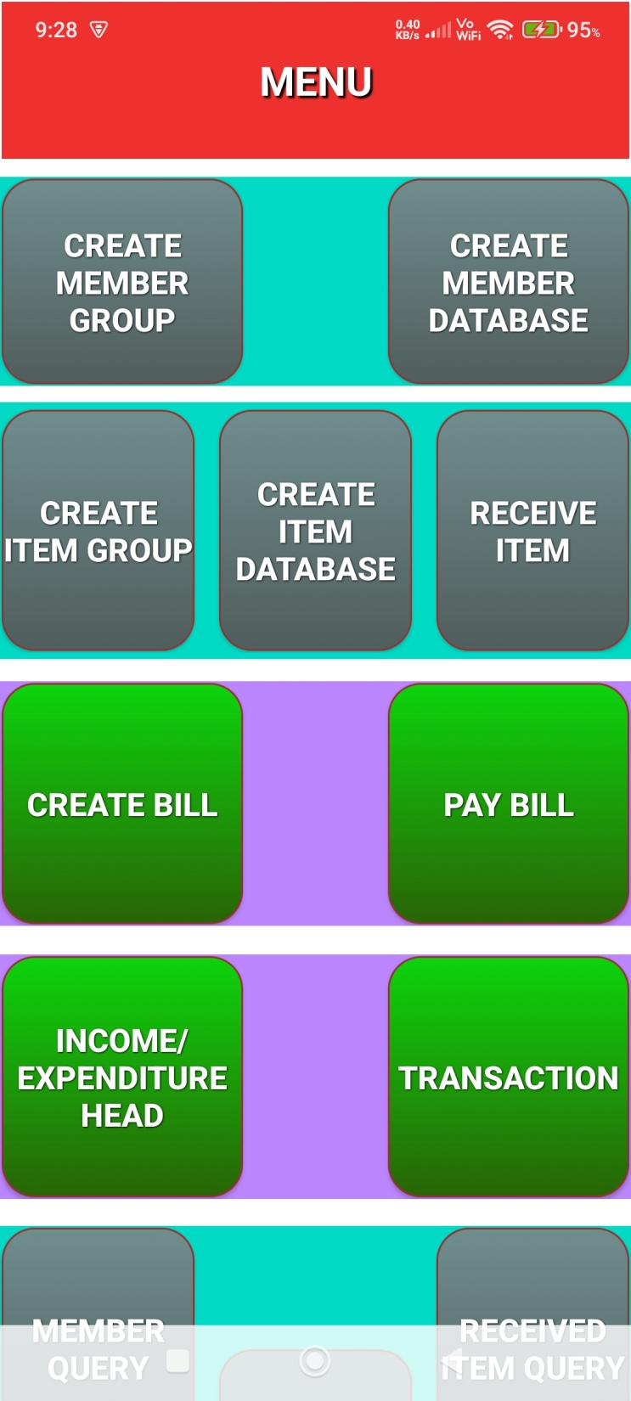

Slide 4
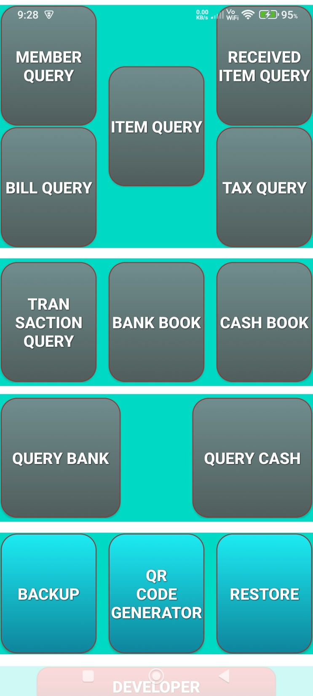

Slide 5
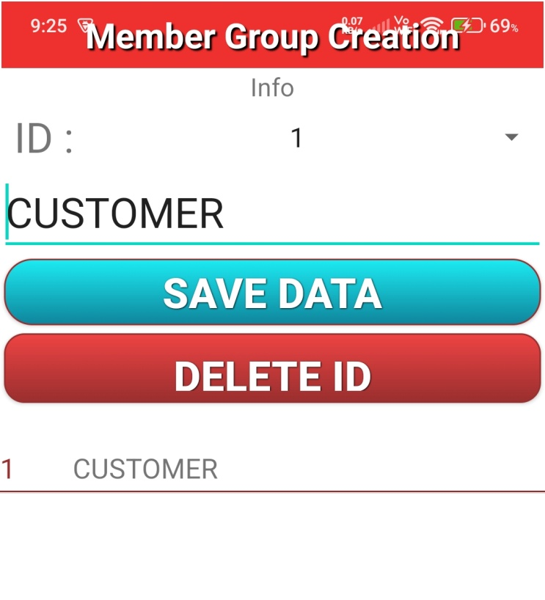
Can Create Group of members such as Customer / Friends etc.

Slide 6
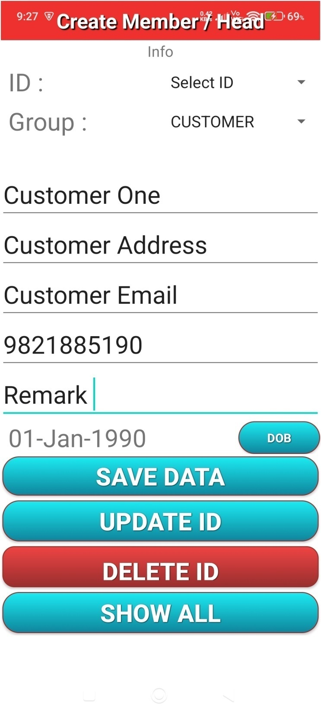
Can Create Customer database , so that while making the bills, need not to enter mobile number / name.

Slide 7
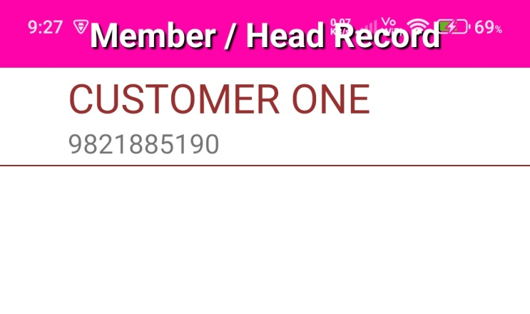
List of Customers on screen.
When list clicked , then details of Customer will be displayed and SMS can be sent or contacted over mobile.

Slide 8
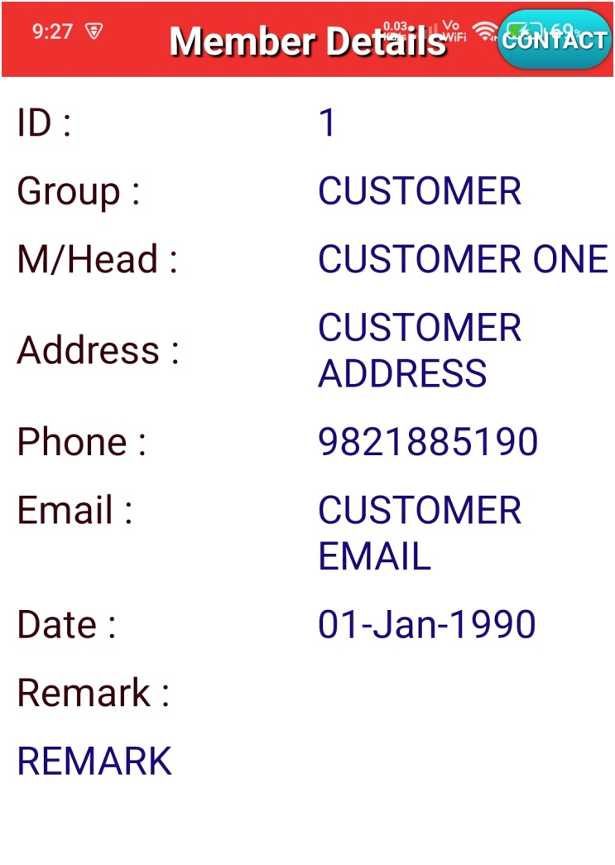
Details of Customer will be

Slide 9
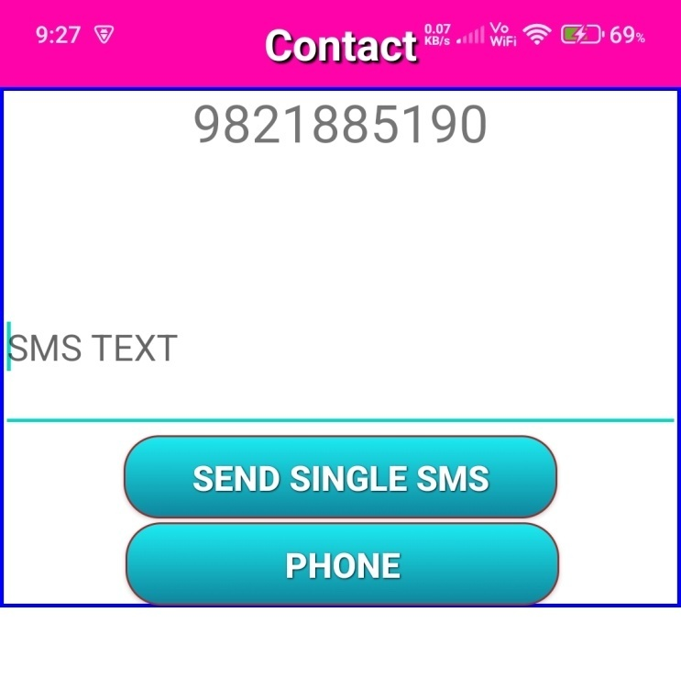
SMS can be sent or contacted over mobile.

Slide 10
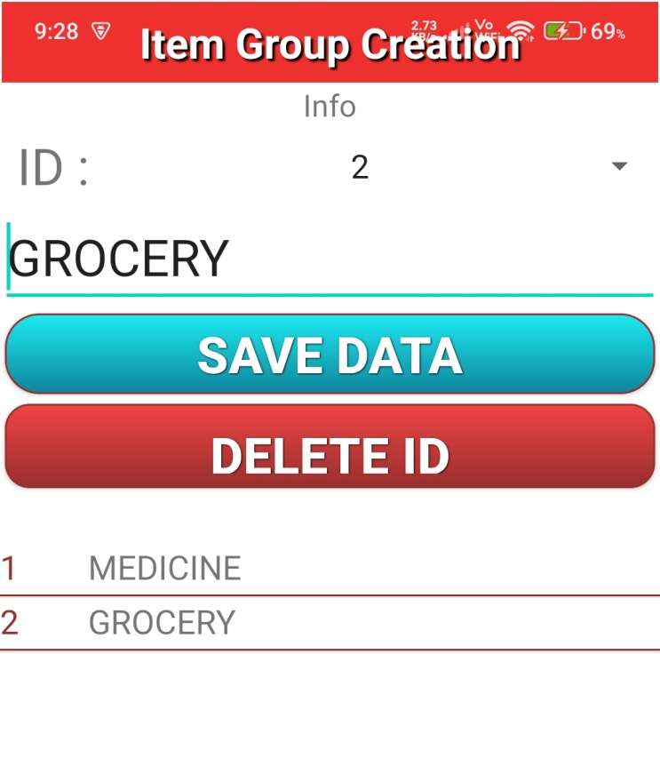
Group of Items can be created.

Slide 11
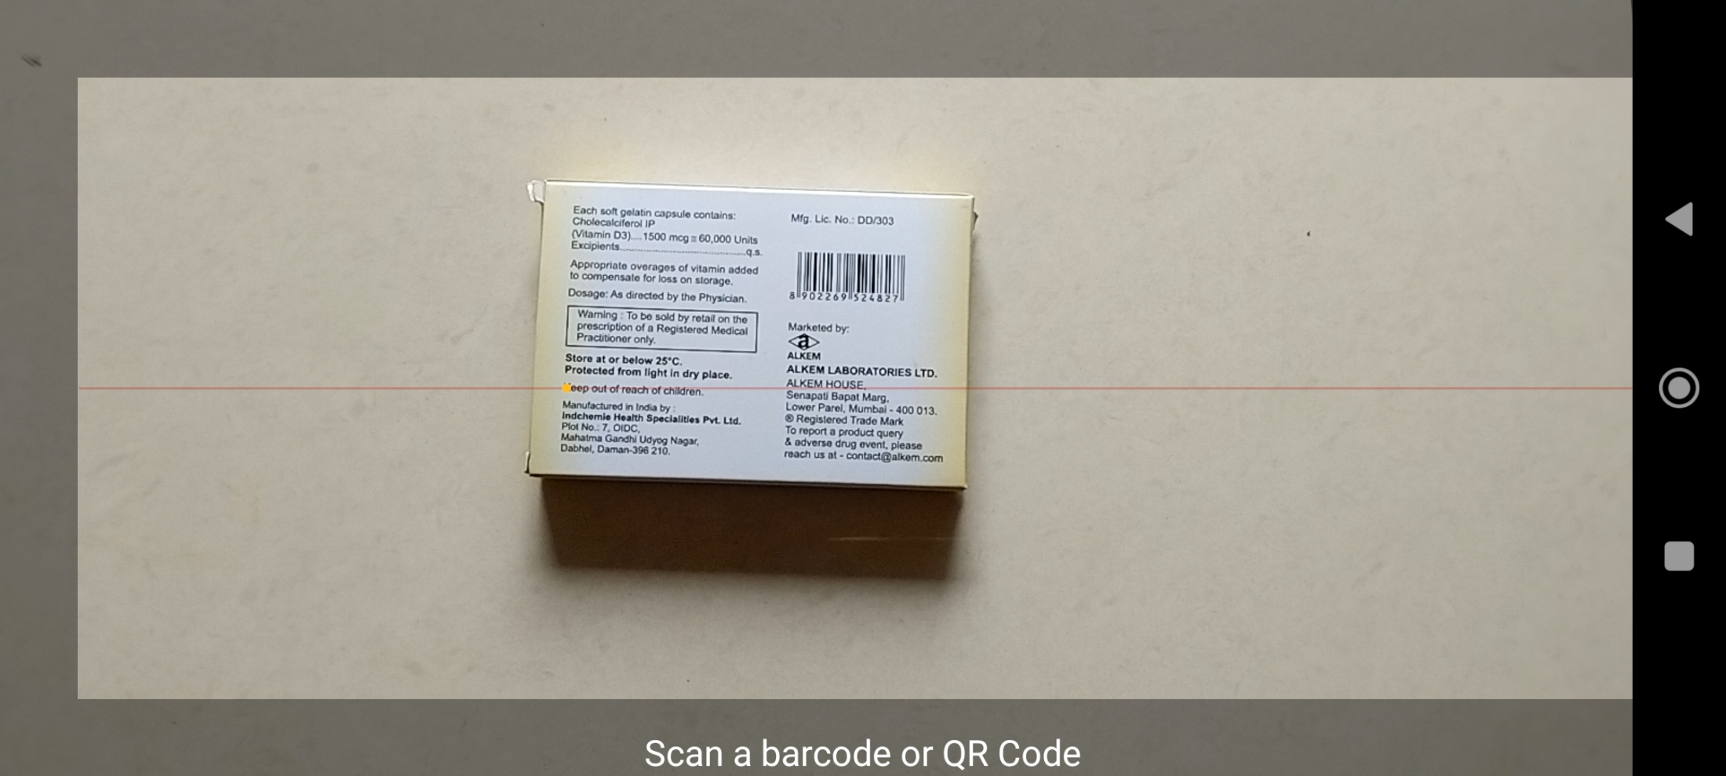
Item’s Barcode can be scanned during Creation of Item database.
It will be used to make Bills.

Slide 12
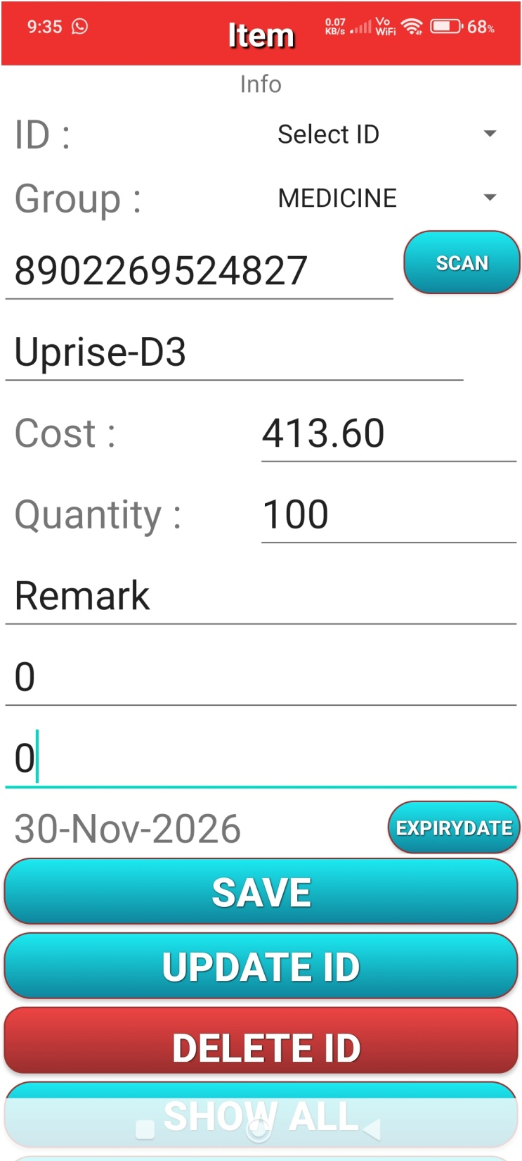
Database of Items
can be created.
So that it will be easy to make bills.

Slide 13
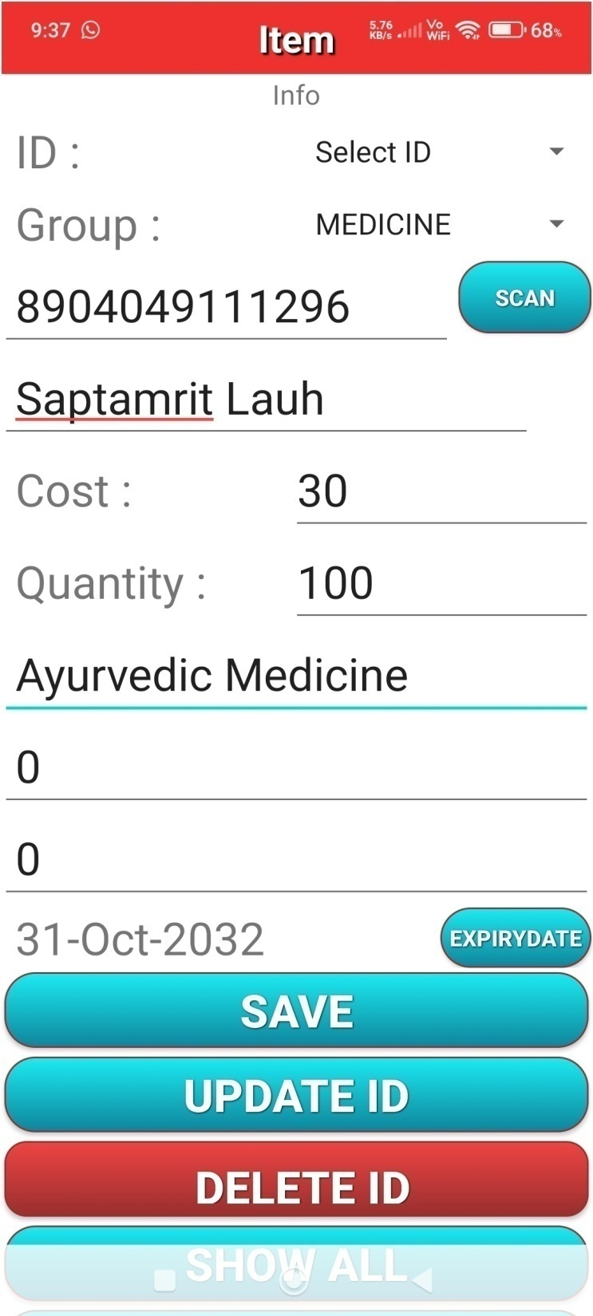
Database of Items
can be created.
So that it will be easy to make bills.

Slide 14
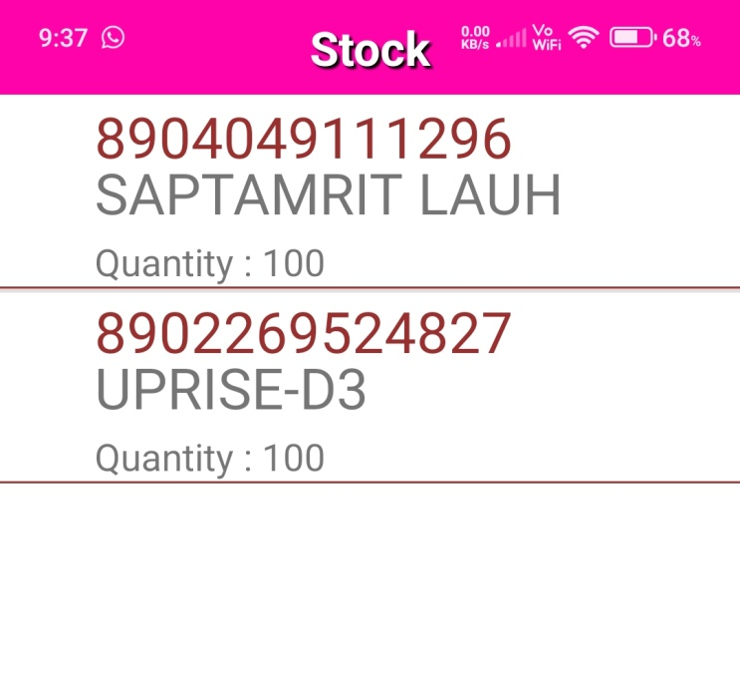
List of Items.
Can be clicked to get full information.

Slide 15
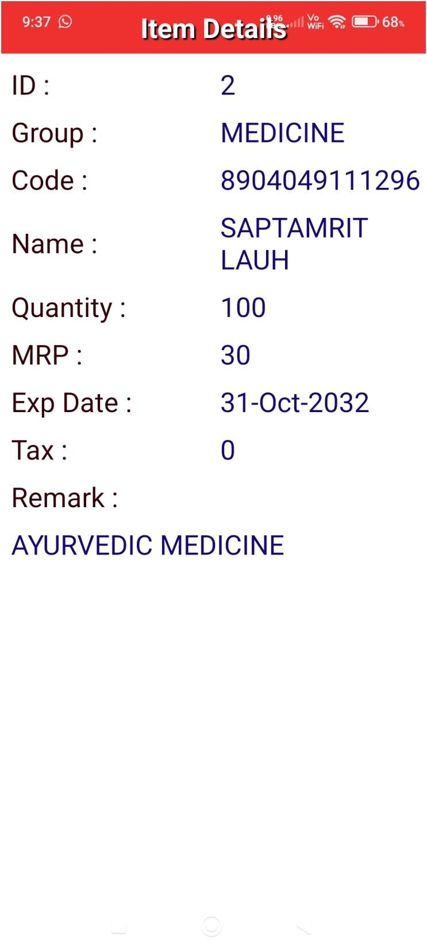
Information of Item.

Slide 16
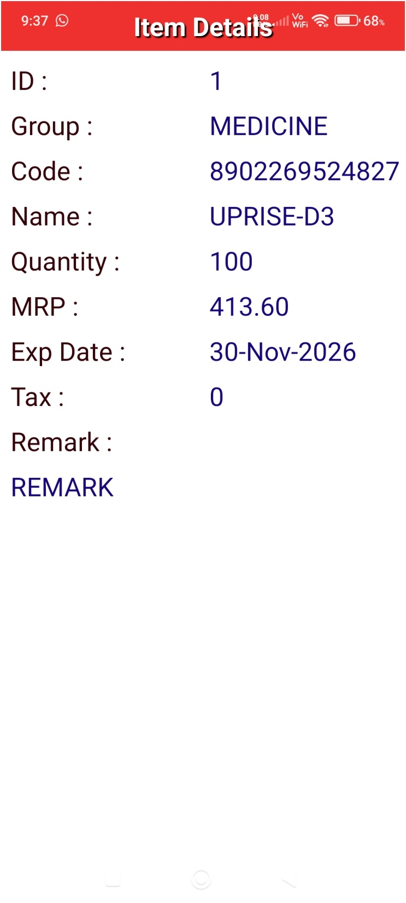
Information of Item.

Slide 17
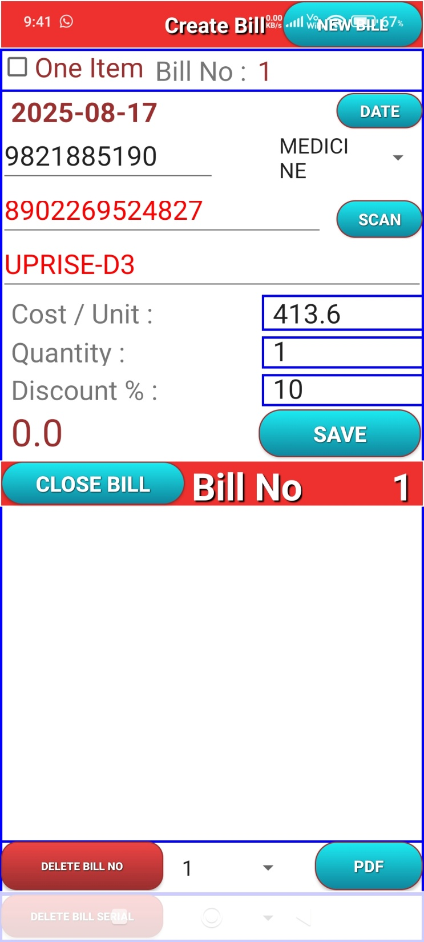
: Make the Bill:
Click New Bill , prior to make any new Bill.
Four Types of Bill entry can be made:
Bills can be made by scanning of Barcode.
By entering manually Barcode.
By entering Item name
Also for quick entry , click One Item , click SCAN button , scan contentiously items. It will make entry of items with one quantity. At last click Back button of Mobile and click CLOSE BILL button of APP.

Slide 18
: Make the Bill:
Click New Bill , prior to make any Bill.
Item Bar Code can be scanned by pressing SCAN button.
If Item data available then ,Item Cost , Code & Name will be filled up.
Write Quantity and Discount.
Click Save.
Again scan another Item Bar Code , repeat 3 -4 .
Repeat till all items included.
At last click Close Bill.

Slide 19
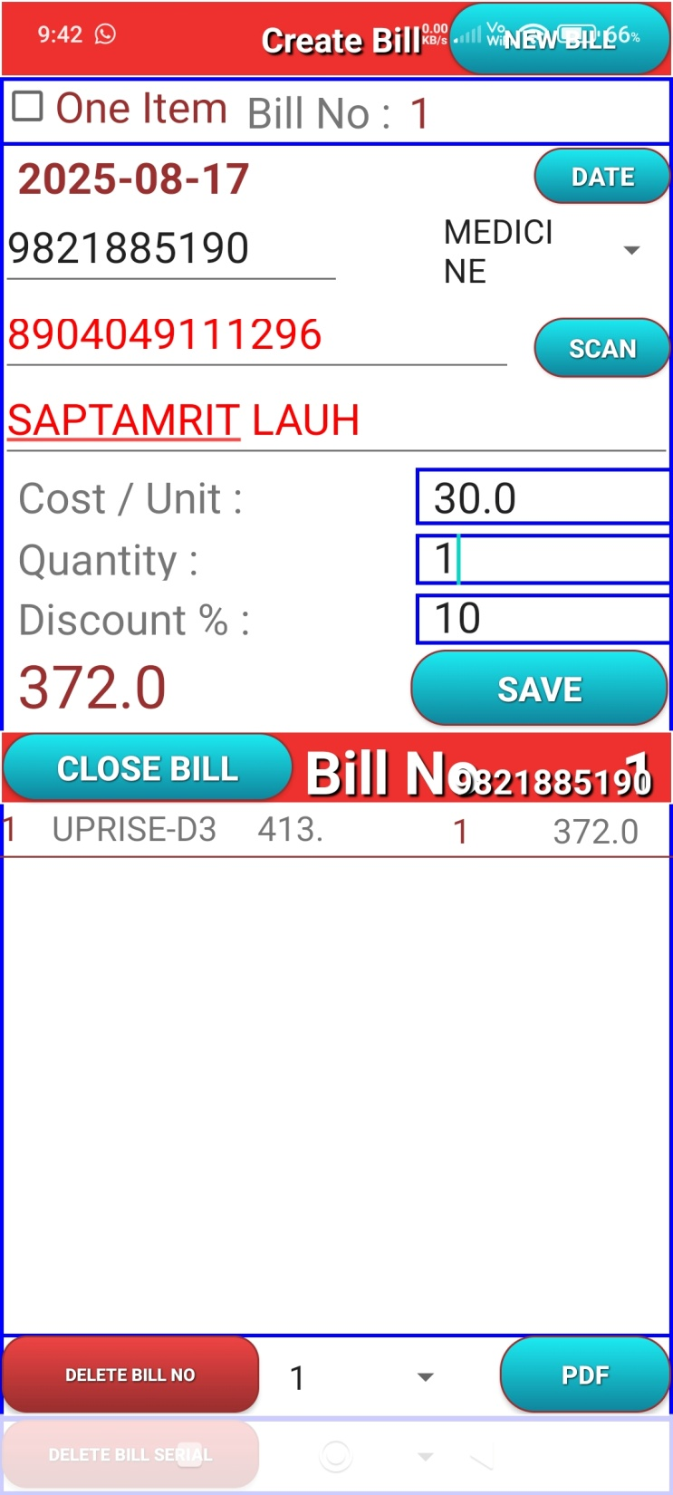
: Make the Bill:
Click New Bill , prior to make any Bill.
Item Bar Code can be scanned by pressing SCAN button.
If Item data available then ,Item Cost , Code & Name will be filled up.
Write Quantity and Discount.
Click Save.
Again scan another Item Bar Code , repeat 3 -4 .
Repeat till all items included.
At last click Close Bill.

Slide 20
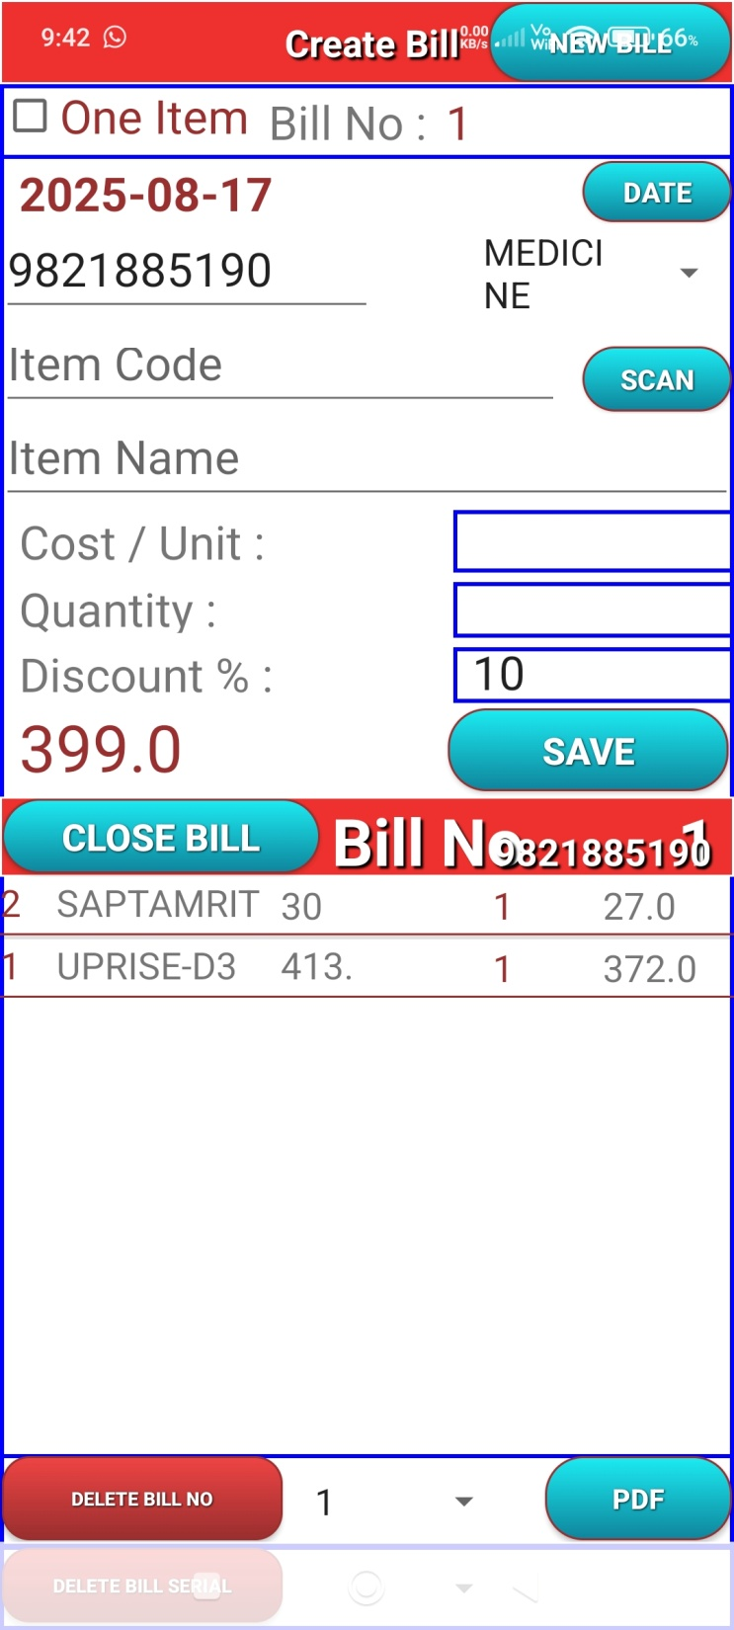
: Make the Bill:
Click New Bill , prior to make any Bill.
Item Bar Code can be scanned by pressing SCAN button.
If Item data available then ,Item Cost , Code & Name will be filled up.
Write Quantity and Discount.
Click Save.
Again scan another Item Bar Code , repeat 3 -4 .
Repeat till all items included.
At last click Close Bill.

Slide 21
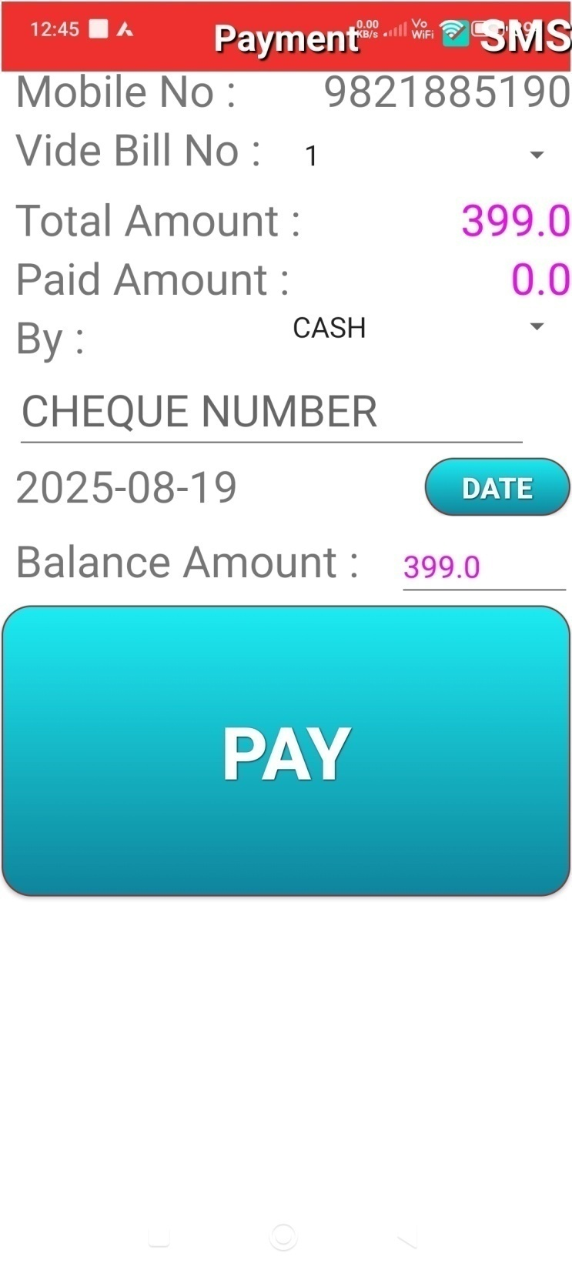
: Pay:
After Close Bill button pressed , Pay window will get open.
Click PAY , then SMS will be received by customer & Bill / Receipt will be shared by WhatsApp (If customer available in WhatsApp)
Bill can be seen in .pdf format
In this windows, old Bills also can be seen by selecting Bill No and clicking SHOW button.

Slide 22
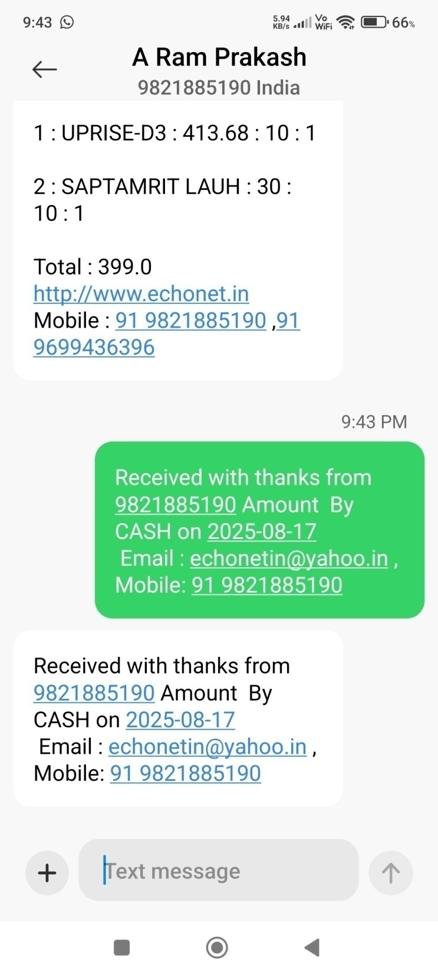
: Pay:
After Close Bill button pressed , Pay window will get open.
Click PAY , then SMS will be received by customer & Bill / Receipt will be shared by WhatsApp (If customer available in WhatsApp)
Bill can be seen in .pdf format
In this windows, old Bills also can be seen by selecting Bill No and clicking SHOW button.

Slide 23
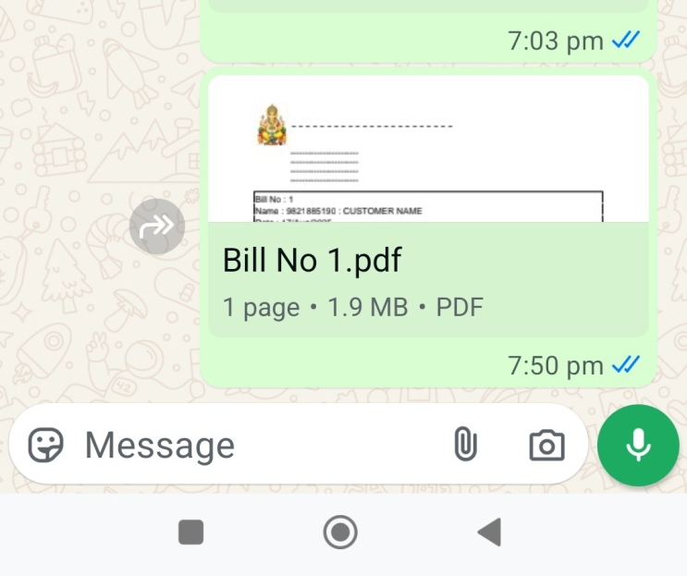
: Pay:
After Close Bill button pressed , Pay window will get open.
Click PAY , then SMS will be received by customer & Bill / Receipt will be shared by WhatsApp (If customer available in WhatsApp)
Bill can be seen in .pdf format
In this windows, old Bills also can be seen by selecting Bill No and clicking SHOW button.

Slide 24
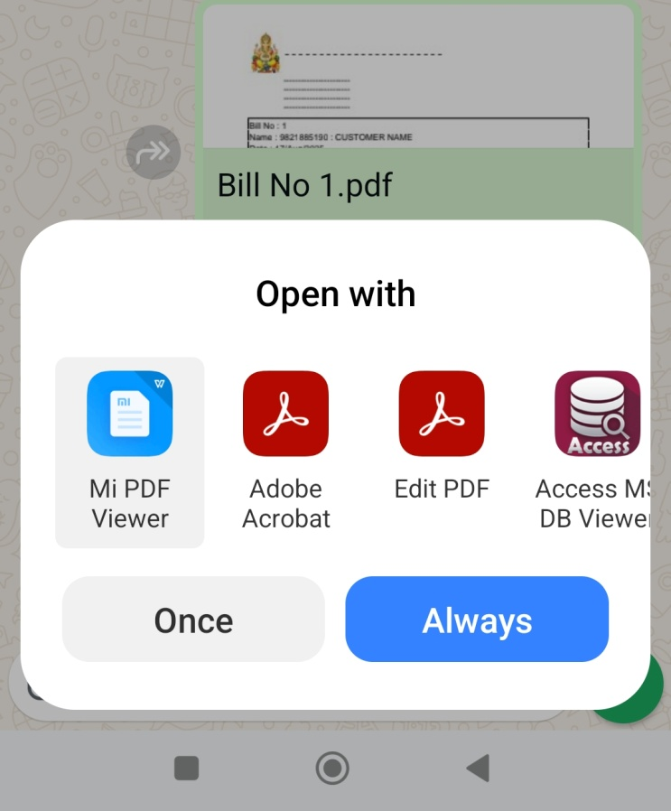

Slide 25
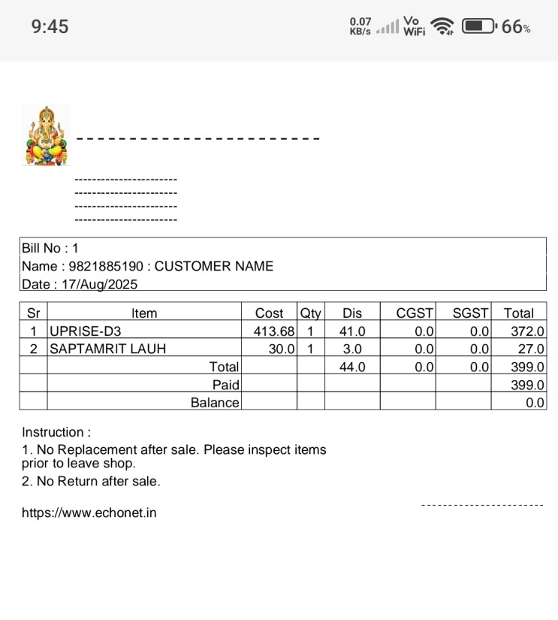
: Pay:
After Close Bill button pressed , Pay window will get open.
Click PAY , then SMS will be received by customer & Bill / Receipt will be shared by WhatsApp (If customer available in WhatsApp)
Bill can be seen in .pdf format
In this windows, old Bills also can be seen by selecting Bill No and clicking SHOW button.

Slide 26
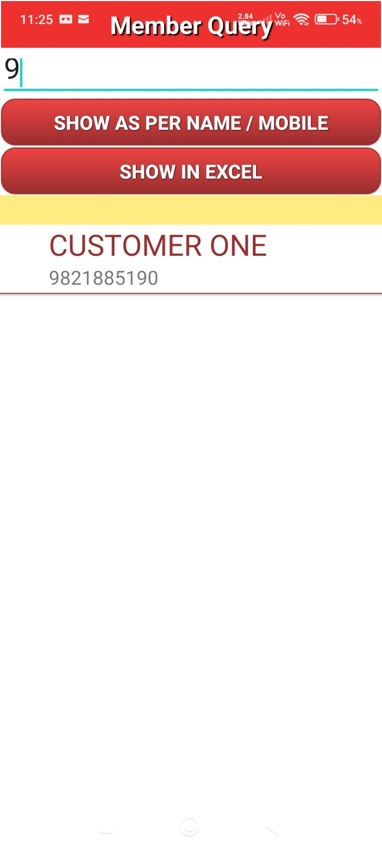
: Customer Query:
Customer can be search.
List of customer can be viewed / printed in MS Excel format.

Slide 27
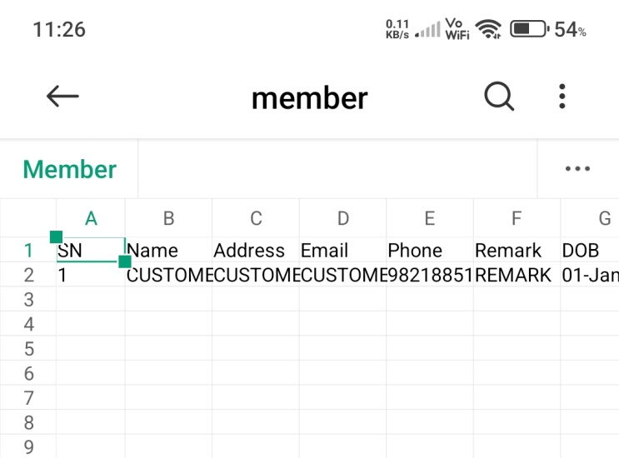
: Customer Query:
Customer can be search.
List of customer can be viewed / printed in MS Excel format.

Slide 28
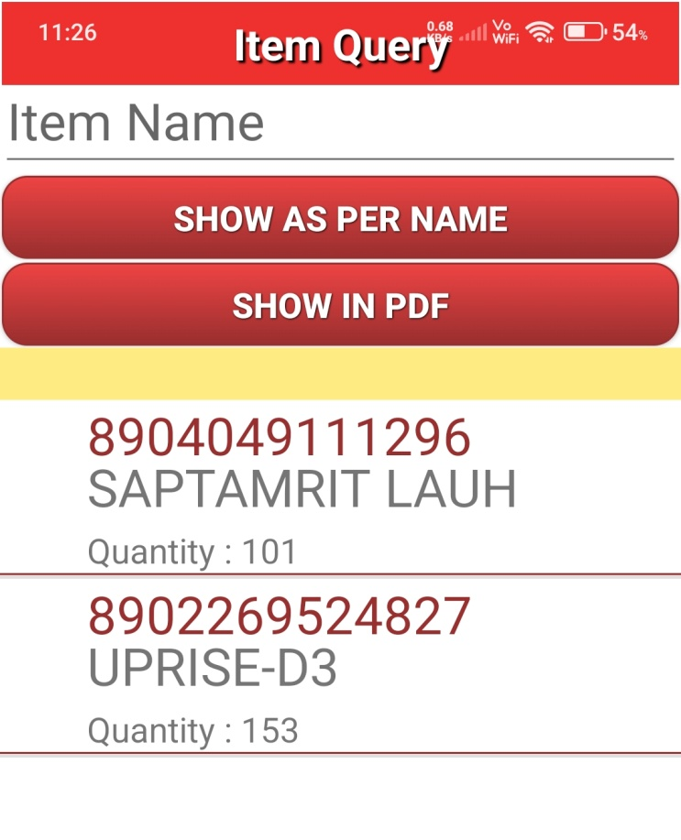
: Item Query:
Item can be search.
List of Items can be viewed / printed in .pdf format.

Slide 29
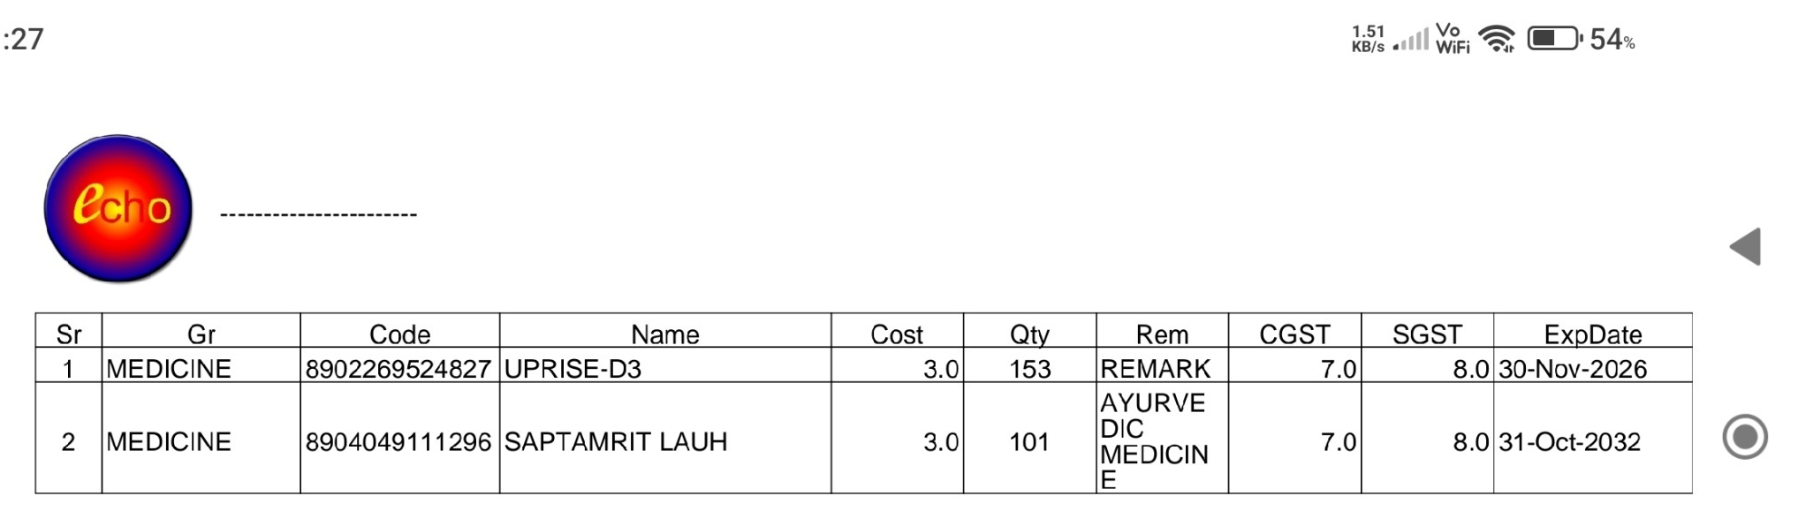
: Item Query:
Item can be search.
List of Items can be viewed / printed in .pdf format.

Slide 30
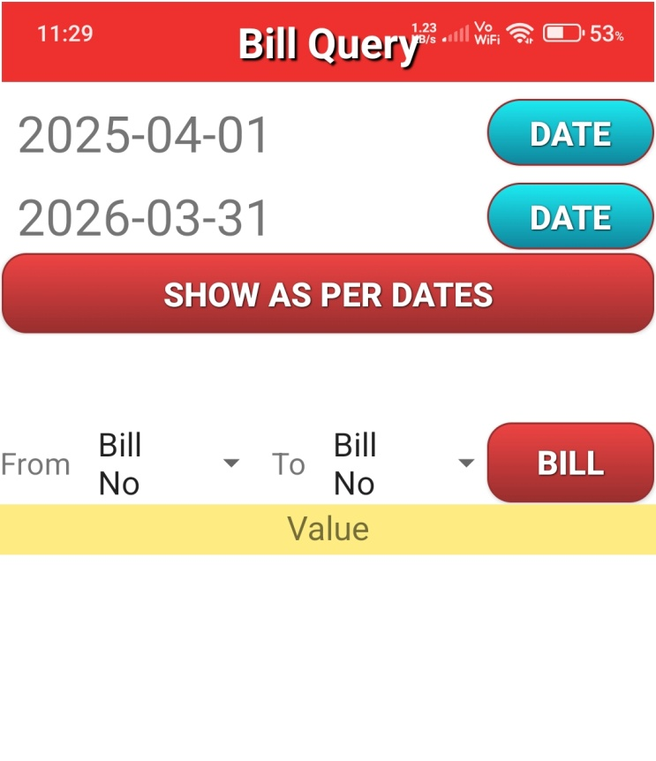
: Bill Query:
Bills can be viewed / printed between two dates.
Also Bills can be viewed as per numbers.

Slide 31
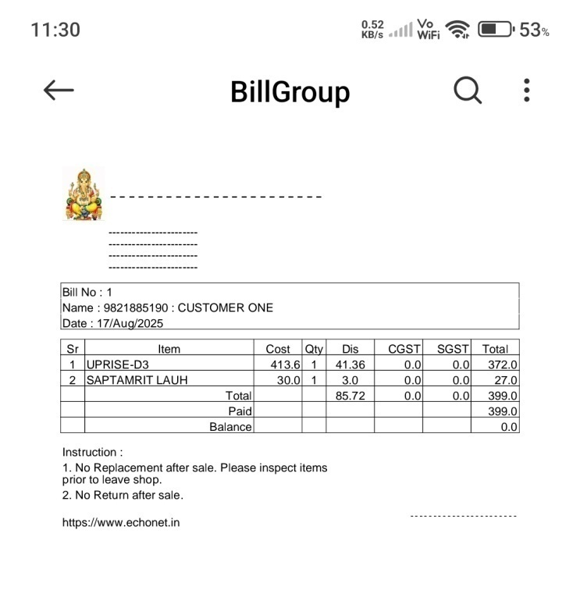
: Bill Query:
Bills can be viewed / printed between two dates.
Also Bills can be viewed as per numbers.

Slide 32
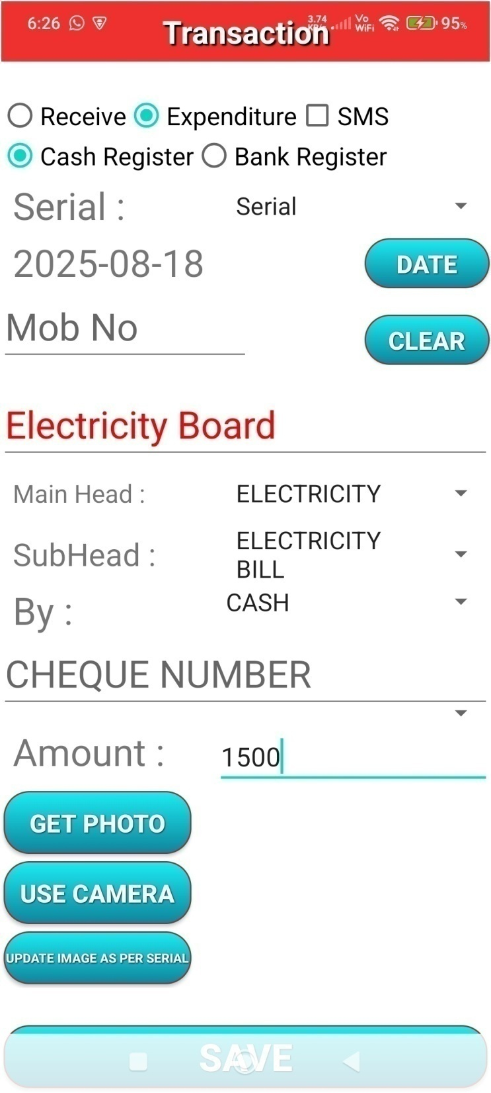
: Transaction:
If bills are deposited , then amount already entered in Transaction / Cash Register / Bank Register.
To maintain other entry for Receive / Expenditure / Cash Register / Bank Register , this window can be used.
Tick mark accordingly , write details , click SAVE. Image also can be saved with other data.

Slide 33
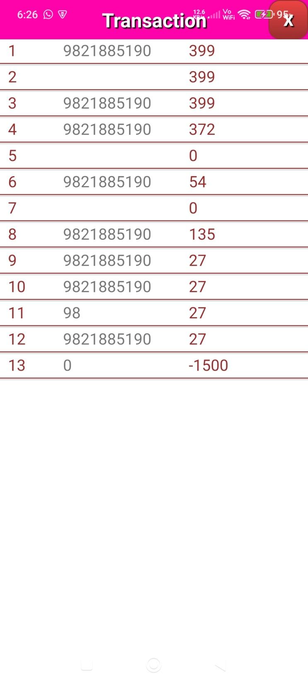
List of Transactions.
Click to get details.

Slide 34
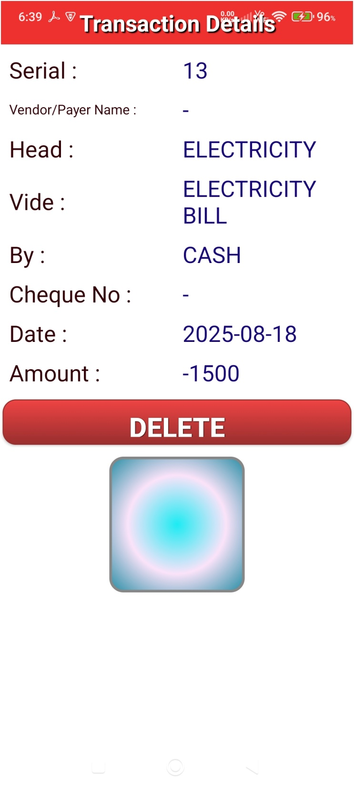
Details of Transaction

Slide 35
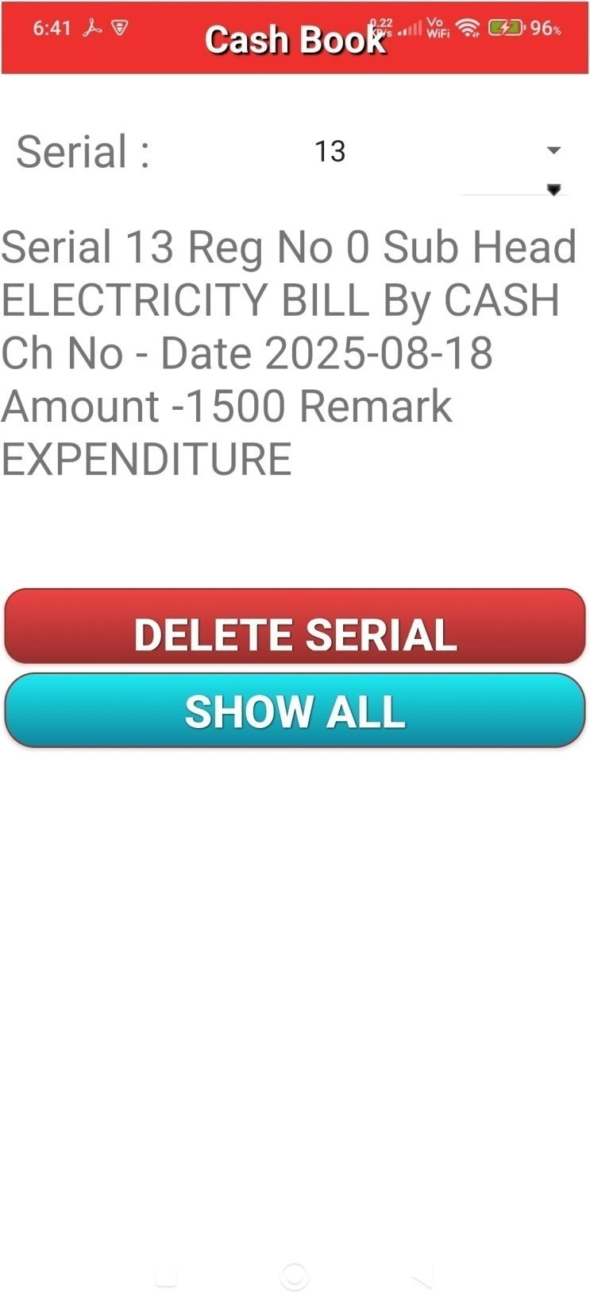
Cash Book details

Slide 36
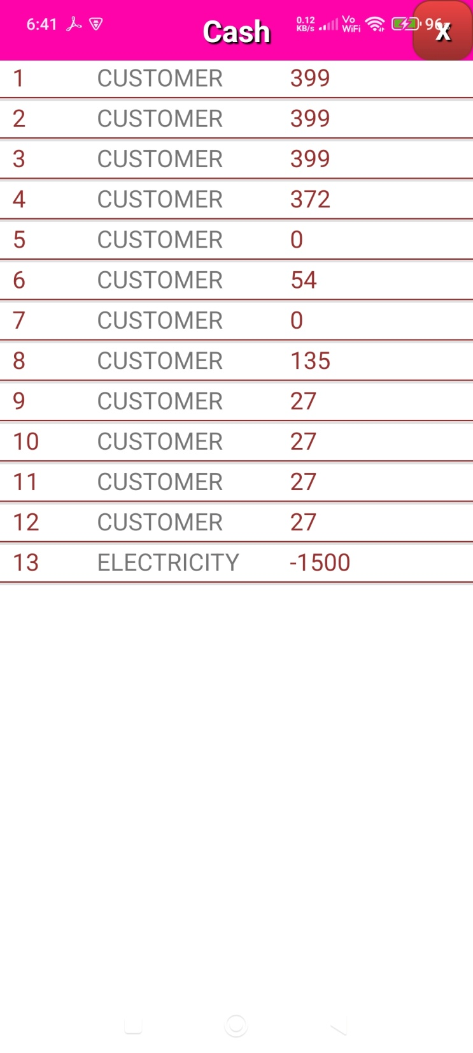
Cash Book List

Slide 37
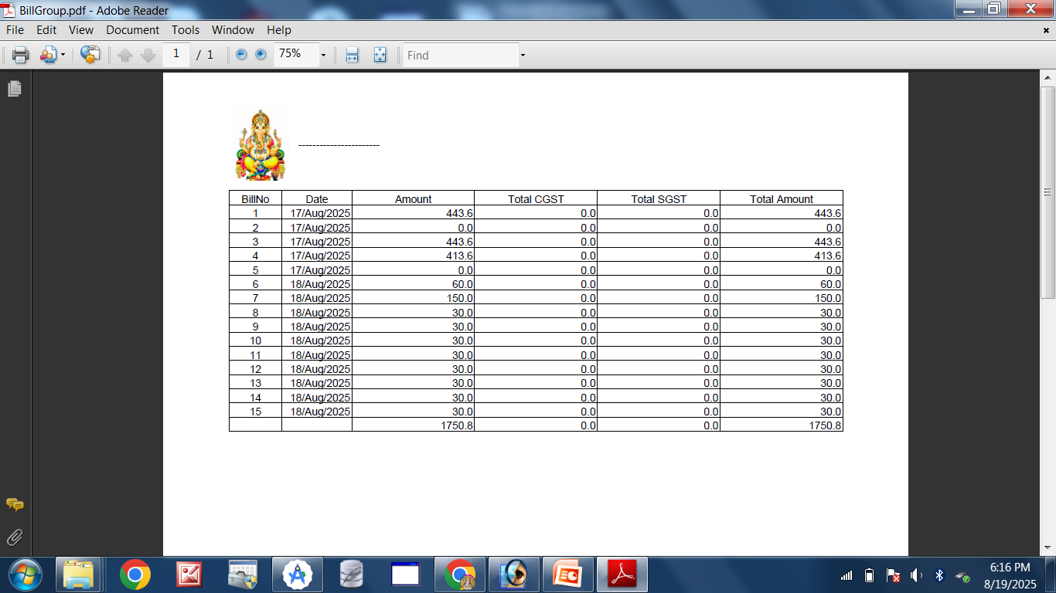
Tax Query

Slide 38
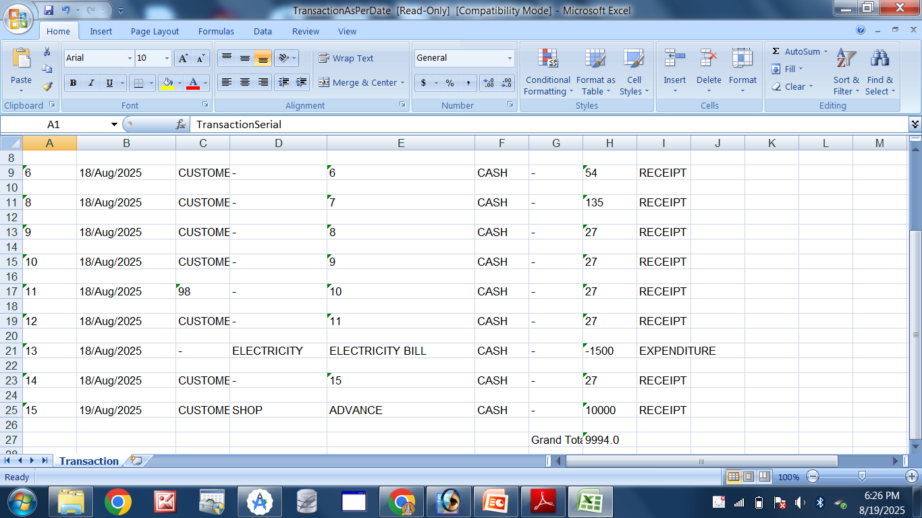
Transaction Query in MS Excel format

Slide 39
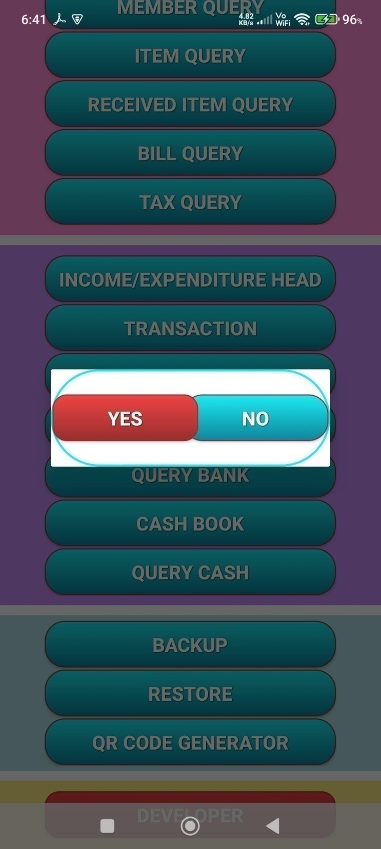
Backup
&
Restore

Slide 40
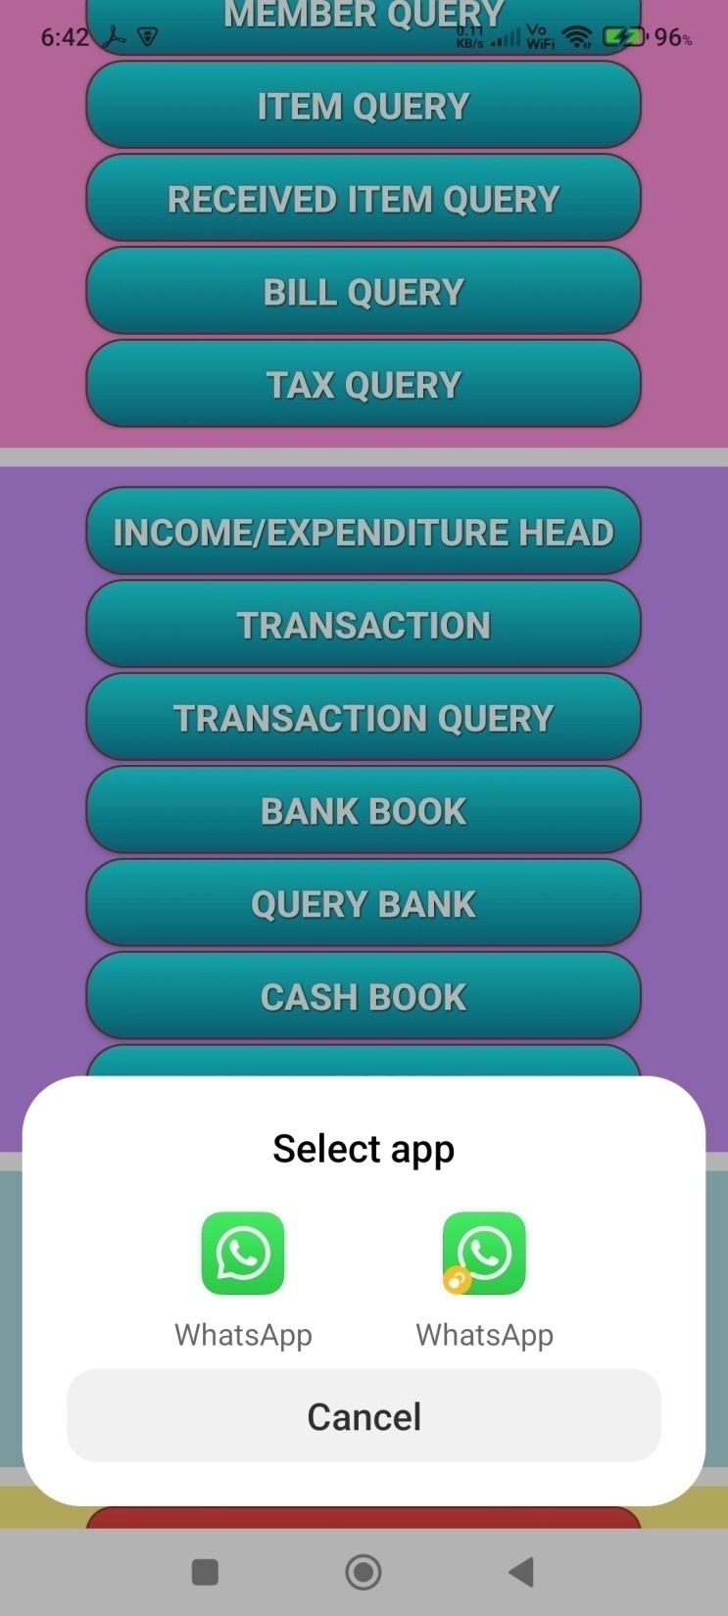
Back up also can be shared using WhatsApp .
In case of mobile failure , data can be recovered.

Slide 41
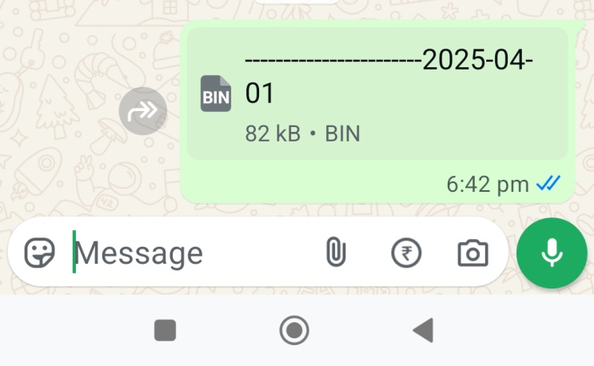
Back up also can be shared using WhatsApp .
In case of mobile failure , data can be recovered.

Slide 42
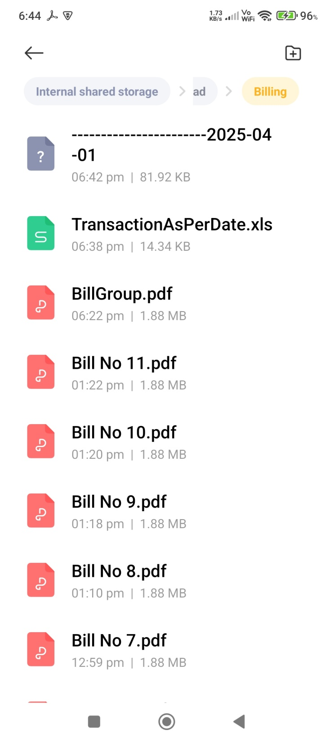
All Data saved in Download / Billing folder after click Backup button.
To restore data, Install Android App again, copy database file in this folder and click Restore button.
All data will be recovered

Slide 43
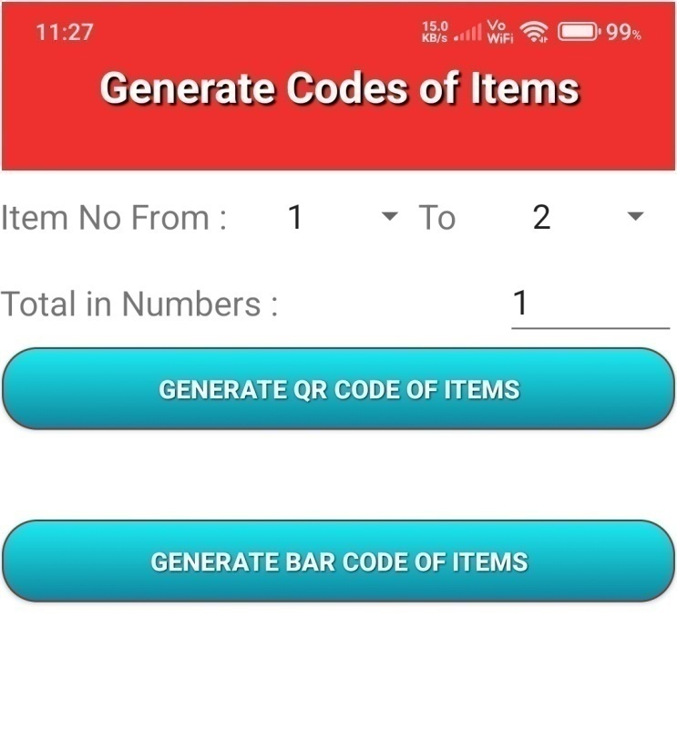
QR and Bar Code of Items can be generated in .pdf format.
Select Item Number From / To and click Button.
Write numbers of copy
(Total in Numbers) , to get more copies.

Slide 44
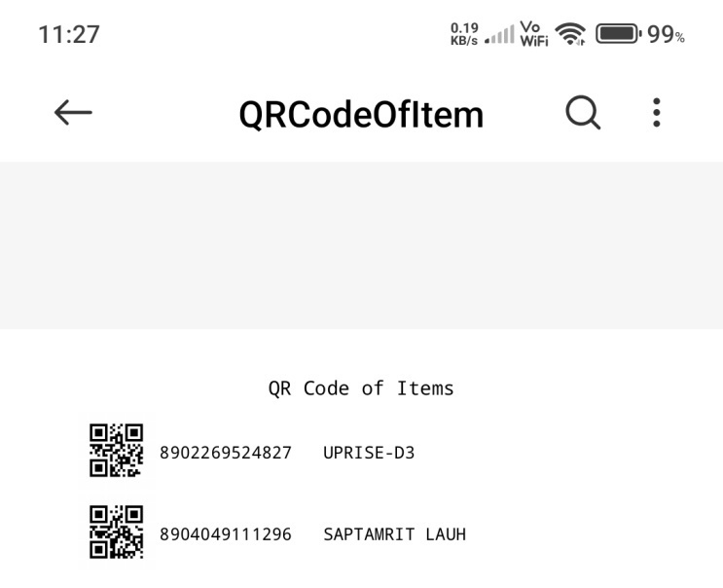

Slide 45
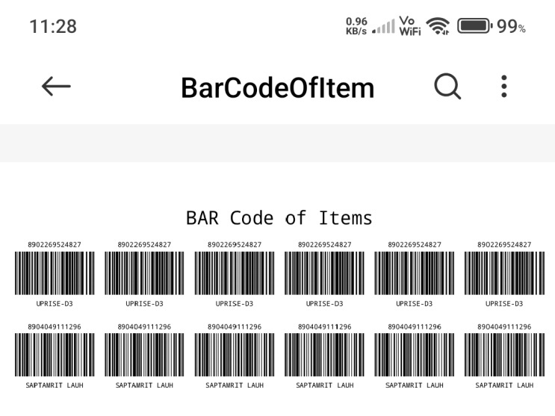

Slide 46
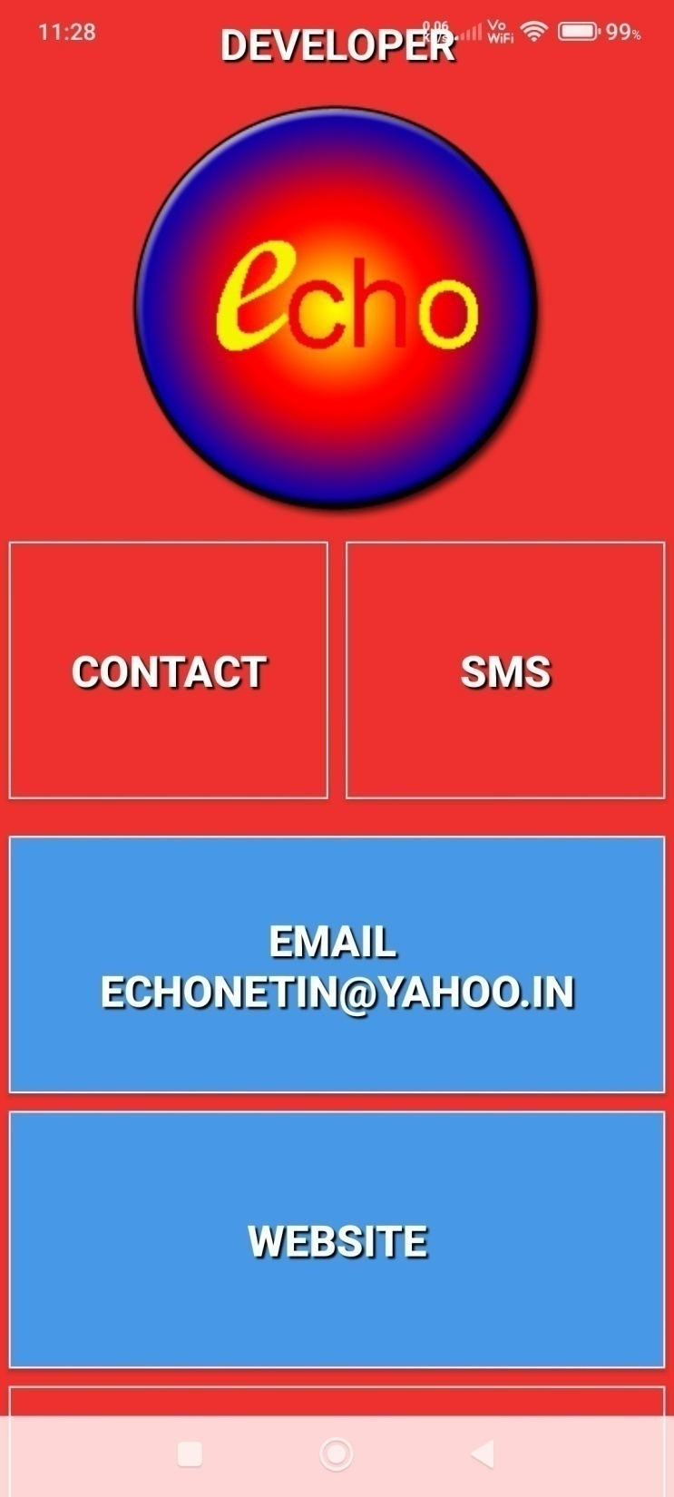

Slide 47
